Slide 2
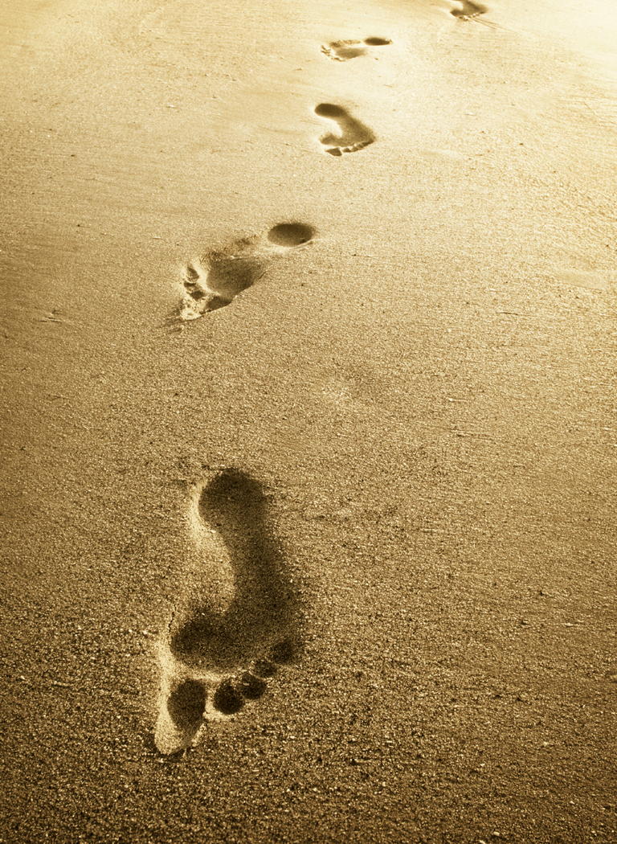
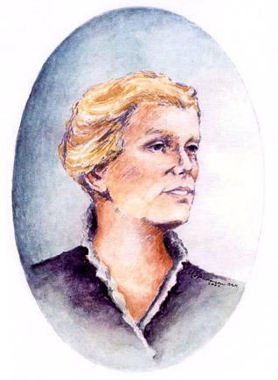
The
Past
Notes:
Final

Slide 5
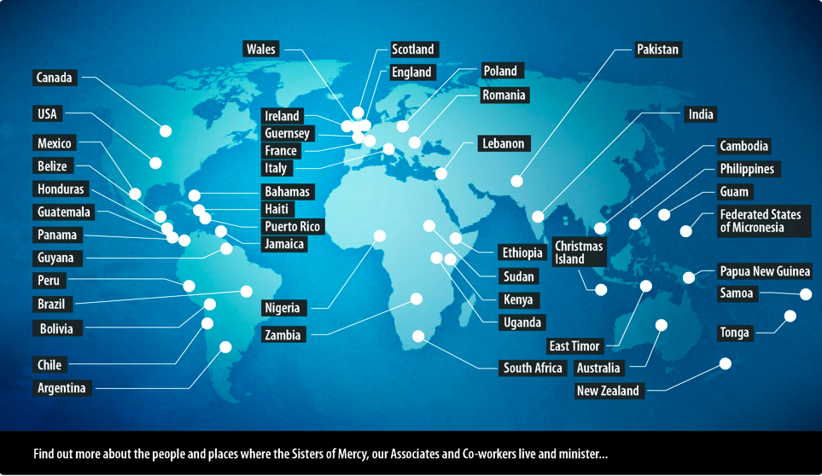

Slide 7
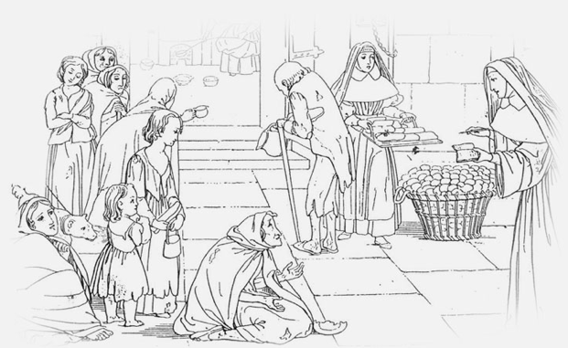

Slide 8
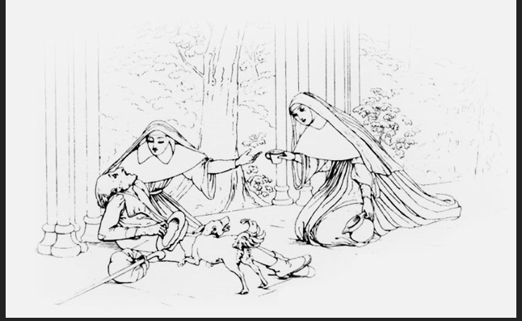

Slide 12
Quiet Reflection

Slide 13
The
Present

Slide 14
Pay attention to:
Scale
Systems at play
Who has power?
Who is left behind?

Slide 18
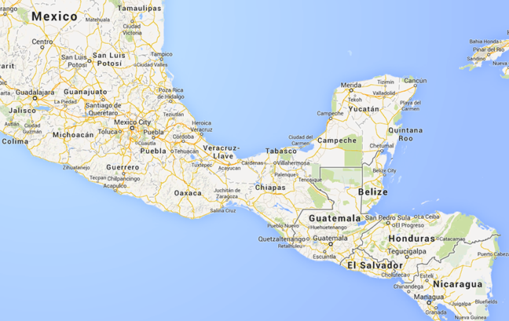
Crisis at the Border: Influx of Child Migrants
Google maps

Slide 21
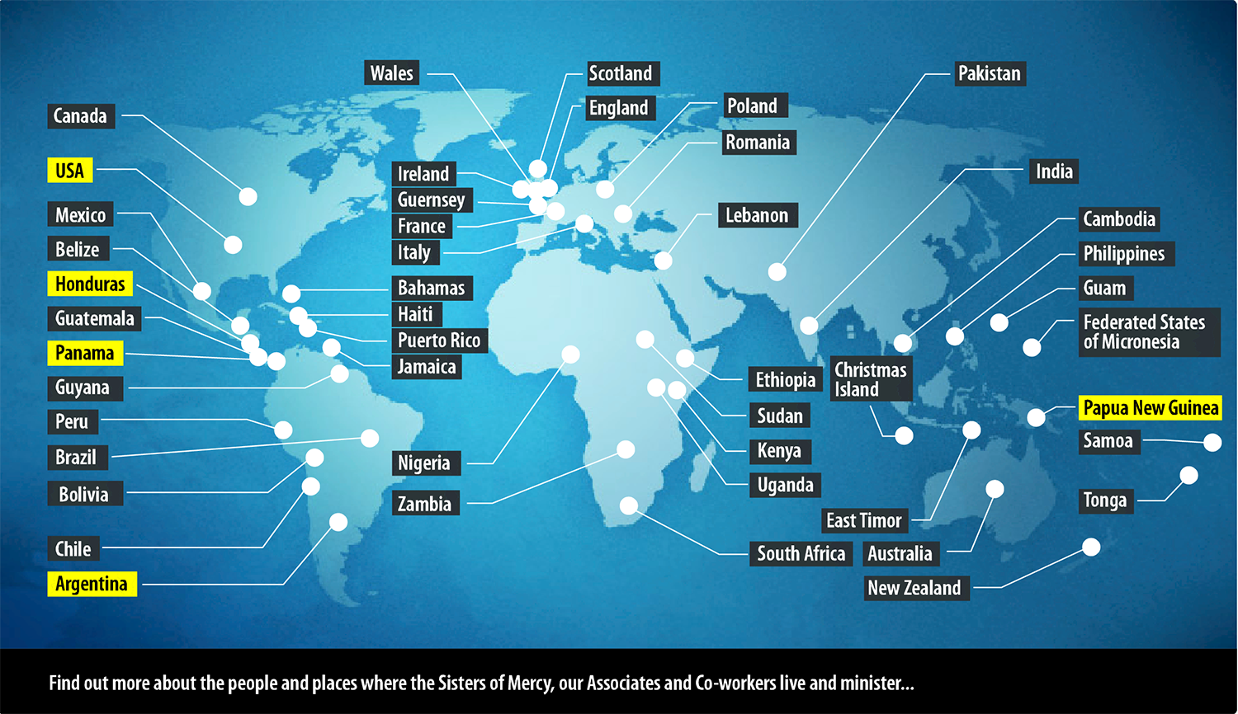
Mining Abuse and Water Issues

Slide 22
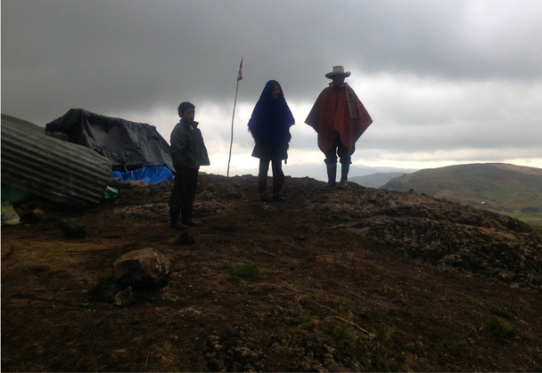
Guardians of the Lake

Slide 23
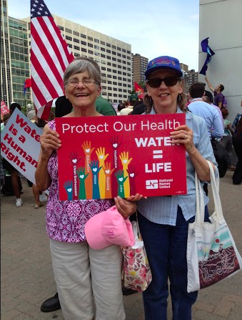
Detroit: Human Right to Water and Sanitation

Slide 25
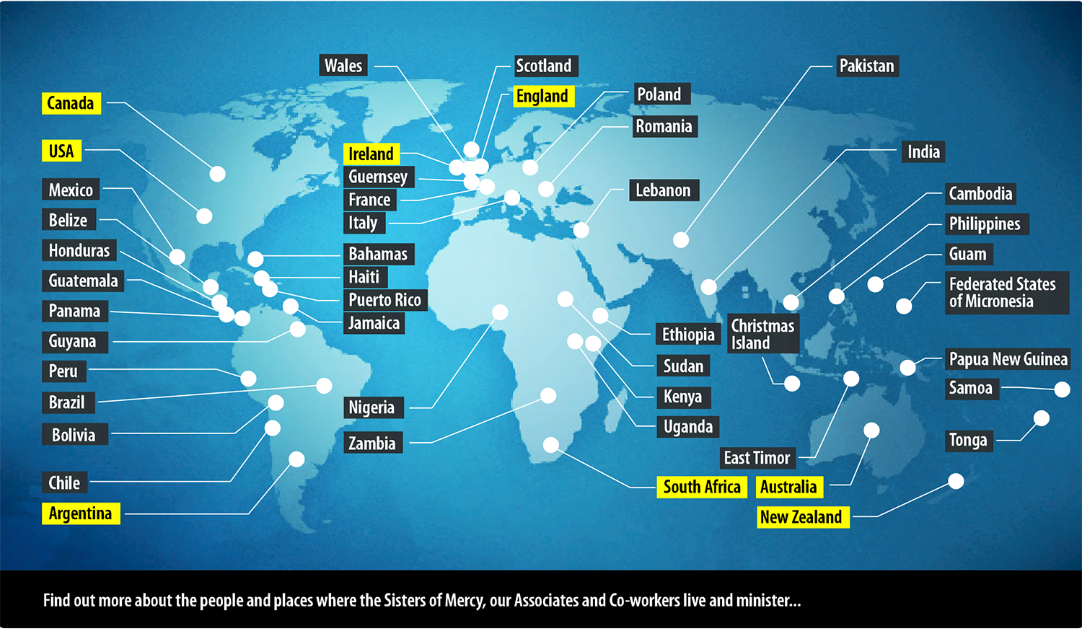
Fracking Concerns

Slide 26
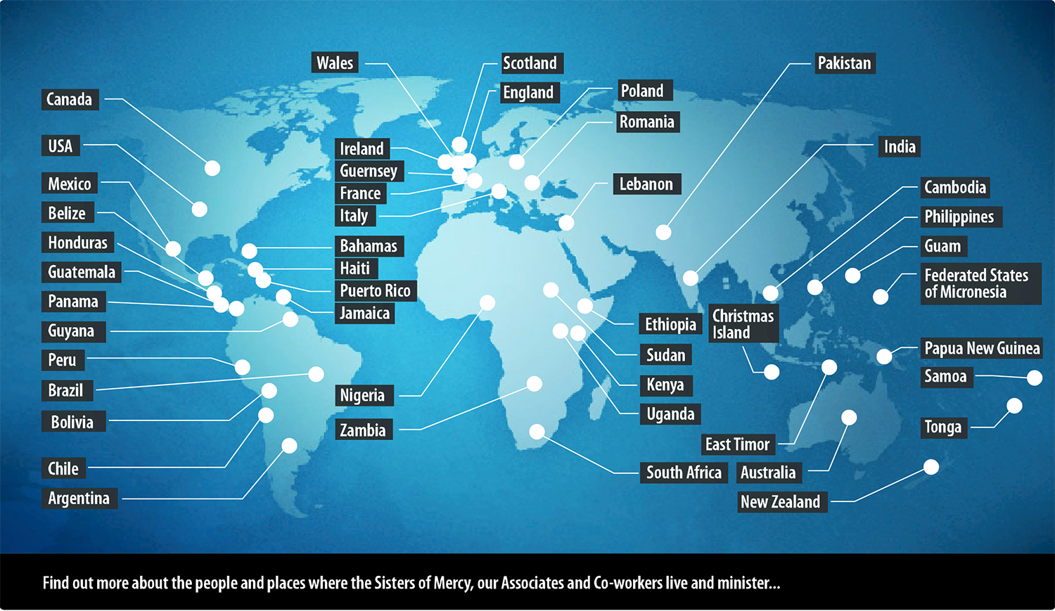
We Need Global Help Now Not Next Month
(Global help: Share their issues with Mercy world wide and take concerns to UN)

Slide 27
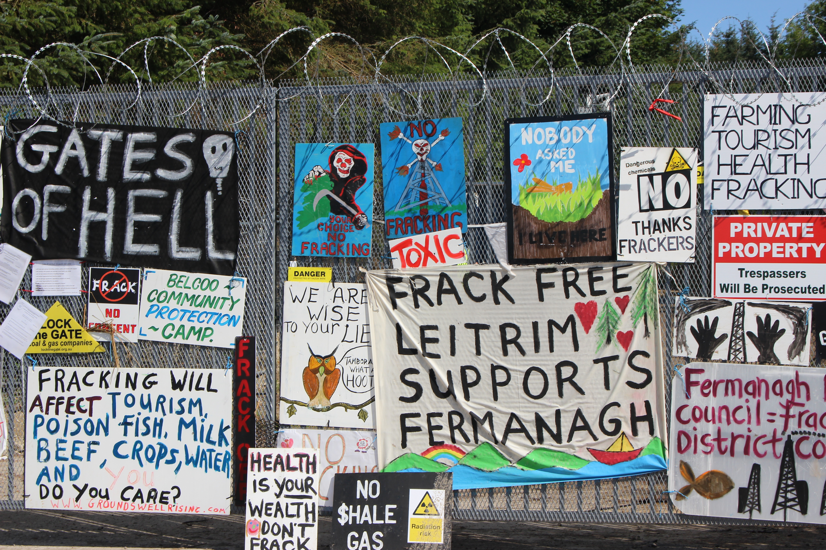

Slide 28
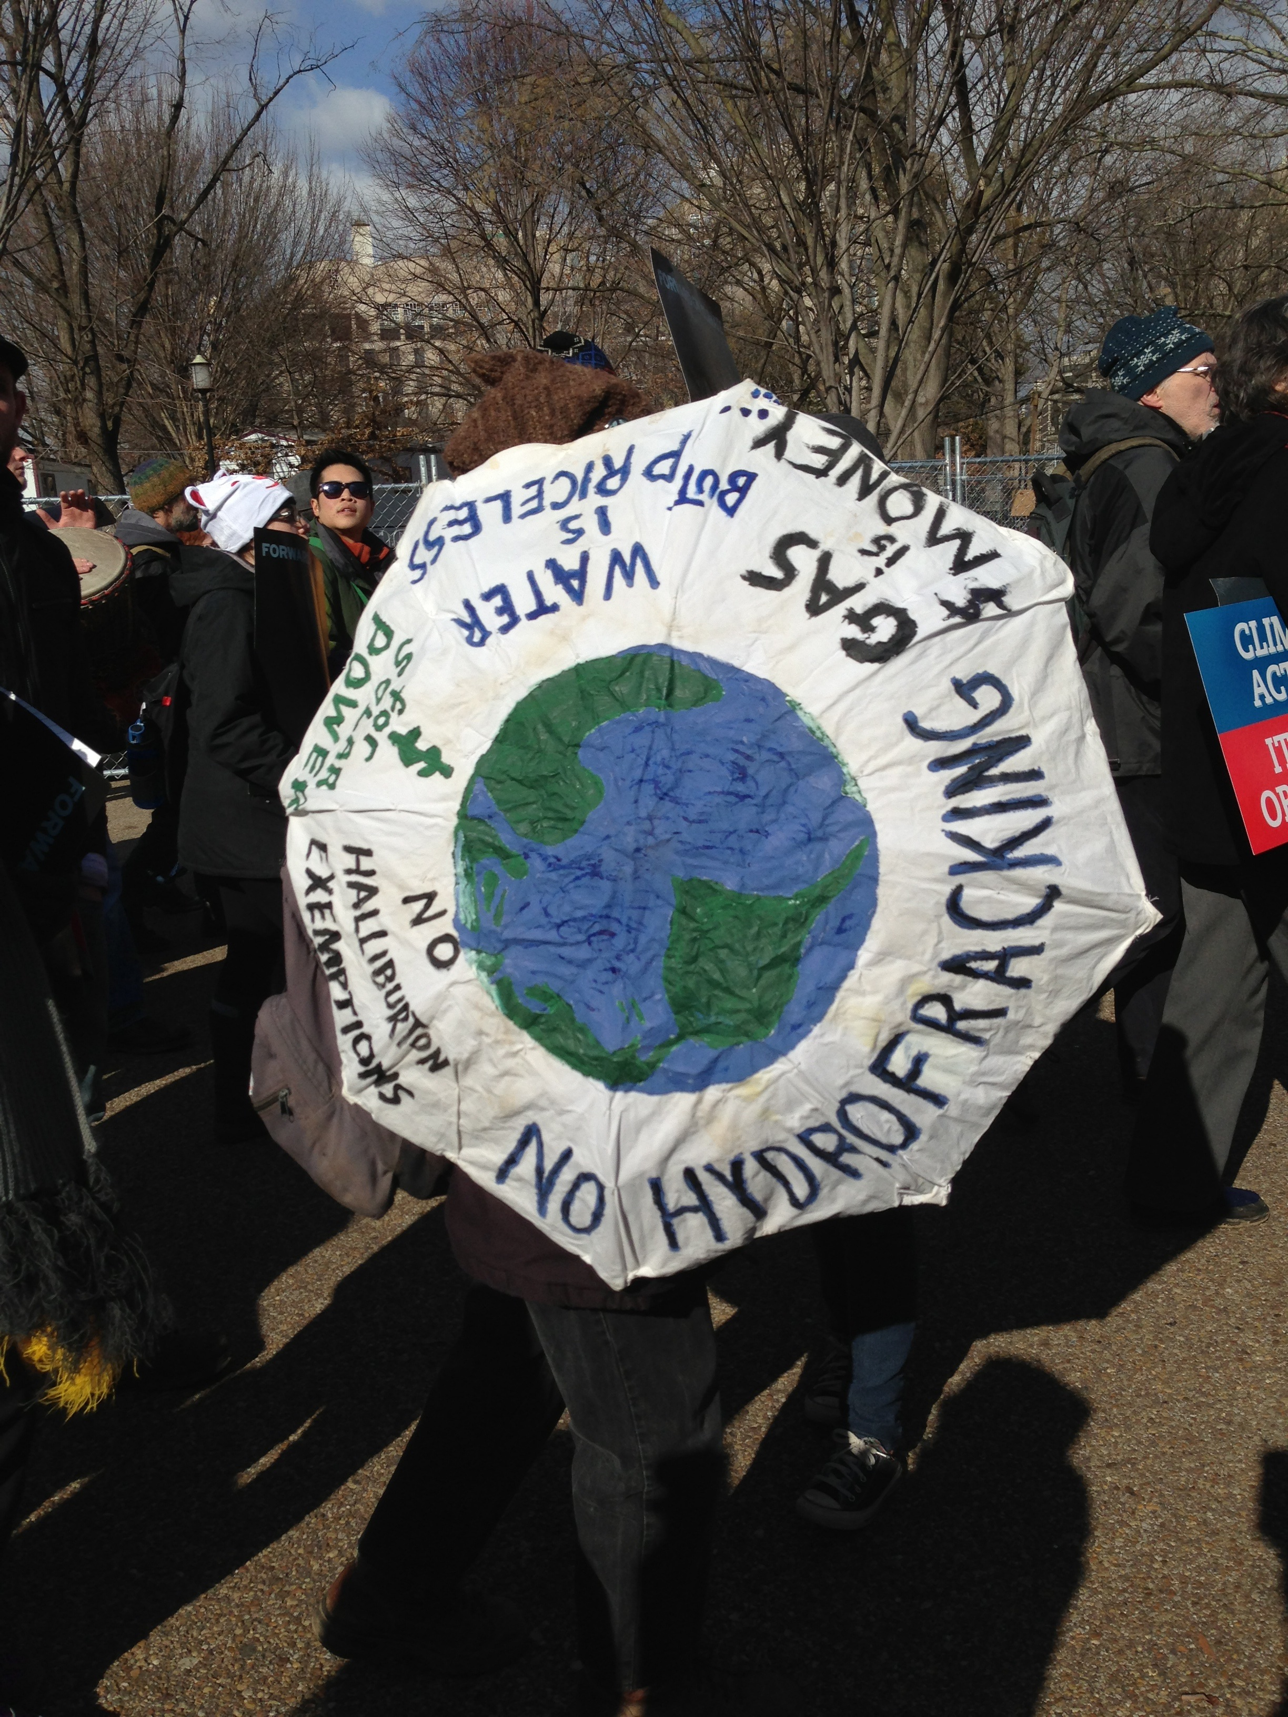

Slide 29
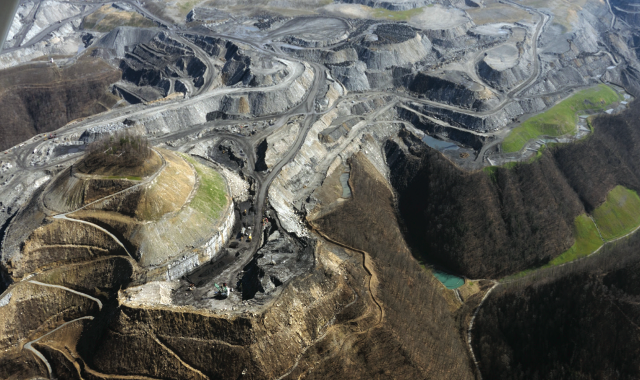
Natural Resource Grabbing
Ovec (Ohio Valley Environmental Coalition) & Southwings. Used with Permission

Slide 30
Mining Abuse and Water Issues

Slide 31
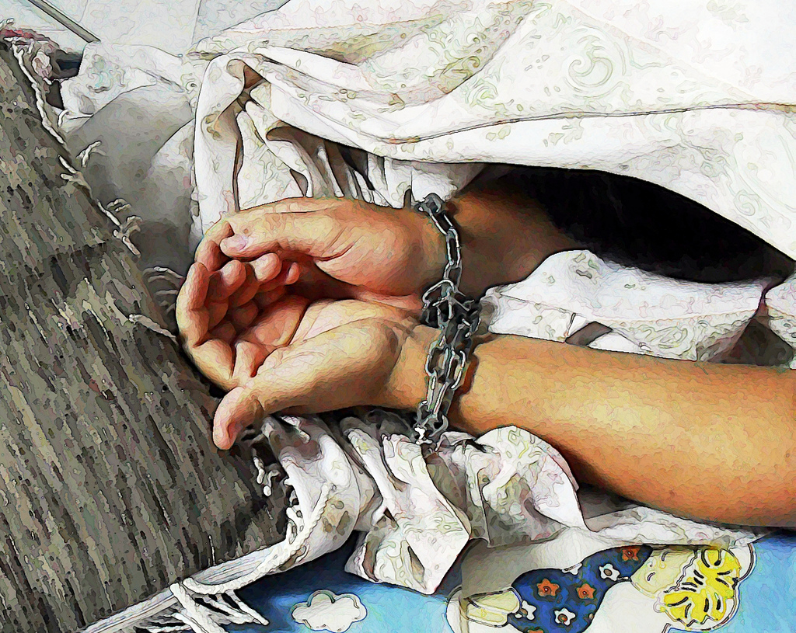
Human Trafficking
Photo by Imagens Evangélicas via Flickr.com

Slide 32
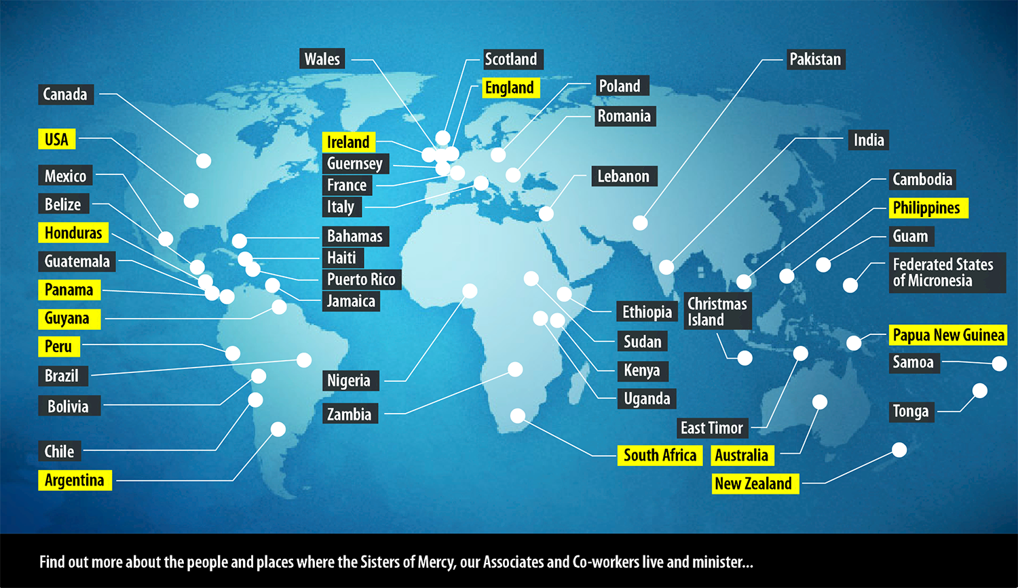
Human Trafficking

Slide 33
Quiet Reflection

Slide 34
No Future Without Justice!
Who benefits?
Who bears the cost?
Who is excluded?

Slide 35
Mercy
at the United Nations

Slide 36
The United Nations
UN Photo/John IsaacPhoto #511, 1980

Slide 37
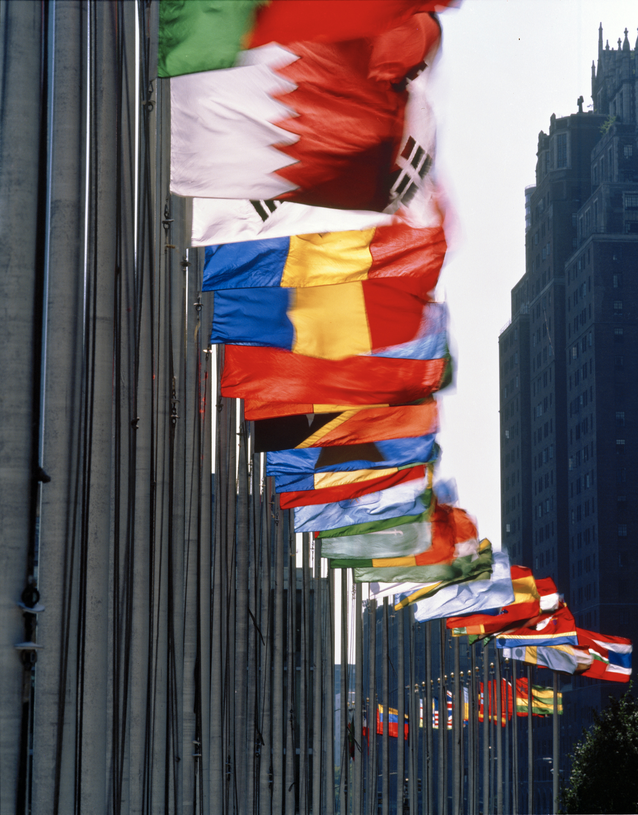
The Purpose of the United Nations
Peace and Security
Cooperation Among Nations
International Problem Solving
Promotion of Human Rights
Harmonize the Actions of Nations
UN Photo/Andrea Brizzi/Photo # 31412

Slide 38
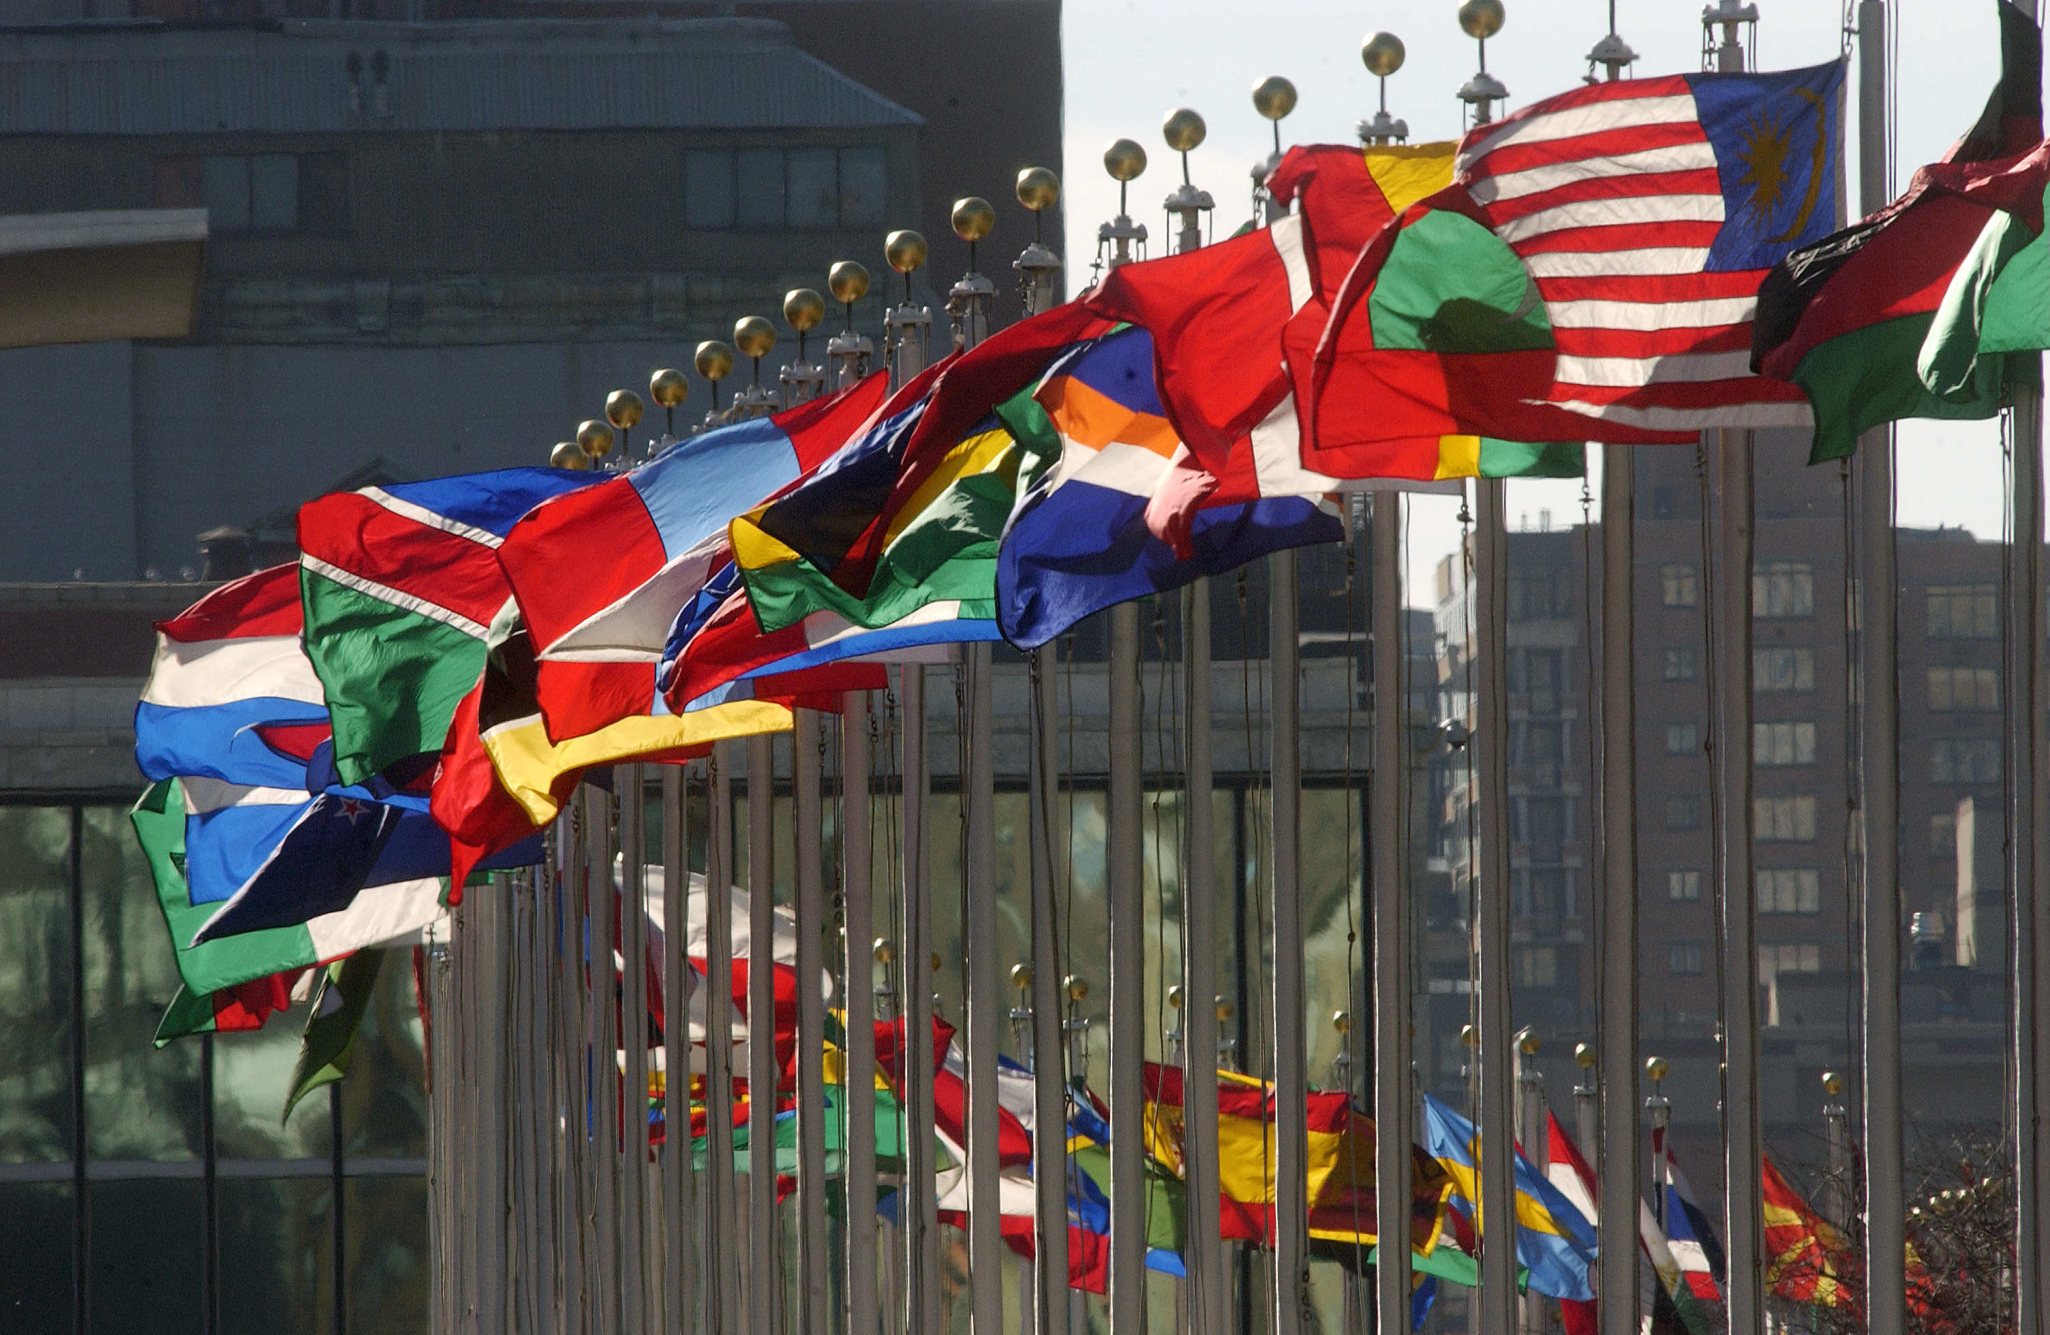
UN Photo/Joao Araujo Pinto/ Photo # 108581
General Assembly
Security Council
Economic and Social Council
Secretariat
Human Rights Council
International Court of Justice
Trusteeship Council (Inactive)

Slide 39
We Need Global Help Now Not Next Month
(Global help: Share their issues with Mercy world wide and take concerns to UN)

Slide 40
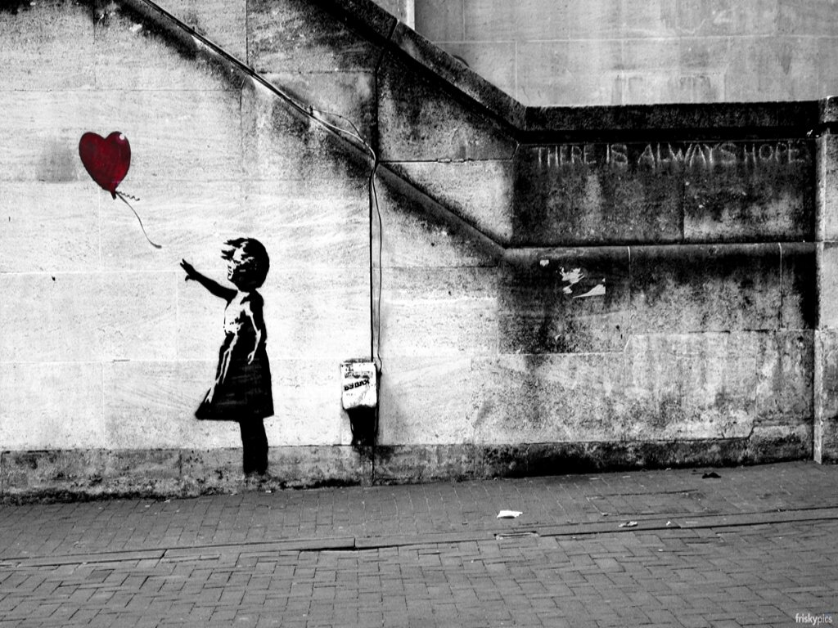
Rooted in our Faith and Tradition
Mercy Global Action NOW

Slide 41
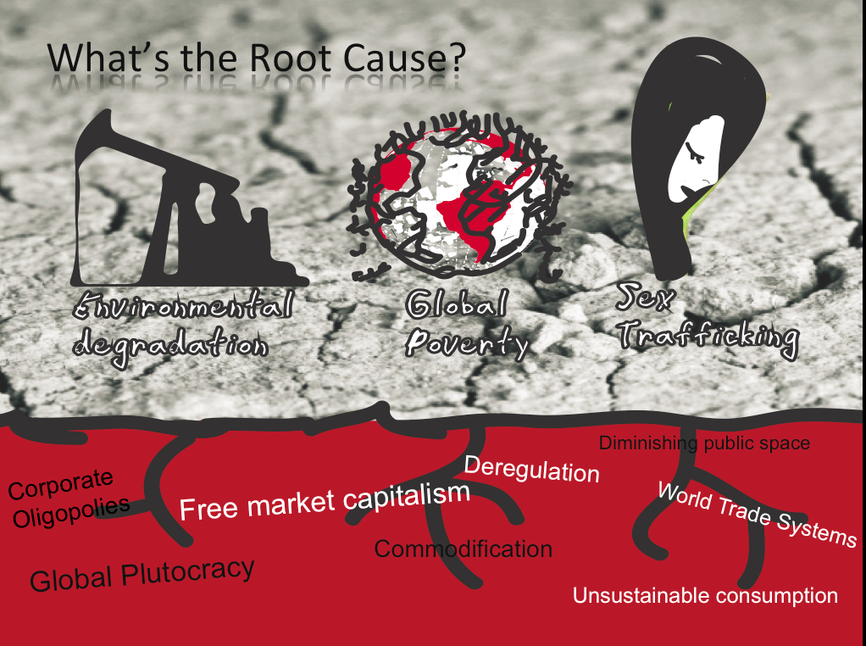

Slide 42
Vital Contact

Slide 44
Sustainable Development and Poverty Eradication
Mining & Water Issues
Combating Human Trafficking

Slide 45
OVEC (Ohio Valley Environmental Coalition) & Southwings. Used with permission.

Slide 46
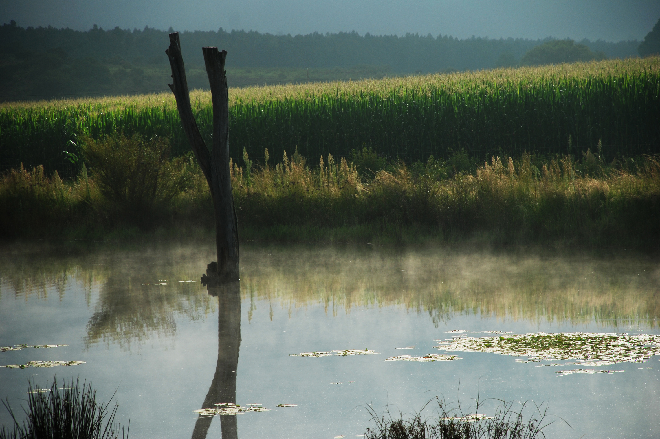
UN Photo/Gill Fickling: Photo # 518971

Slide 47
Human Trafficking
Photo by Imagens Evangélicas via Flickr.com

Slide 48
Global Development Agenda
UN Photo/John Isaac/ Photo #511

Slide 49
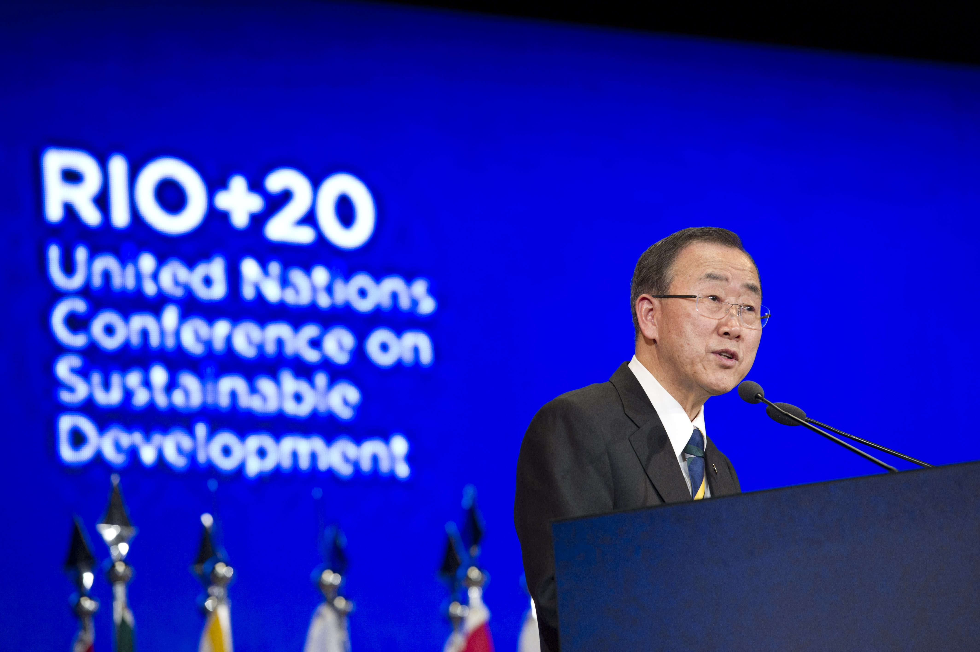
UN Photo/ Mark Garten/# 518506

Slide 50
Sustainable Development Goals
and
Post 2015 Development
Agenda
UN Photo/John Isaac/ Photo #511

Slide 51
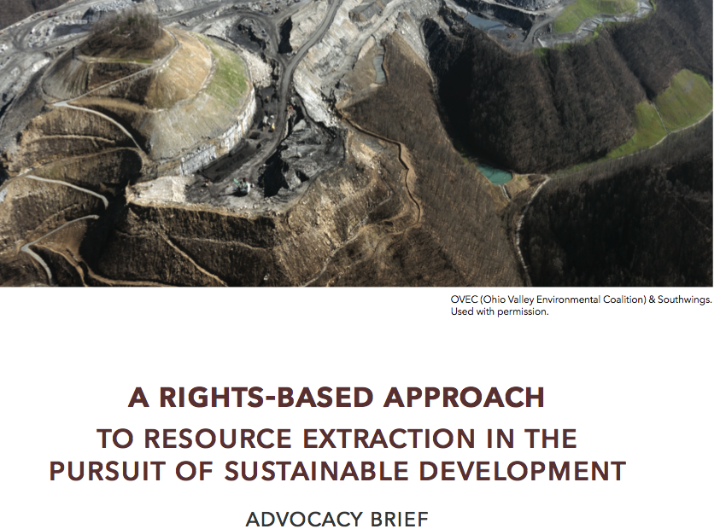

Slide 52
A Rights-Based Approach:
Resource Extraction in the Pursuit of Sustainable Development
The Rights-Based Litmus Test
• Do no harm
• Eradicate root causes of poverty
• People as rights-holders
• Sustainability

Slide 53
Human Trafficking
Photo by Imagens Evangélicas via Flickr.com

Slide 54
Development Model and the Root Causes of Human Trafficking
Economic
Social Exclusion and Gender Discrimination
Political, Legal, and Conflict

Slide 55
Gendered Impact
Ovec (Ohio Valley Environmental Coalition)
& Southwings.
Photo by Imagens Evangélicas via Flickr.com

Slide 56
The Human Right to Water and Sanitation

Slide 58
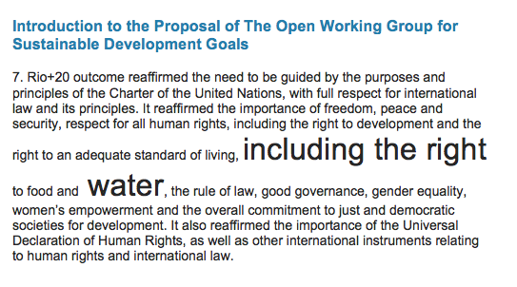
Human Right to Water and Sanitation

Slide 59
Reflection

Slide 60
For all
that
shall be
YES!
Notes:
Place holder

Slide 61
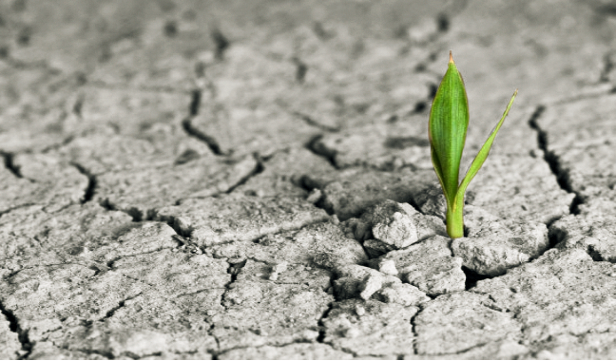
Living Yes!

Slide 62
No Future Without Justice!
No Future Without Justice!
Development for whom?

Slide 63
No Future Without Justice!
Who benefits?
Who bears the cost?
Who is excluded?

Slide 65
In Solidarity

Slide 66
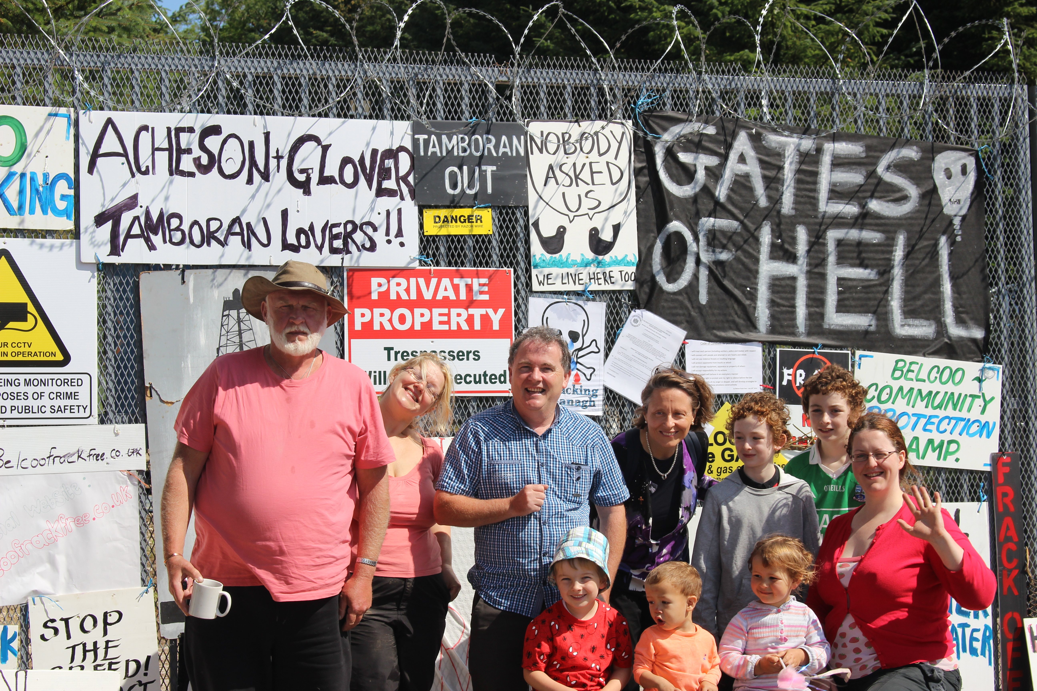

Slide 67
We Need Global Help Now Not Next Month
(Global help: Share their issues with Mercy world wide and take concerns to UN)

Slide 68
Another world is not only
Possible,
she is on her way.
On a quiet day, I can hear her
Breathing.
-Arundhati Roy

Slide 69
Image of Catherine McAuley by Marie Henderson, RSM http://www.mcauleyimages.com

