Slide 1
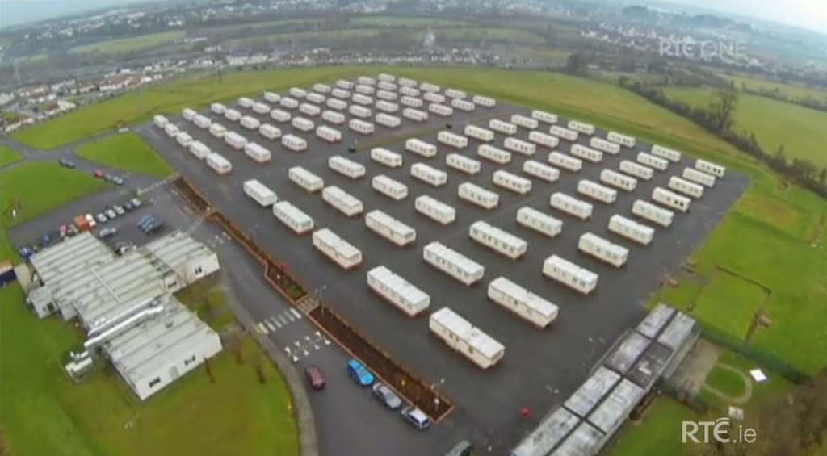
Primary schools relationships with asylum-seeking families in Ireland
World Refugee Day Workshop 20th June 2017
UCD/Irish Refugee Council

Slide 2
Background
Small-scale qualitative study examining interactions between asylum-seeking mothers and primary school teachers.
To succeed in school, the supports made available to asylum-seeking children need to extend beyond the academic.
Schools are often the only statutory agencies offering formal supports to refugee children (Hek 2005).
Migrant parents in Ireland have been constructed by educational practitioners/ management as ‘non-involved’ and ‘hard-to-reach’ (McGovern and Devine 2016).

Slide 3
Policy context: Intercultural Education
Contradictory approaches in State education policy:
  fixing of ‘deficits’ approach highlighting deficient acculturation practices of parents and poor practices in individual schools,
  holistic approach acknowledging importance of recognition and sensitivity to ‘mother-tongue’ learning (Devine, 2013)
The Intercultural Education Strategy 2010–2015 commits to
partnership and communication between education providers,
students, parents and communities.
  Goals are heavily focused on supporting English-language learning.
  Fails to recognise different contexts for asylum seekers and other
  types of migrants.

Slide 4
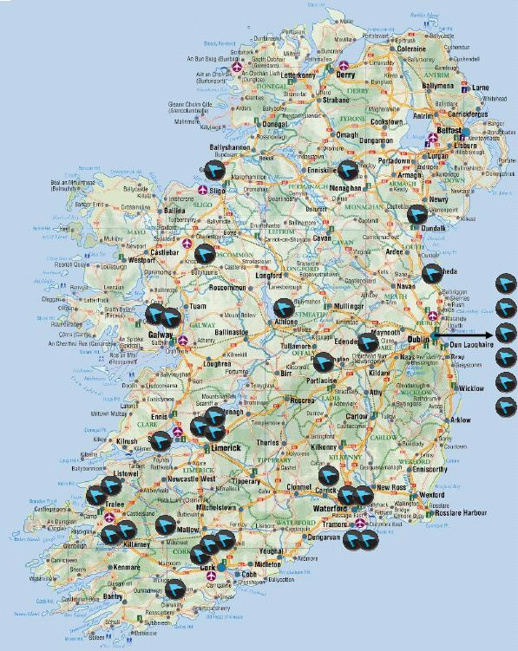
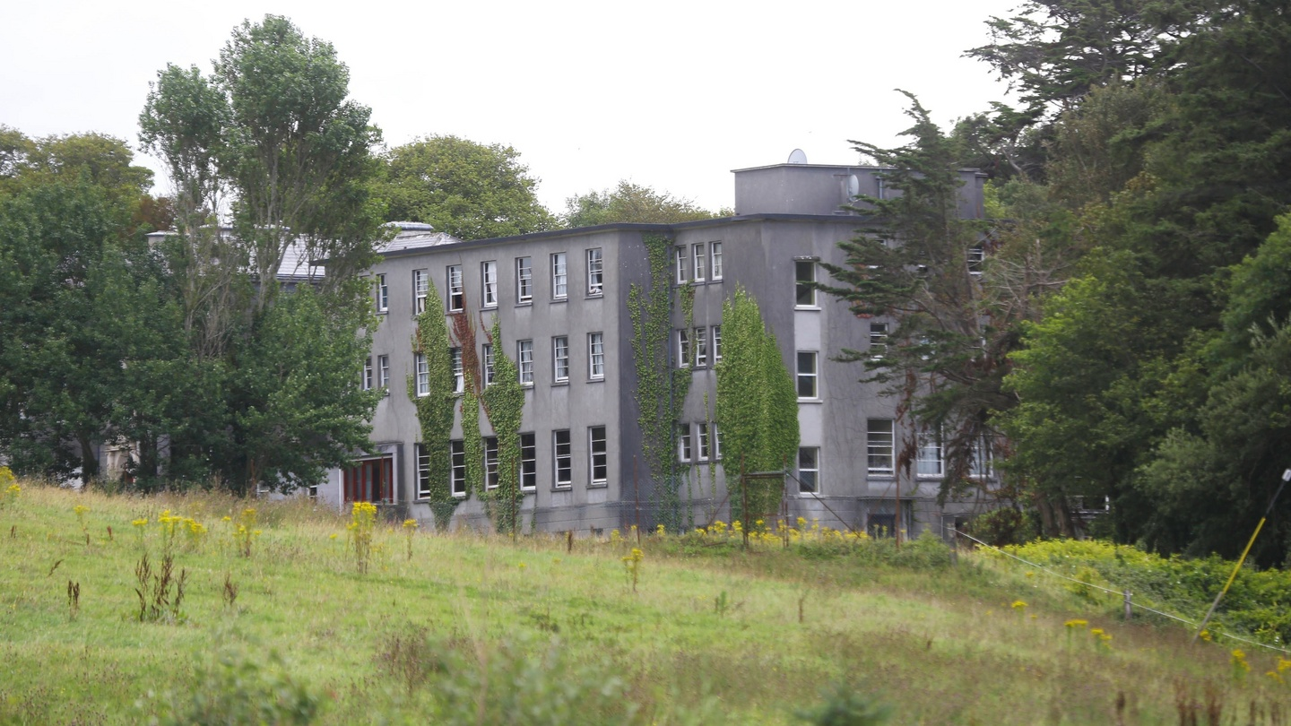
Policy context: Direct provision
In 2000 the Irish Government introduced a system of Dispersal & Direct Provision accommodation (DP) for asylum seekers. Primarily, a short-term emergency response to a rapidly escalating figure of asylum seekers presenting in Ireland from the late 1990s.
There are currently 32 such centres located across the country.
4786 residents,
1230 of which are children (RIA, May 2017).
Successive Irish Governments have also introduced a restrictive asylum system:
  Ireland is the only EU27 country not to sign the 2003 Reception Conditions Directive.
  Asylum seekers in Ireland are not entitled to seek employment and restricted in their right to Social Welfare payments. Receive a weekly allowance - €19.10 per adult & €15.60 per child.
Notes:
32 = 1 Reception centre in Dublin, 29 accommodation centres, 2 self-catering centres in Dublin & Louth.
Only three were built ("system built") for the purpose of accommodating asylum seekers. The majority of the portfolio comprises buildings which had a different initial purpose i.e. former hotels, guesthouses (B&B), hostels, former convents / nursing Homes, a holiday camp and a mobile home site.
McMahon report (2015) called for the Direct Provision weekly allowance to be increased from €19.10 to €38.74 for adults and from €9.60 to €29.80 for children. The DP Allowance for children increased from €9.60 to €15.60 with effect from January 2015. In its second progress report in Feb 2017, it states that any further increase to the DPA rate is a matter for Government and would have to be considered in a budgetary context.

Slide 5
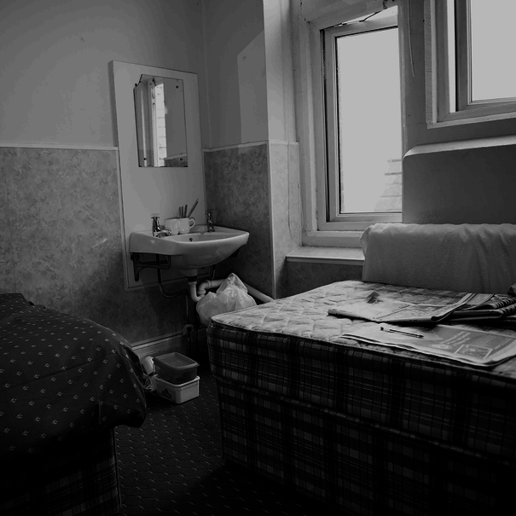
Direct provision
Direct Provision has been the subject of much debate and criticism :
  inadequate living conditions,
  isolation from local communities,
  extended lengths of stay,
  limited financial support,
  inadequate security,
  poor-quality food and
  cramped living conditions,
  mental health of residents,
  lack of child-friendly facilities.
Marginalisation of residents and the long-term negative impacts of segregation (Fanning and Veale 2004; King 2004; Arnold 2012; White 2012; Ogbu, Brady, and Kinlen 2014).

Slide 6
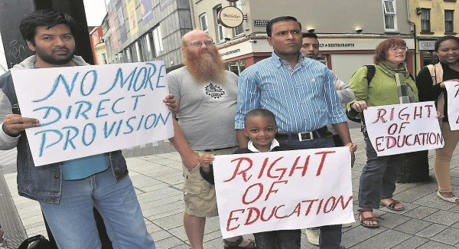
Direct provision and children’s education
Children and young people under the age of 18 living in
DP are entitled to attend primary and secondary school, with
recently introduced limited access to Third level.
Parents living in DP generally report primary schools to be a positive influence and experience for their children (O’Riordan et al. 2013; Ogbu et al. , 2014).
However, the conditions and restrictions imposed on parents’ and children’s lives by Irish asylum policy and DP impact negatively on their educational opportunities.
  DP environment is not conducive to learning (Arnold 2012; O’Riordan et al. 2013; Ogbu et al., 2014).
  Significant child protection concerns within the DP system (Coulter, 2013; Shannon 2014).
Notes:
Department of Education and Skills’ Pilot Student Support Scheme, is a welcome first step in this area, it contains strict criteria which means few children caught up in the asylum system can avail of it. A person must have spent five years in an Irish school, five years in the asylum process, completed their Leaving Certificate and not have a deportation order against them.

Slide 7
Literature: Refugee and asylum-seeking parent’s relations with teachers
Vincent and Warren (1999) argue that parent-teacher partnerships in the UK, particularly for minority ethnic parents and working-class parents, are often characterised by an imbalance of power in favour of the teacher.
‘In order to be ‘good’ or acceptable parents, minority ethnic parents, had to become like the ideal - the white middle-class parent: in other words they had to assimilate’ (Crozier, 2001: 335).
Devine (2011) in an Irish study of 24 immigrant parents in five schools, including asylum-seeking parents, found classed, racialised and gendered patterns of formal parental involvement.

Slide 8
Literature: Refugee and asylum-seeking parent’s relationships with teachers
Migrant parents are often labelled as ‘hard-to-reach’ and blamed for their lack of involvement rather than reflection on the practices of the school and educators themselves (Crozier and Davies, 2007; Hornby and Lafaele, 2011).
Tourney and Kao (2010) found that minority immigrant parents identified far more barriers to becoming involved in their children’s education than non-migrant parents.
Language barriers experienced by some migrant parents are an obstacle to parental engagement in their children’s education (Smyth et al. 2009; Taguma et al. 2011) & their apparent lack of involvement is often due to ineffective communication between school & home (Huat and Gorard 2014).

Slide 9
Methods
Small-scale qualitative study conducted in an urban area in Ireland.
Sample - 7 asylum-seeking mothers living in Direct Provision and 8 primary school personnel (6 Teachers and 2 Principals) from two schools located close to DP centres.
All of the school personnel interviewed were members of the majority white ethnic Irish community.
The schools are Catholic, co-educational and have a diverse student population with over 20% in each school described as of ‘non-Irish origin’ in the Department of Education’s annual school census 2013/14, as compared to 11.4% nationally.

Slide 10
Findings
Living in Direct Provision – imposed limitations on education access and participation
Teachers’ limited knowledge of life in Direct Provision
Parent-teacher communication
Ad hoc supports for inclusion and integration
‘Those parents’ don’t get involved in parent associations
Dual role of the school: advocacy and surveillance

Slide 11
Imposed limitations on educational access and participation
Choice of school and access to school was limited by lack of transport,
  when my first child started school ... it was very difficult for me because ... I don’t have any car or the means of taking him to school and so there was a friend of mine, I was lucky, who was helping me. The other mothers ... we did a demonstration towards it, we even bring the children … that the centre should provide a bus. (Mother 1)
Full participation in the social and academic life of school was restricted by financial constraints, and lack of space and privacy in DP,
  I see [those] with 5 in the family, others are in big school and others are in pre-school and these kids they need to do homework, one is crying … and they are in the same room so it really affects the kids performance in school I would say. Because you can only do so much with 5 kids in a single room. (Mother 3)
Notes:
All Direct Provision accommodation centres that host families should be required to provide or facilitate (i.e. through an NGO or local organisation), as part of their contract, a full-time serviced after-school homework or study club, or transport to and from school-based homework or study clubs, throughout the school year. The on-site clubs should be age-appropriate, attractive, well-heated, appropriately supervised and equipped with Wi-Fi and sufficient numbers of computers.
Department/Agency Responsible: RIA
Current Position: This recommendation was reported as implemented in June 2016.

Slide 12
Teachers’ limited knowledge of life in Direct Provision.
Interactions of teachers with asylum-seeker mothers often demonstrated a lack of recognition that their situation is different from other migrants/newcomers and is particularly challenging because of living in DP and being under the threat of deportation.
  It is the supportive back-up that they need from home to help them … just to make sure they do their homework, or just to be there for them, or sit with them rather than coming in with nothing done or that sort of thing again. Attitudes are a big part of it and you can see the difference with the nationalities there. (Teacher 3)
Notes:
Recommendation: An awareness initiative should be rolled out to ensure that Boards of Management and school principals are familiar with the financial and other challenges facing children in Direct Provision and their families.
Department/Agency Responsible: Department of Education and Skills
Current Position: Department of Education and Skills have seconded an officer to RIA and that Officer links in with local schools and accommodation centres as appropriate and necessary.

Slide 13
Parent-teacher communication
Parents were generally positive about communication with their children’s primary school. A view of asylum-seeking parents as conforming to the requirements of the school and being ‘compliant’ was common among teachers. Communication was heavily reliant on notes written in English
  Well I think there is enough people down there [DP centre] who speak English to help each other, that is what I think happens. Effectively, you might not understand the note but your friend …, there is a good level of collegiality down there among parents, from what I have seen. (Primary Principal 2)

Slide 14
Ad hoc supports for integration
There was limited wider social and community inclusion of asylum seekers within school activities. Failed attempts at social integration by the school through after-school sports activities.
  The children themselves were delighted to come but it has fallen back… Initially, it would have been easy for us to go into X [DP centre], and transport them up ourselves. We decided not to do that, we decided to try and make people self-sufficient. Like, being part of a community means you take full part in all aspects of it. That worked for a while but it hasn’t worked recently you know. (Primary Principal 2)

Slide 15
Direct and indirect exclusion of asylum-seeking parents
Low level of involvement by asylum-seeking parents in parent associations and other forms of networking with other parents,
  … we would find reluctance on the part of those parents to get involved in those kinds of things, you know. They want to get them as inclusive as possible, but there wouldn’t be anything specific geared towards these particular parents, you know. (School Principal 1)

Slide 16
Conflicting roles of advocacy and surveillance performed by schools
Schools are asked to provide support and welfare letters for migration applications and social services. While these are crucial to the families, the relationship between parents and teachers is embedded in one of reliance and charity which is structurally unequal.
Despite teachers awareness of a culture of fear among parents in DP, there was evidence that some school principals communicated directly with the management/staff of the DP centres about the children and parents. This raises serious ethical concerns about privacy and the development of a surveillance culture.
  … but we would get some background from the secretary in the accommodation centre. We would have regular contact with them. (School Principal 1)
  We had a child last week whose parents didn’t identify to us as having lice, the teacher noticed it, it was an [asylum-seeking] parent. We sent a letter out, it wasn’t treated. So then I went to the [DP] manager and asked the manager. There was also a language barrier; the mother didn’t have very good English, maybe she didn’t understand the letter, she probably didn’t understand the letter, and therefore, the manager said that she would talk to her about it and it was done. (School Principal 2)

Slide 17
Schools were largely viewed as caring institutions which are independent from the migration system, but there was a silence around the issue of deportation,
  Two of our pupils left on a Friday and they were deported … some of the pupils were a little bit upset because they had great friends in the school … the children weren’t very aware of the circumstances of why they left. In other words, we said, look, they have gone to another school or whatever, which would be normal. (School Principal 1)
Notes:
In trying to ‘normalise’ the deportation of children by saying that they were just moving to another school, the School Principal denies the role of the school personnel, at least indirectly, in the State’s asylum process, and appears to underestimate children’s awareness of the situation of their peers.

Slide 18
Conclusions
Social solidarity between parents and teachers that is so important to young asylum seekers’ education and the capacity of mothers’ to provide a safe and stable ‘home’ environment for their children is undermined by the system of DP.
Parents identified education as a positive influence on the lives of their children, which provides them with opportunities for integration.
Asylum seeking parent - teacher relationships and integration & inclusion improved
  if teachers were given the support and space to understand the lives and conditions of asylum-seeking children and their parents; and to develop a more nuanced cultural understanding of different norms and practices.
  If schools had resources and supports including language and translation services to allow them to engage effectively with families.

Slide 19
Martin, S. Horgan, D. O’Riordan, J. & Christie, A. (2016) Advocacy and surveillance: primary schools teachers’ relationships with asylum-seeking mothers in Ireland, Race Ethnicity and Education, DOI: 10.1080/13613324.2016.1248827

