Slide 1
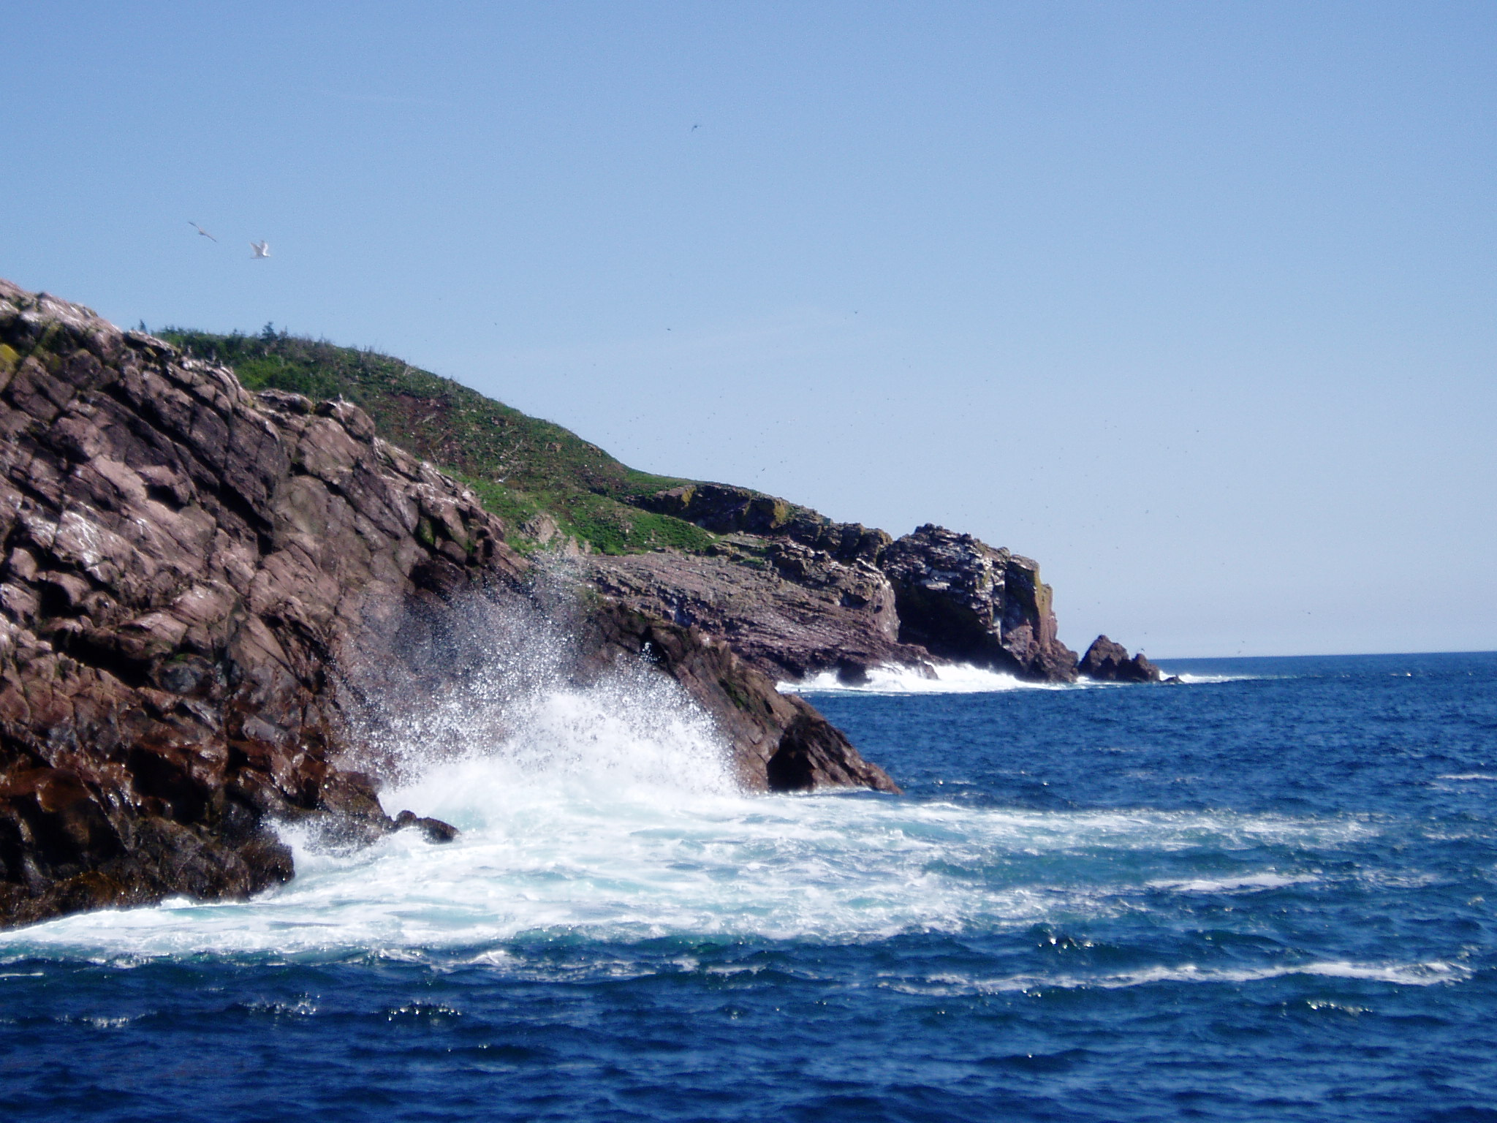
Notes:
Slide for Beginning of Ritual –
Ringing of prayer gong or chimes

Slide 2
Notes:
Refrain for Dance of the elements

Slide 3

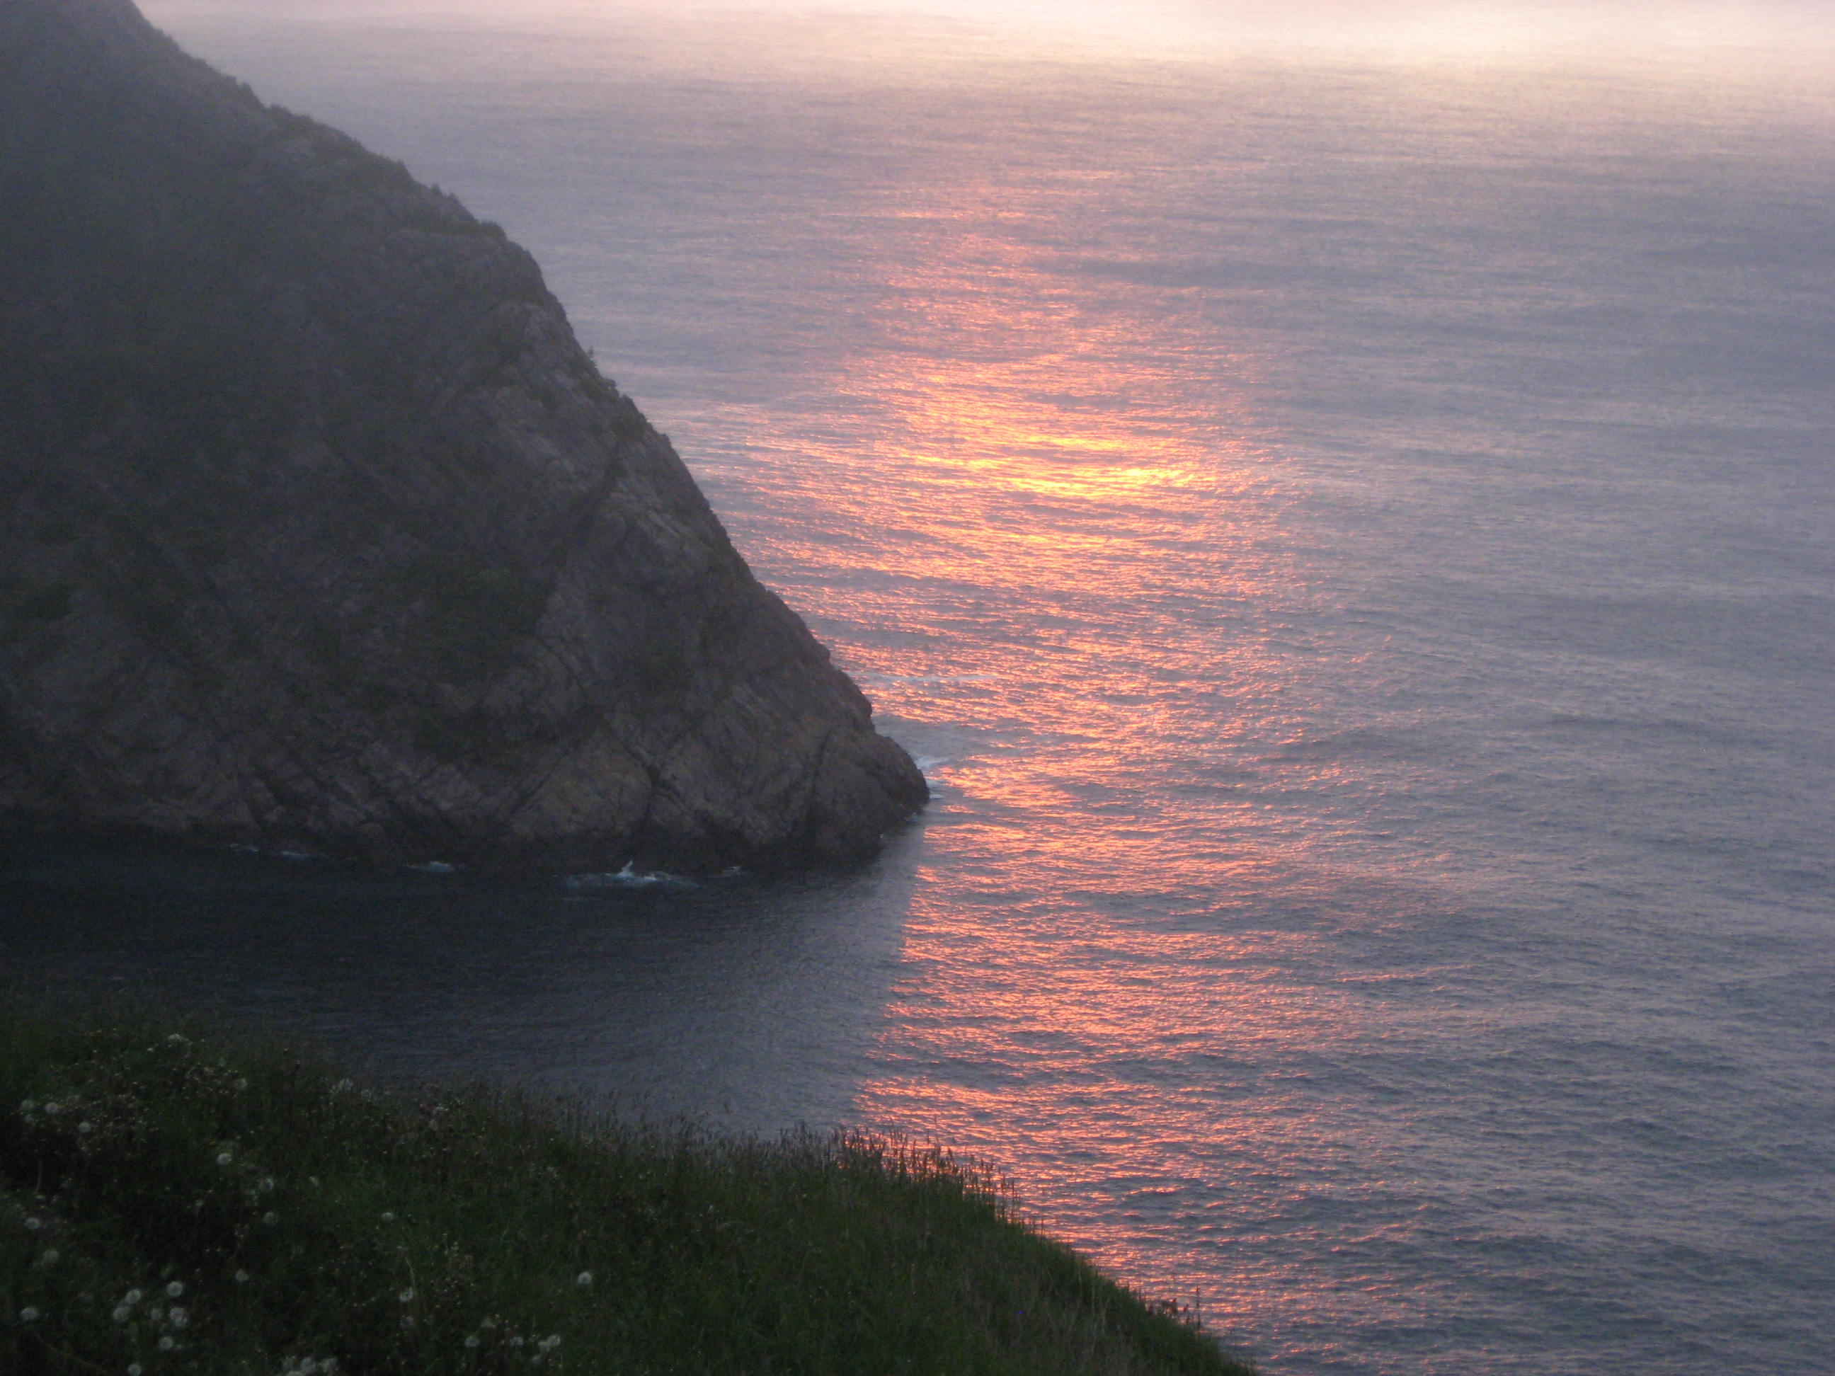
Notes:
Slide for Reflection with instrumental music – Country Rose

Slide 4
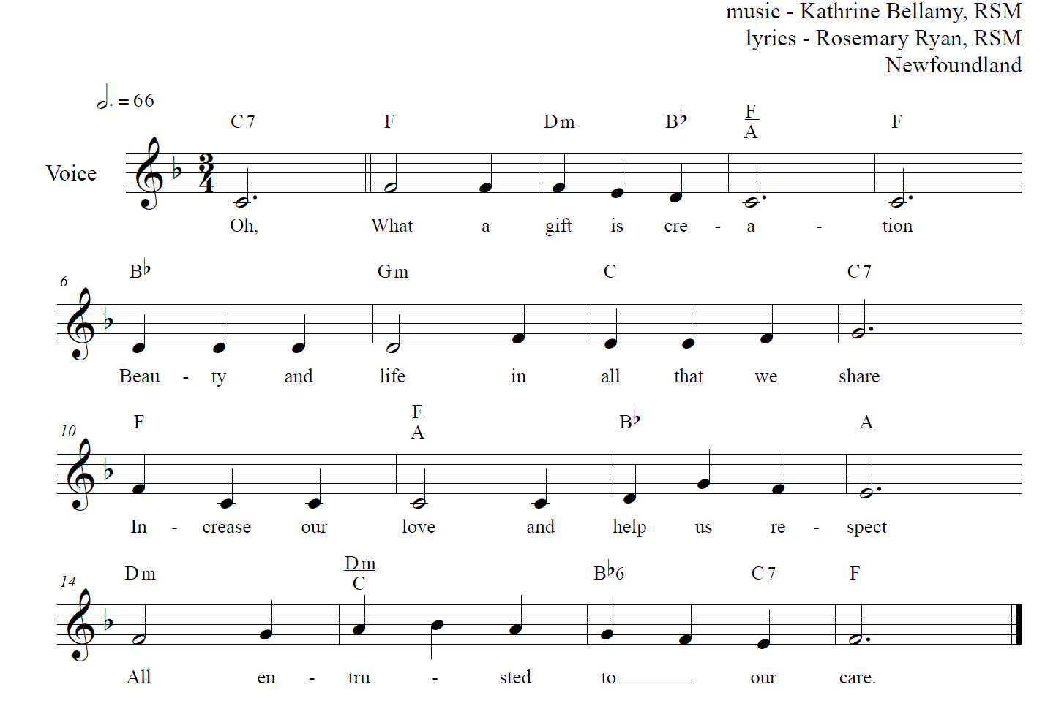
Oh, What A Gift
Notes:
Refrain to begin the Readings

Slide 5
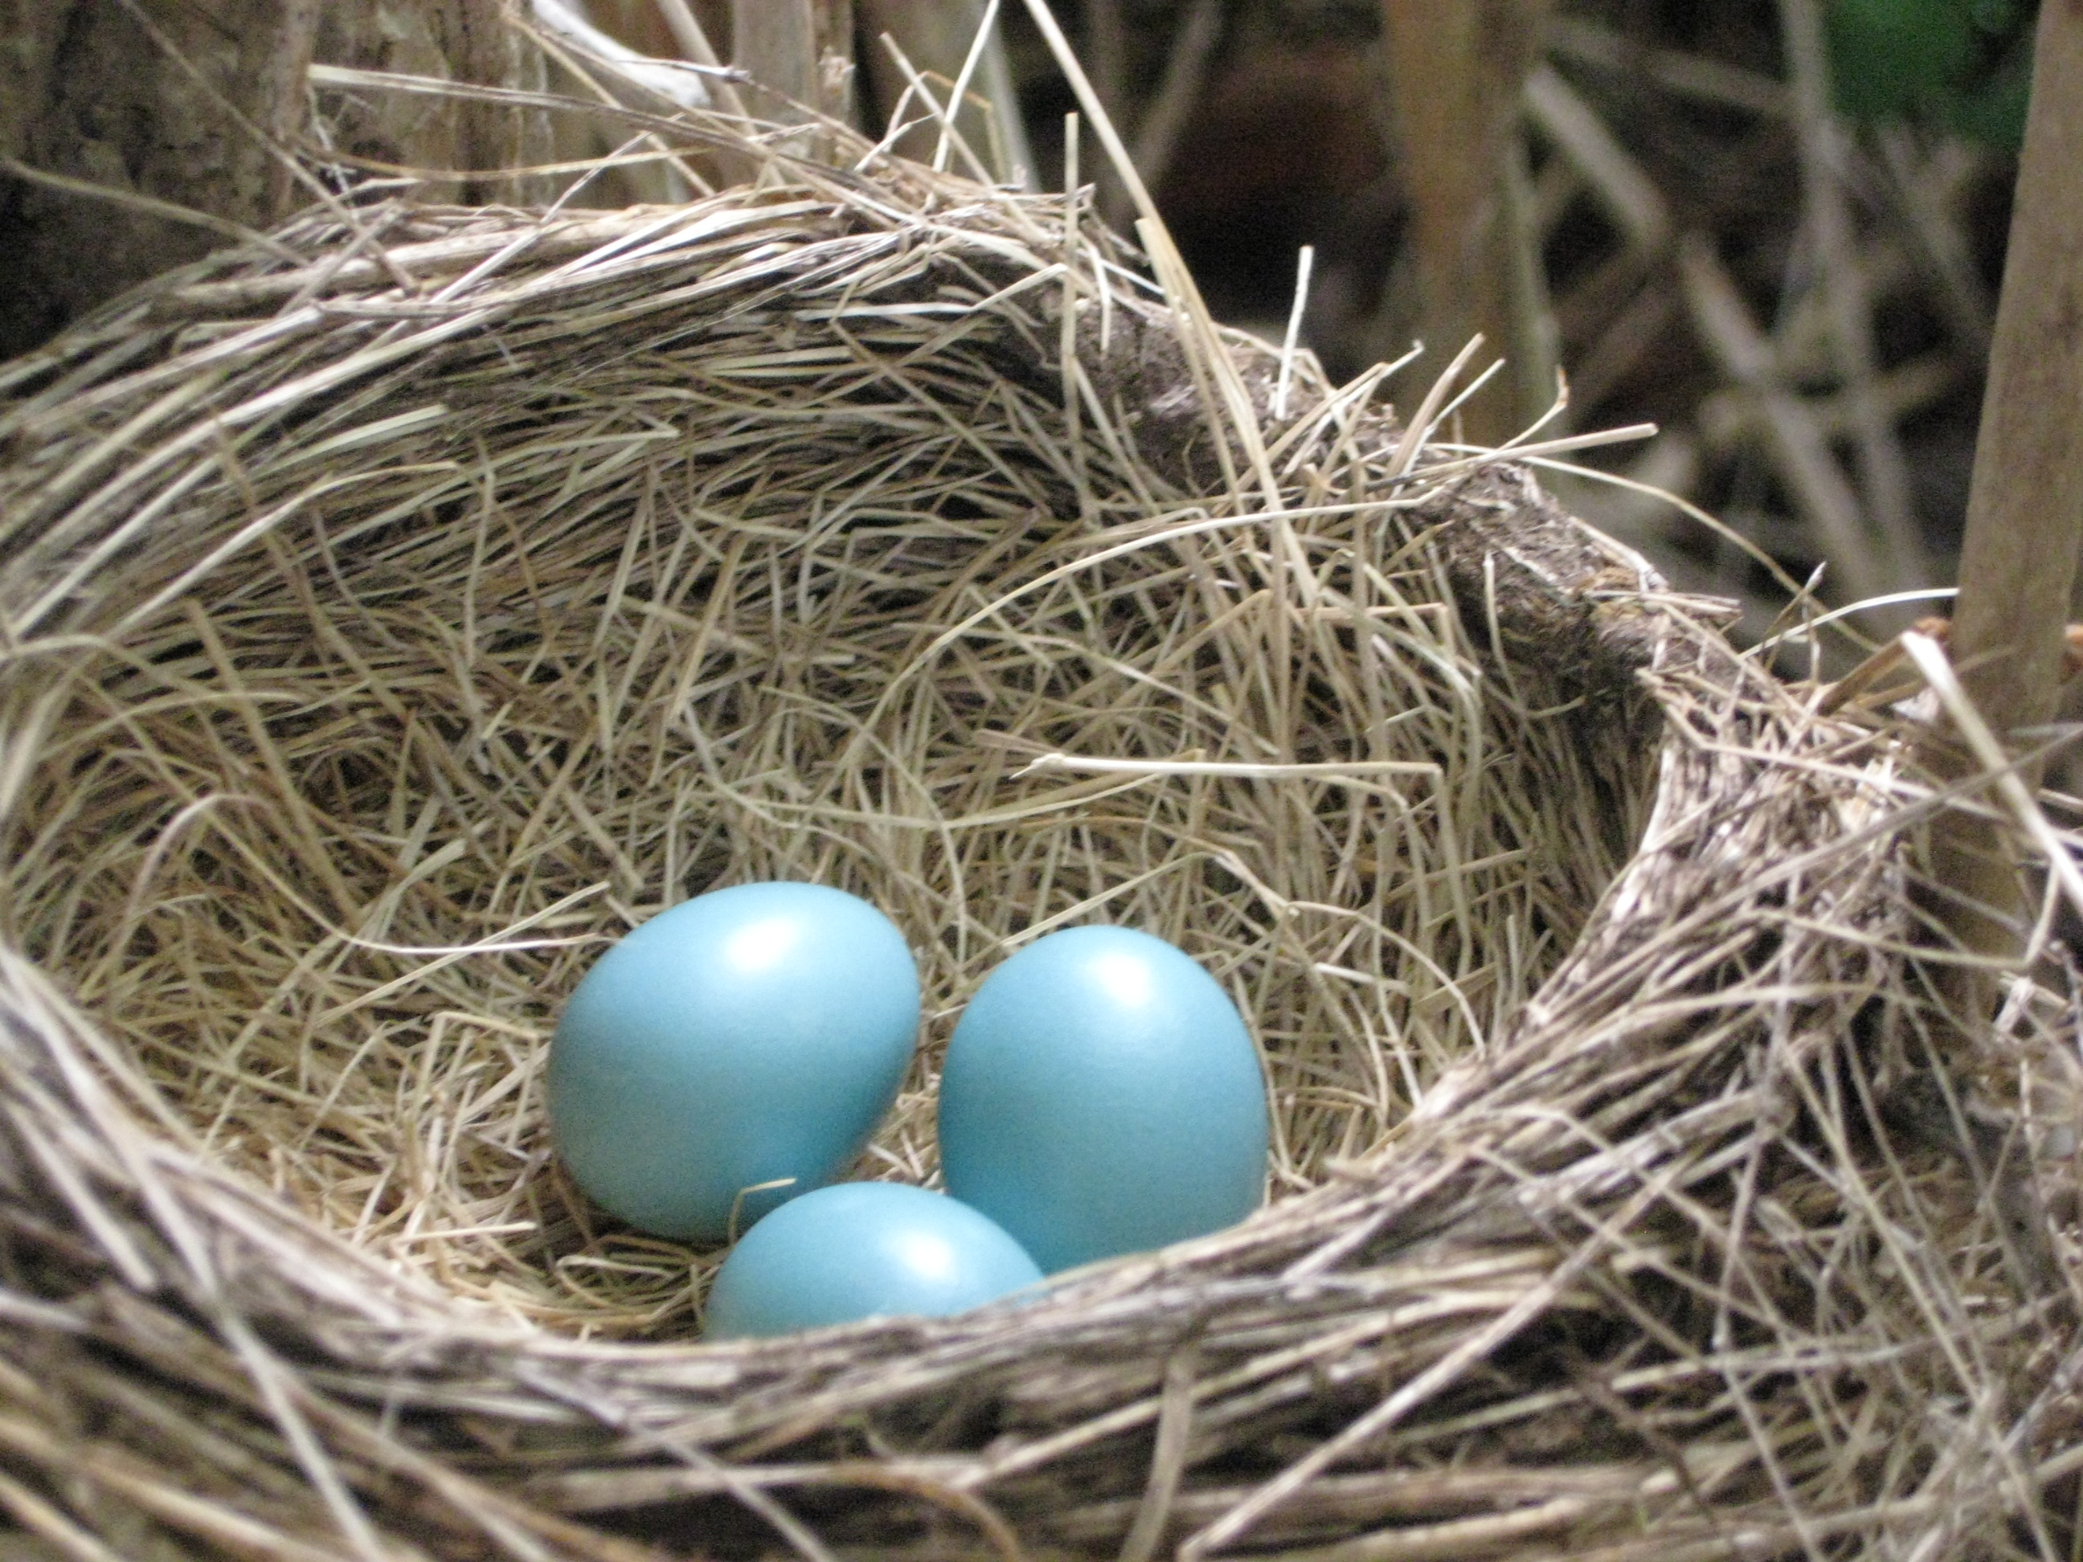
Notes:
First Reading

Slide 6
Recordamos Su Merced / We Remember Your Mercy
Notes:
Following First Reading – Leader says response then all sing this refrain

Slide 7
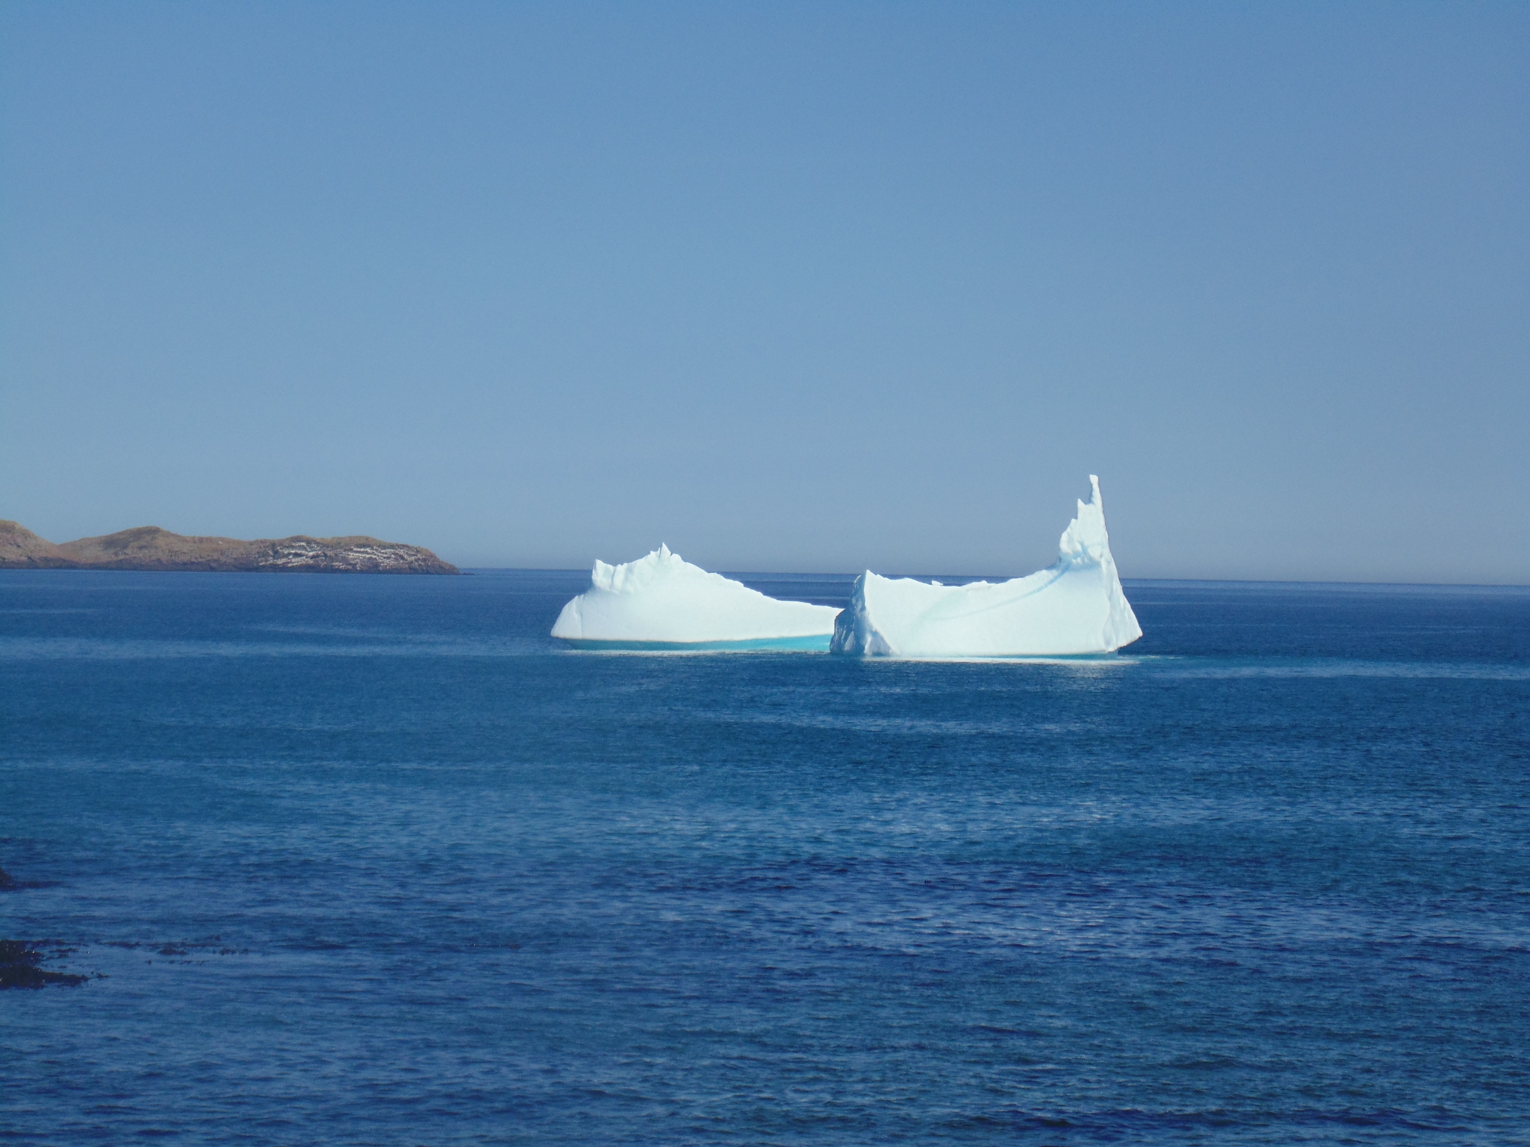
Notes:
Second Reading

Slide 8
Recordamos Su Merced / We Remember Your Mercy
Notes:
Following Second Reading – Leader says response then all sing this refrain

Slide 9
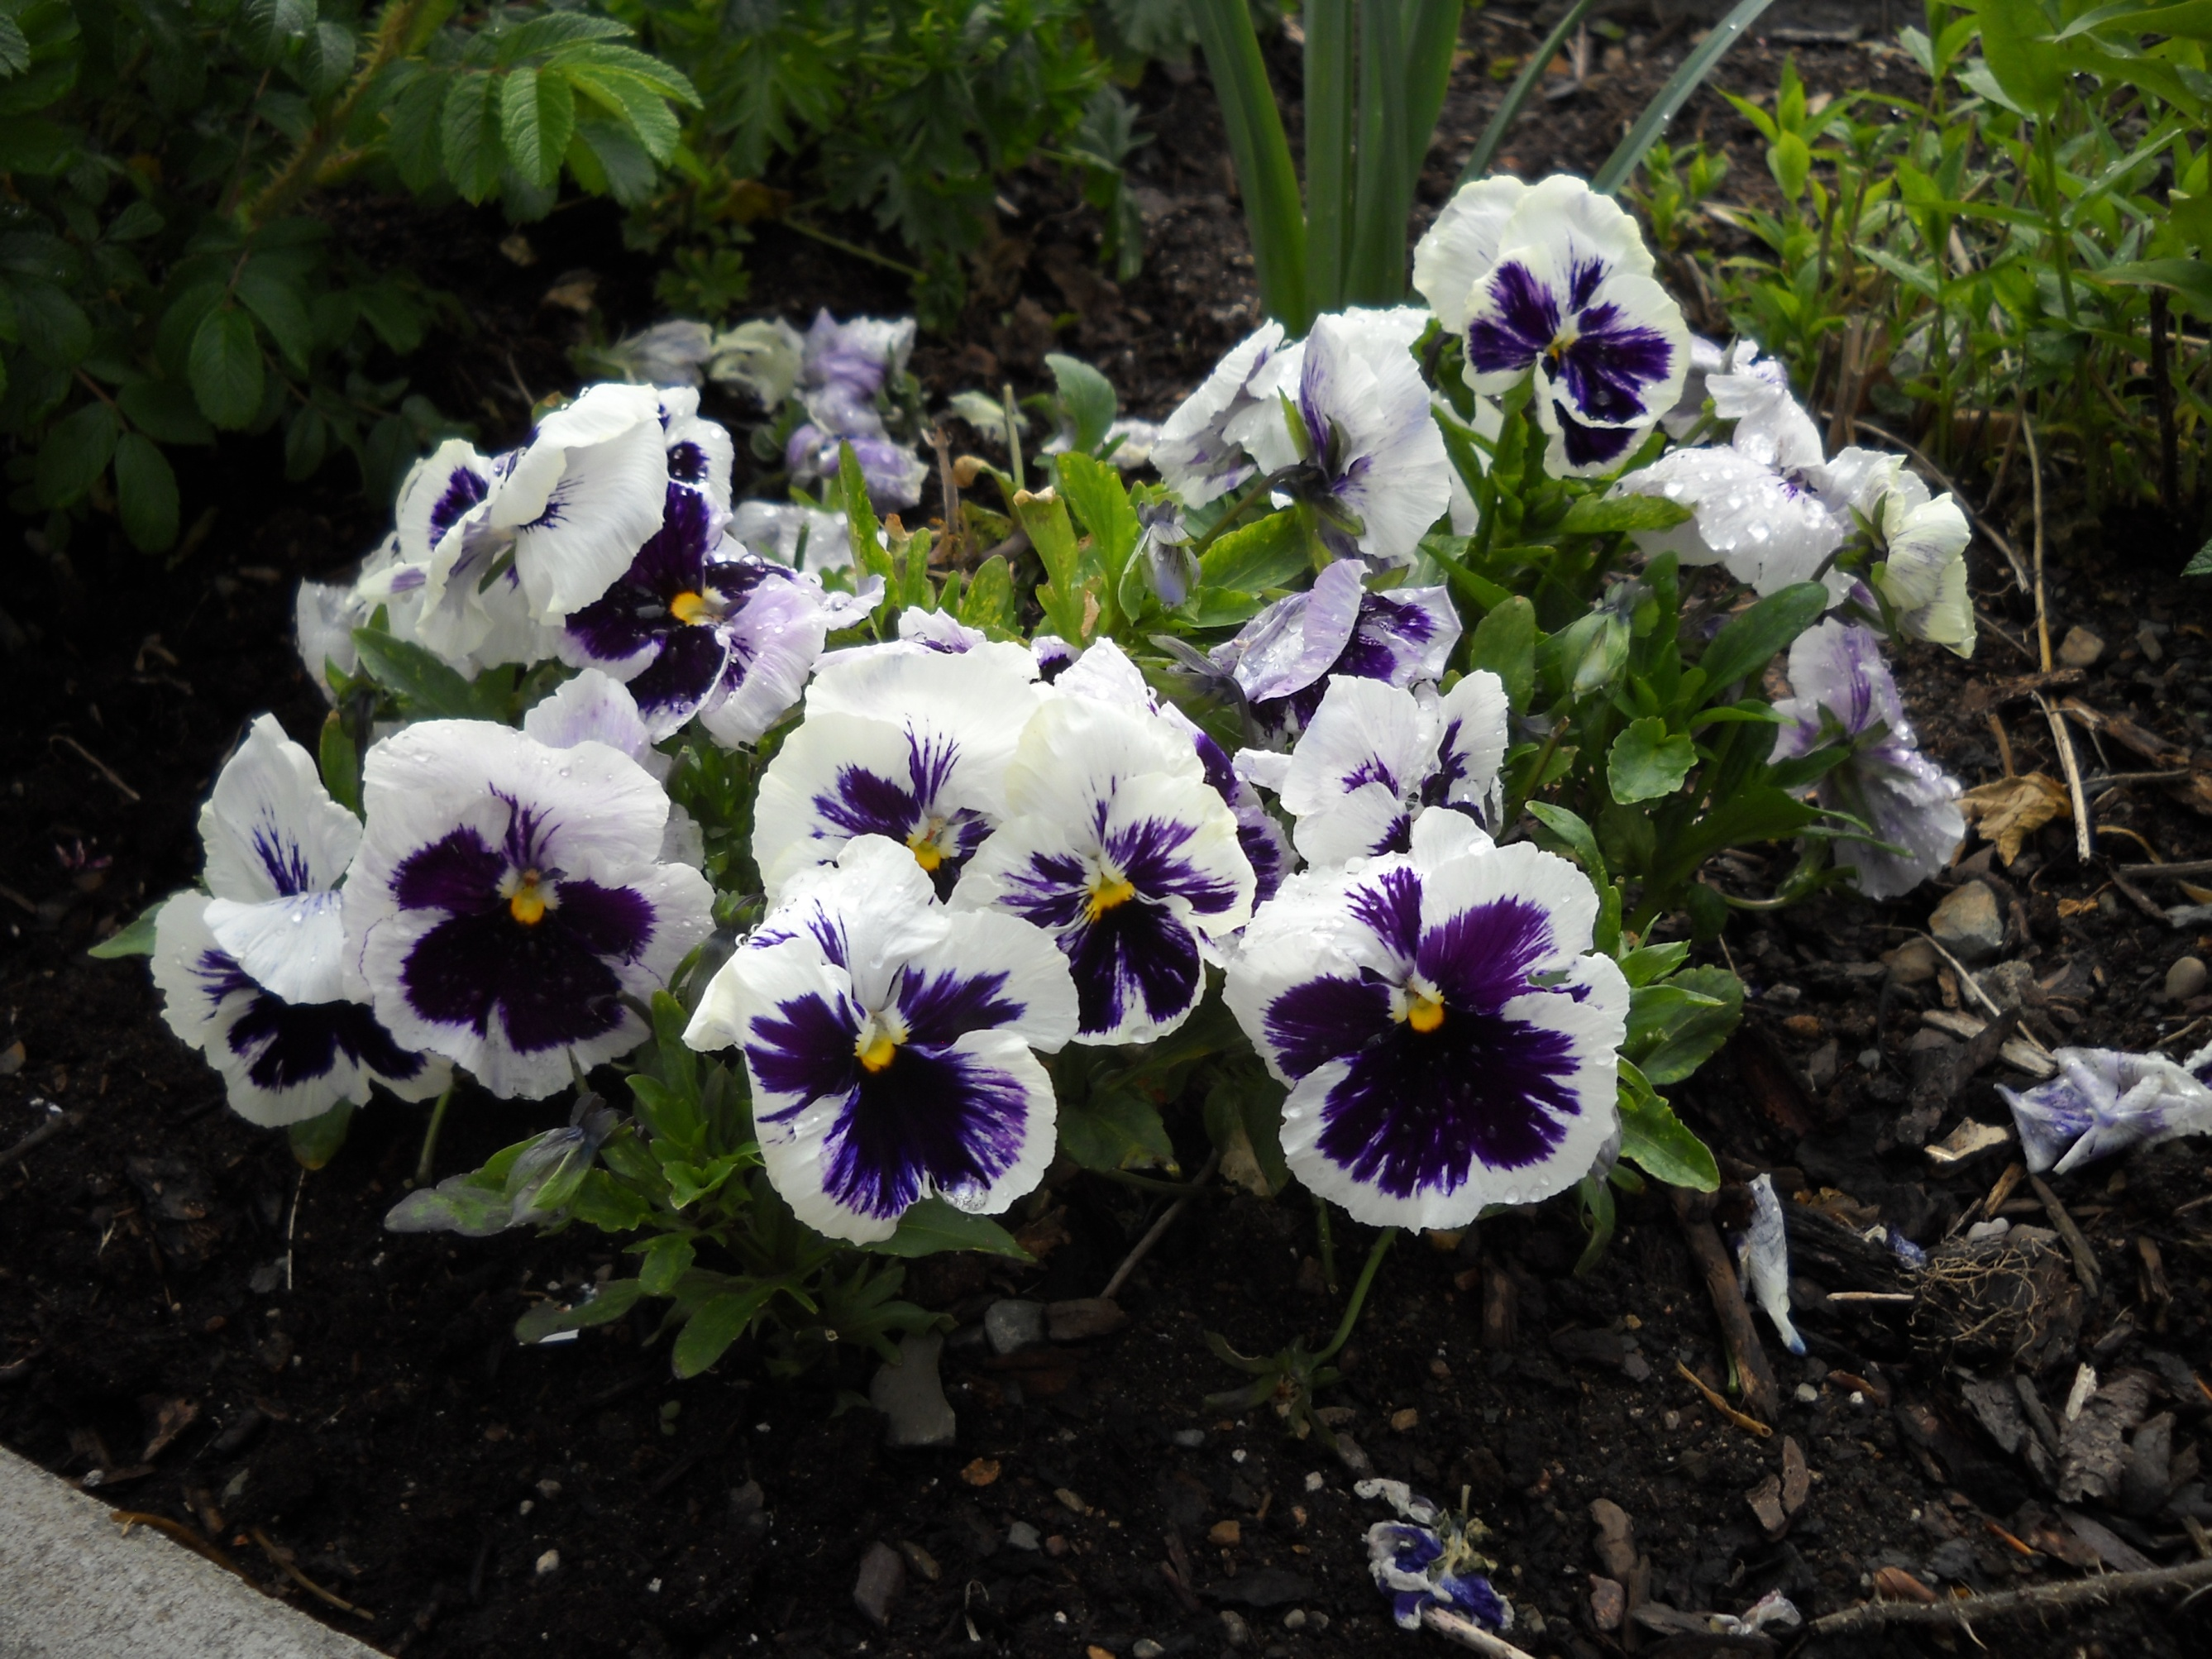
Notes:
Third Reading

Slide 10
Recordamos Su Merced / We Remember Your Mercy
Notes:
Following Third Reading – Leader says response then all sing this refrain

Slide 11
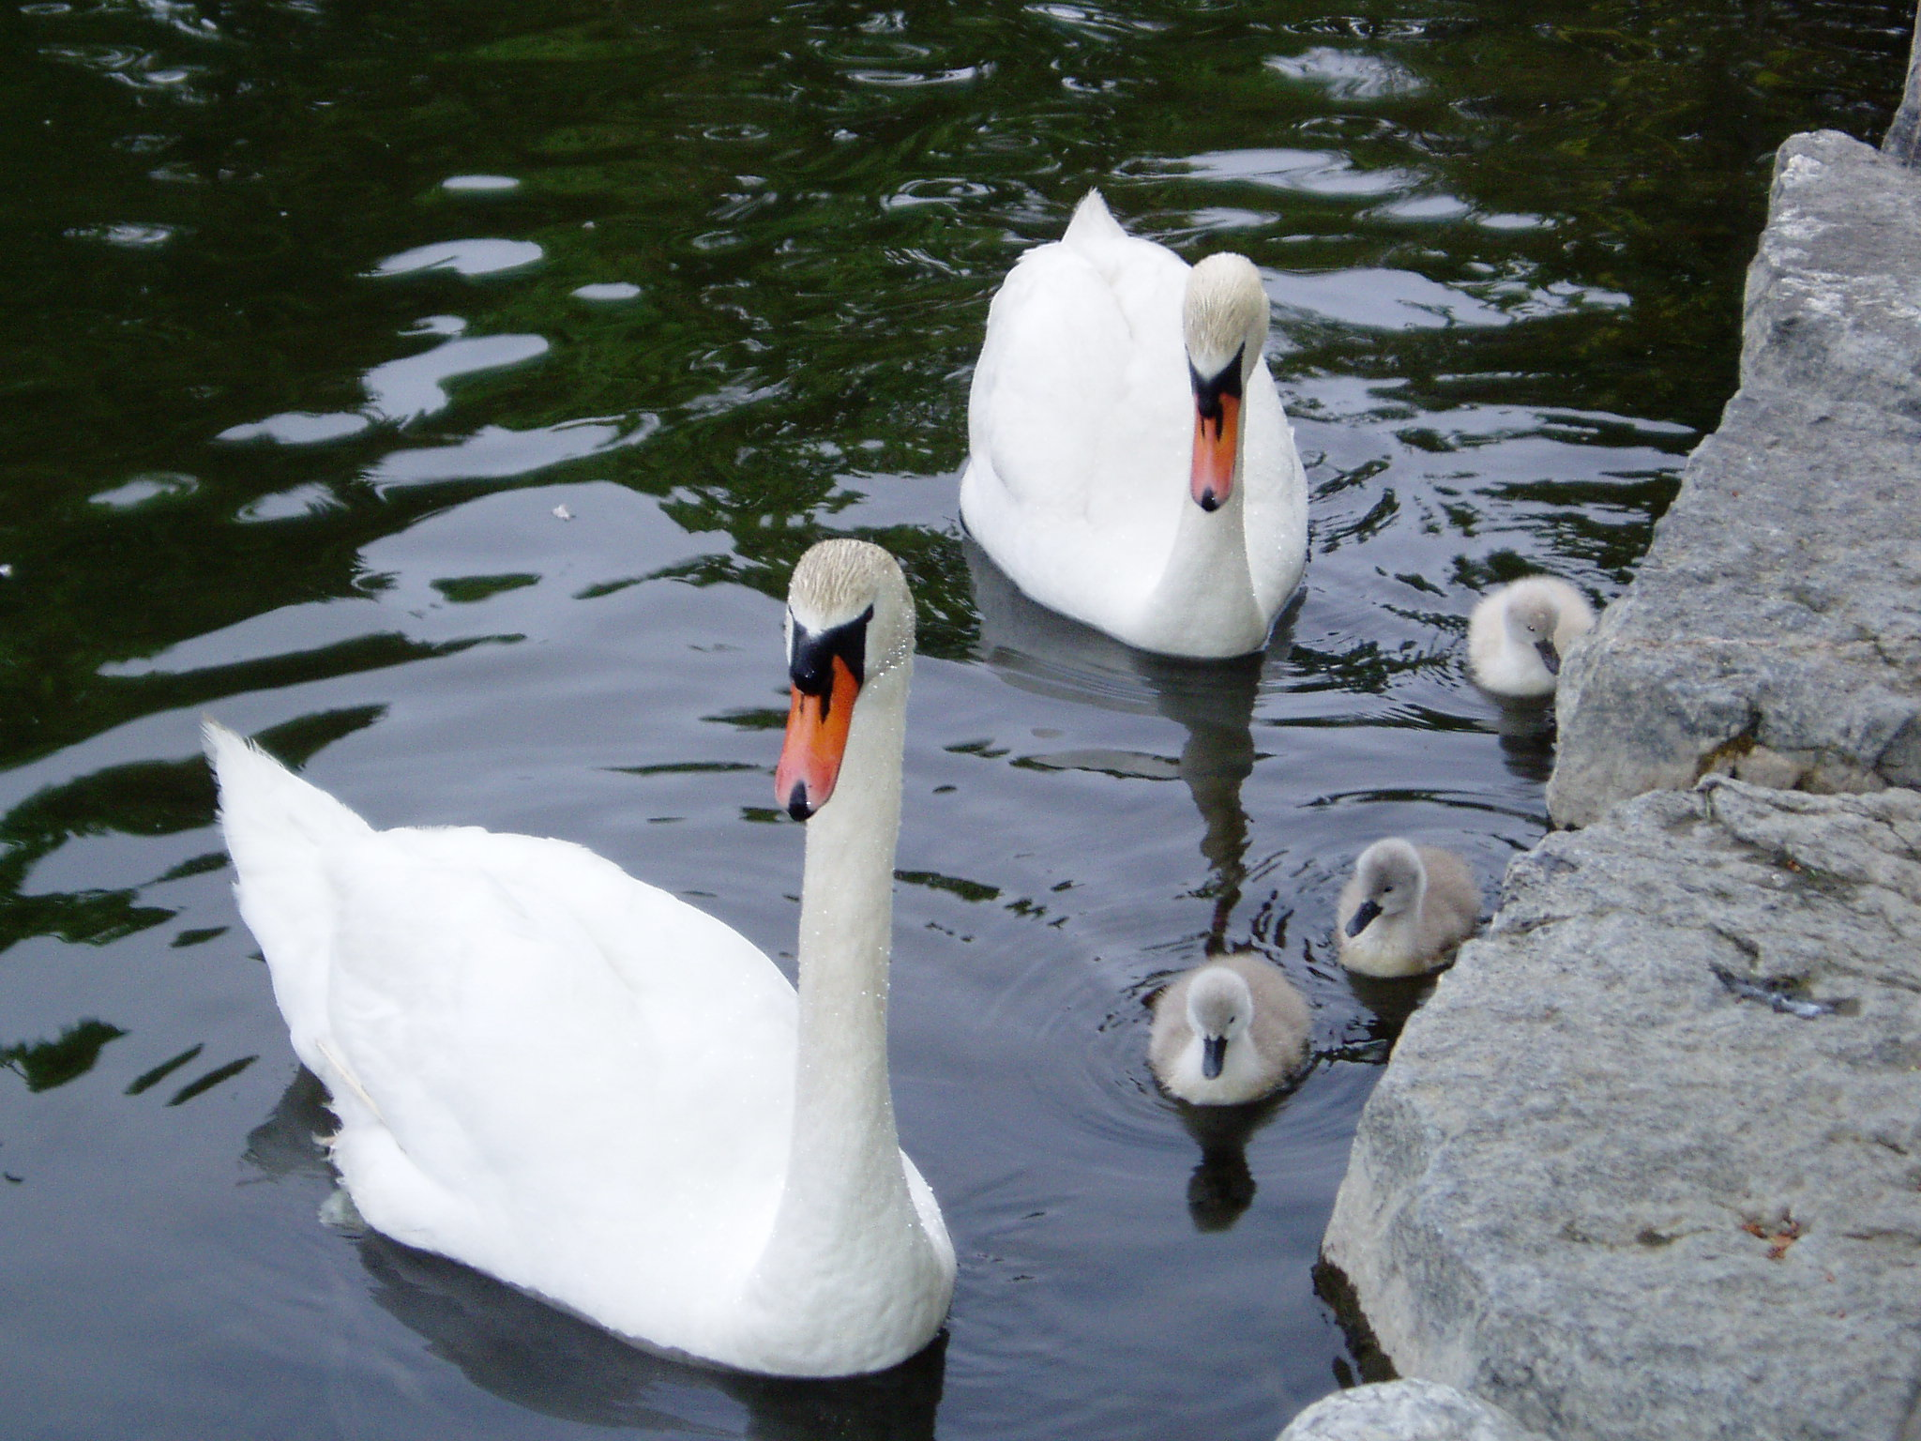
Notes:
Fourth Reading

Slide 12
Oh, What A Gift
Notes:
Immediate Response following Fourth Reading

Slide 13
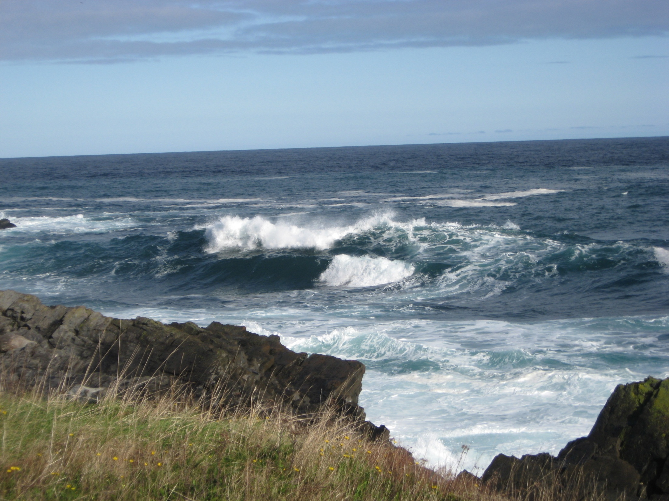
Notes:
Slide for Blessing of Water

Slide 14
Notes:
Slide for Procession To The Water

Slide 15
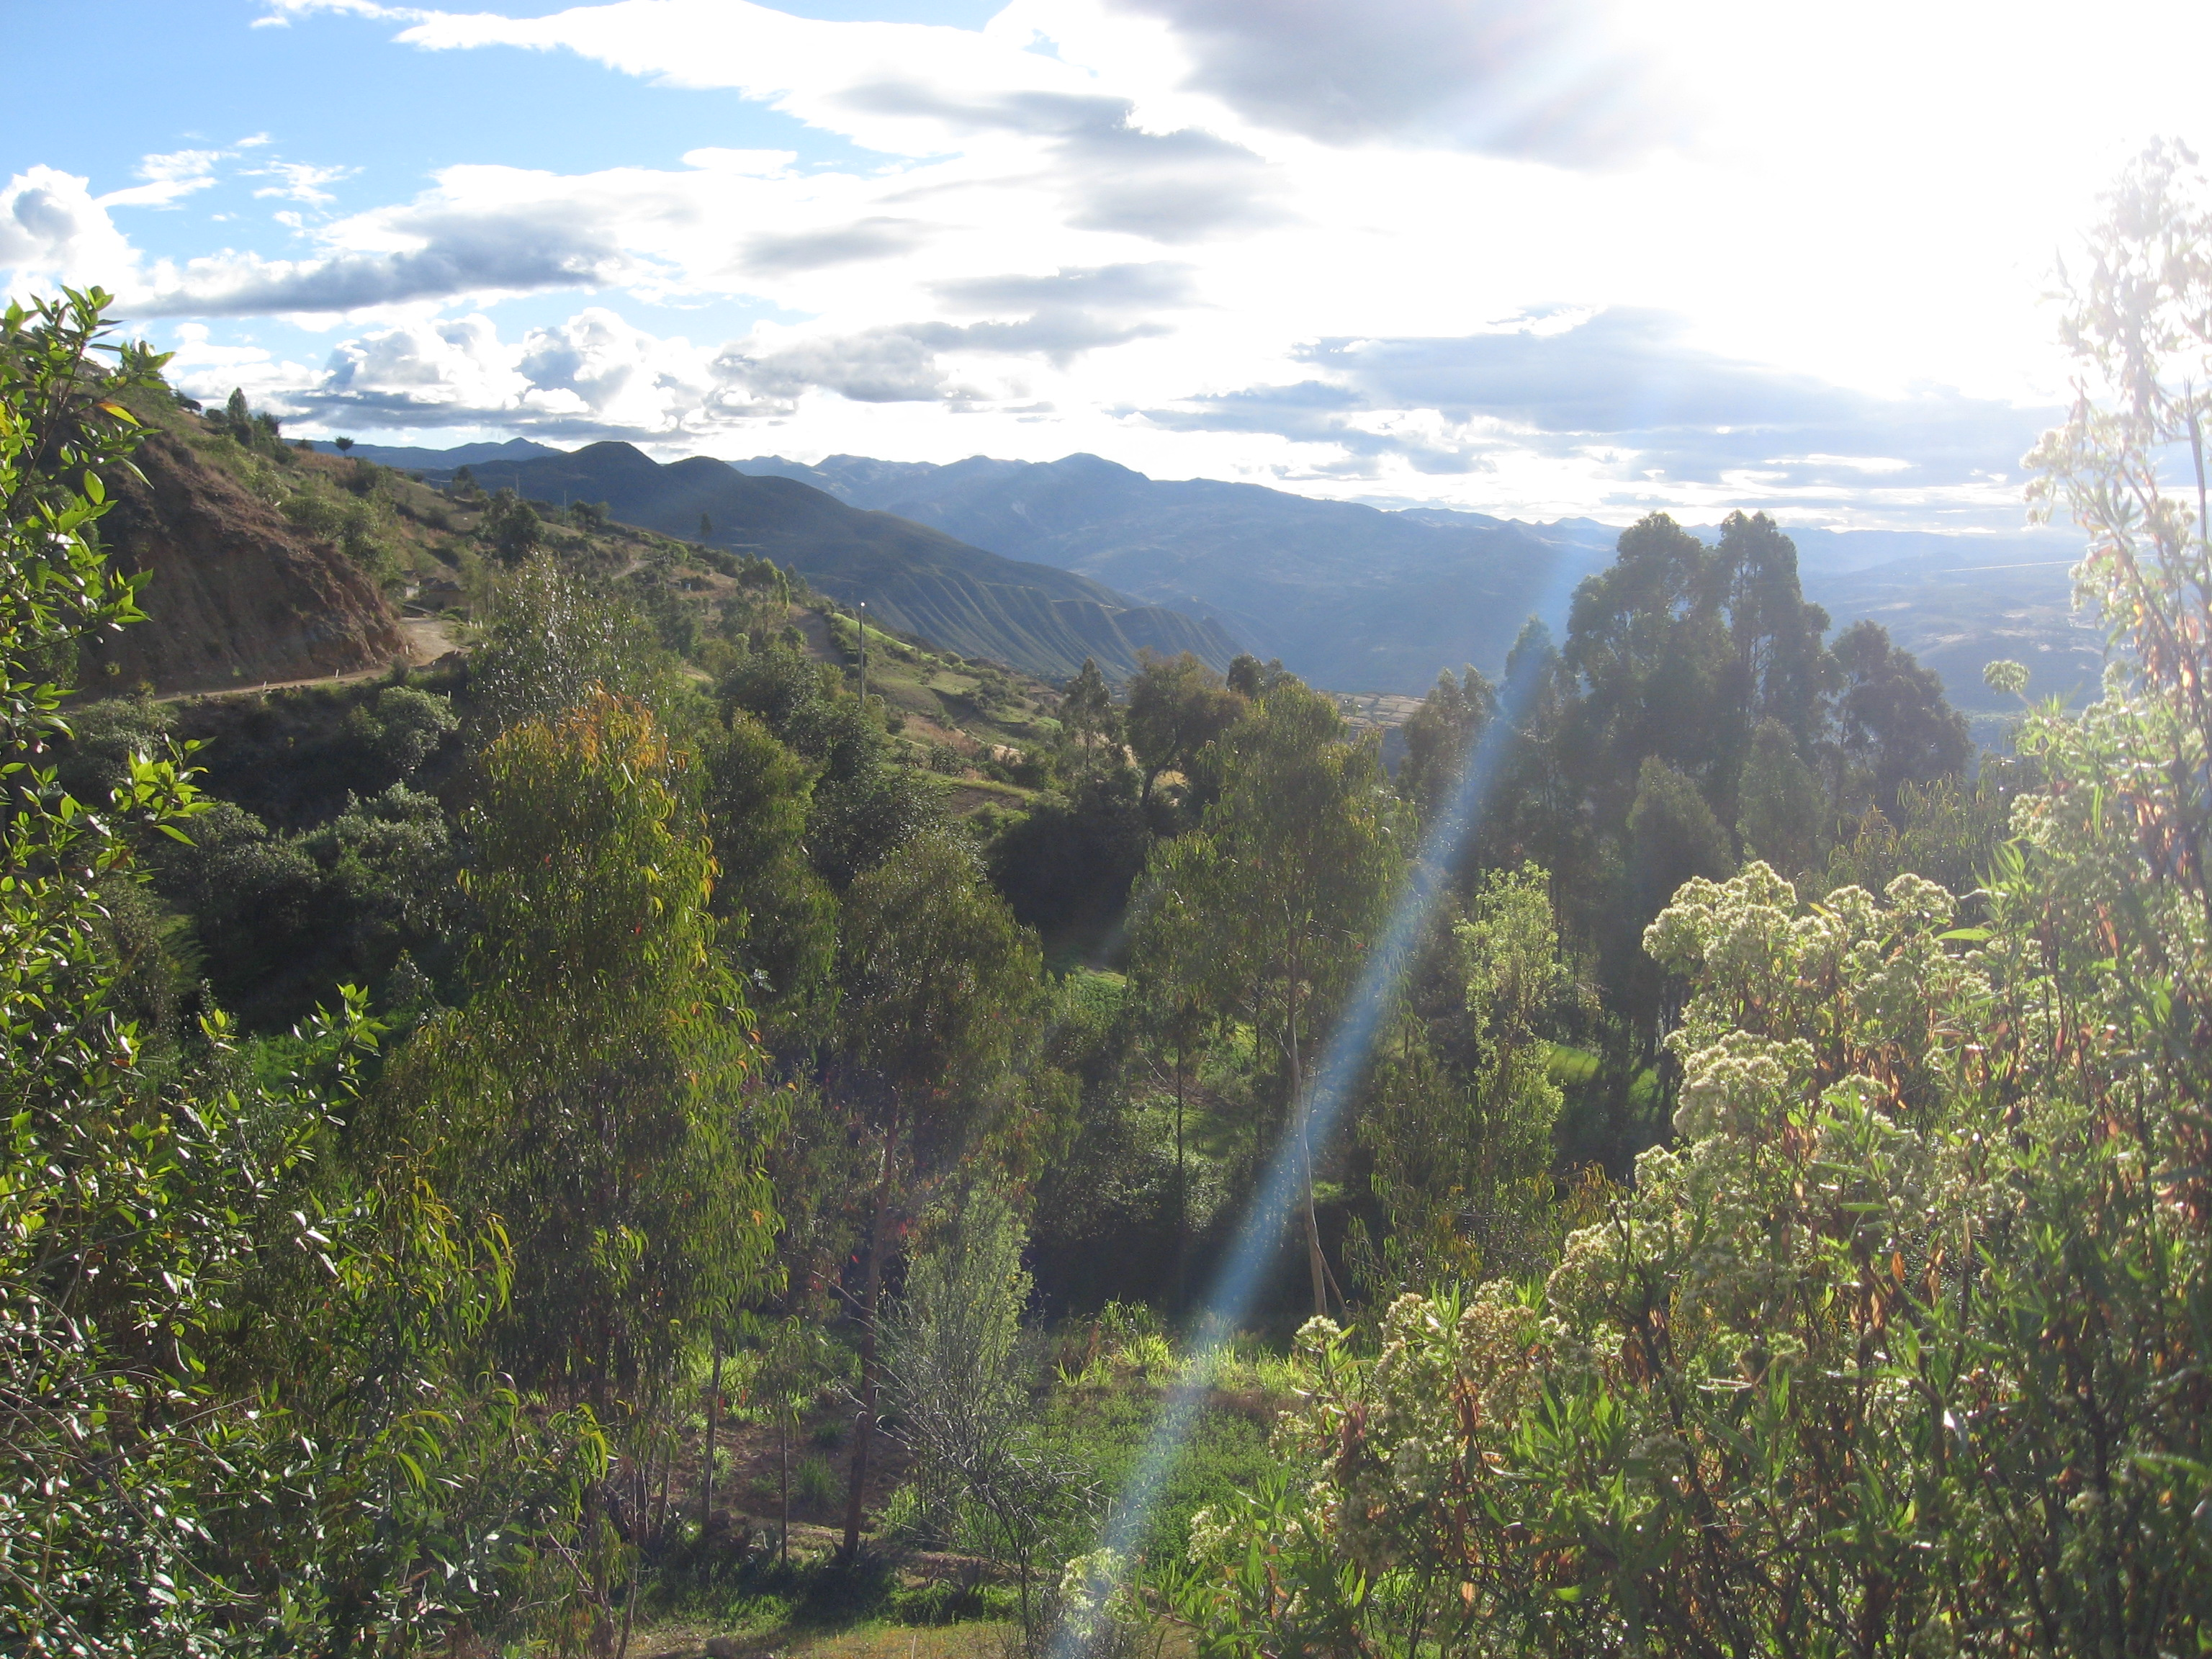
Notes:
Slide for Closing Blessing

Slide 16
Notes:
Final Song

