Slide 1
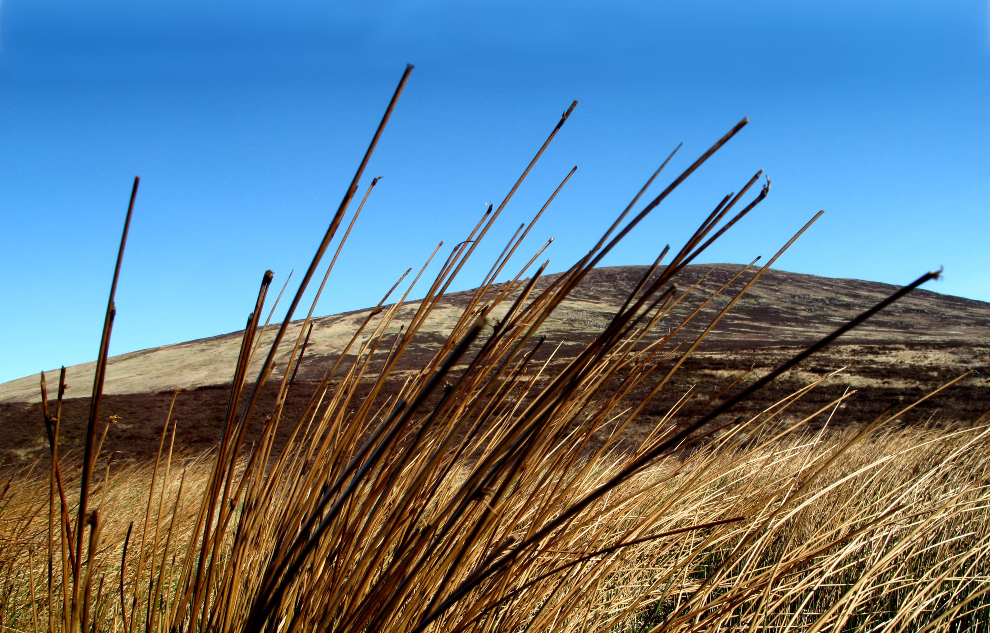
In the midst of all our tripping about…

Slide 2
…our hearts can always be in the same place …

Slide 3
C. Mc Auley

