Slide 1
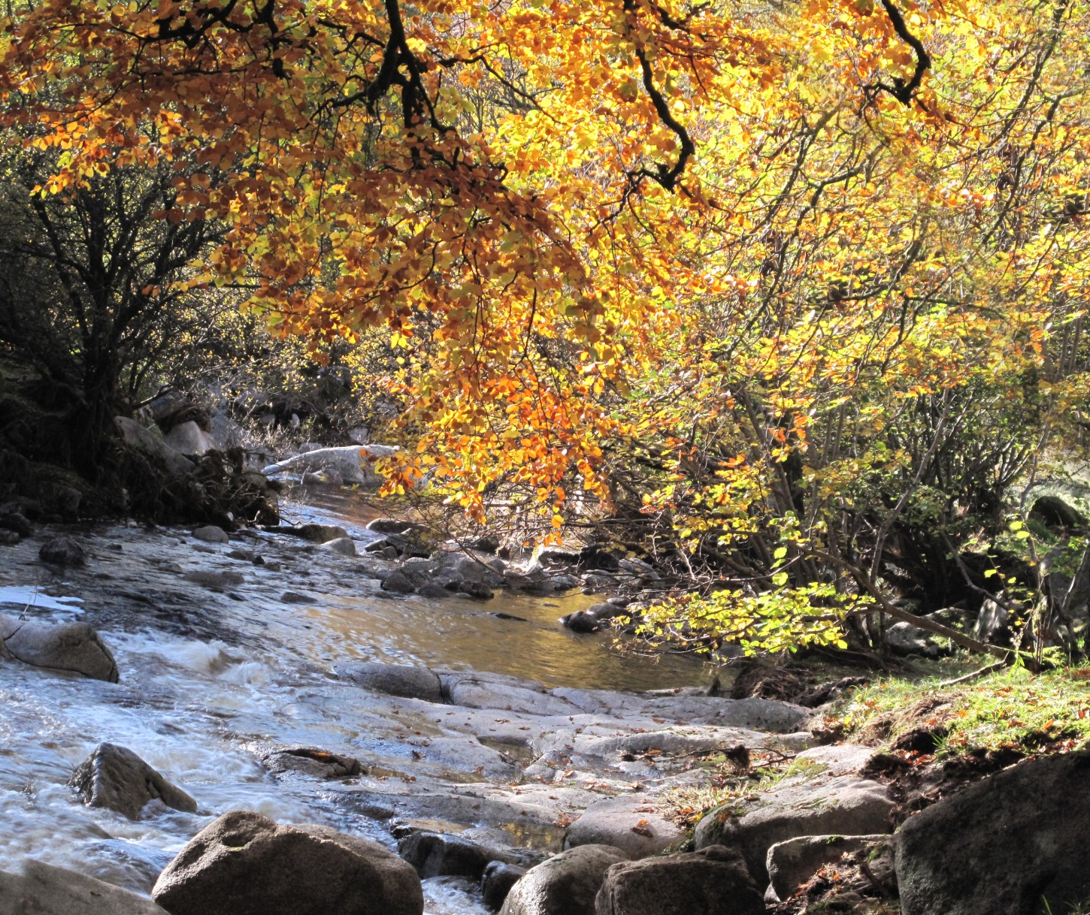
“THE
CALL
IS
MERCY”
by Carmel Bracken, rsm

Slide 2
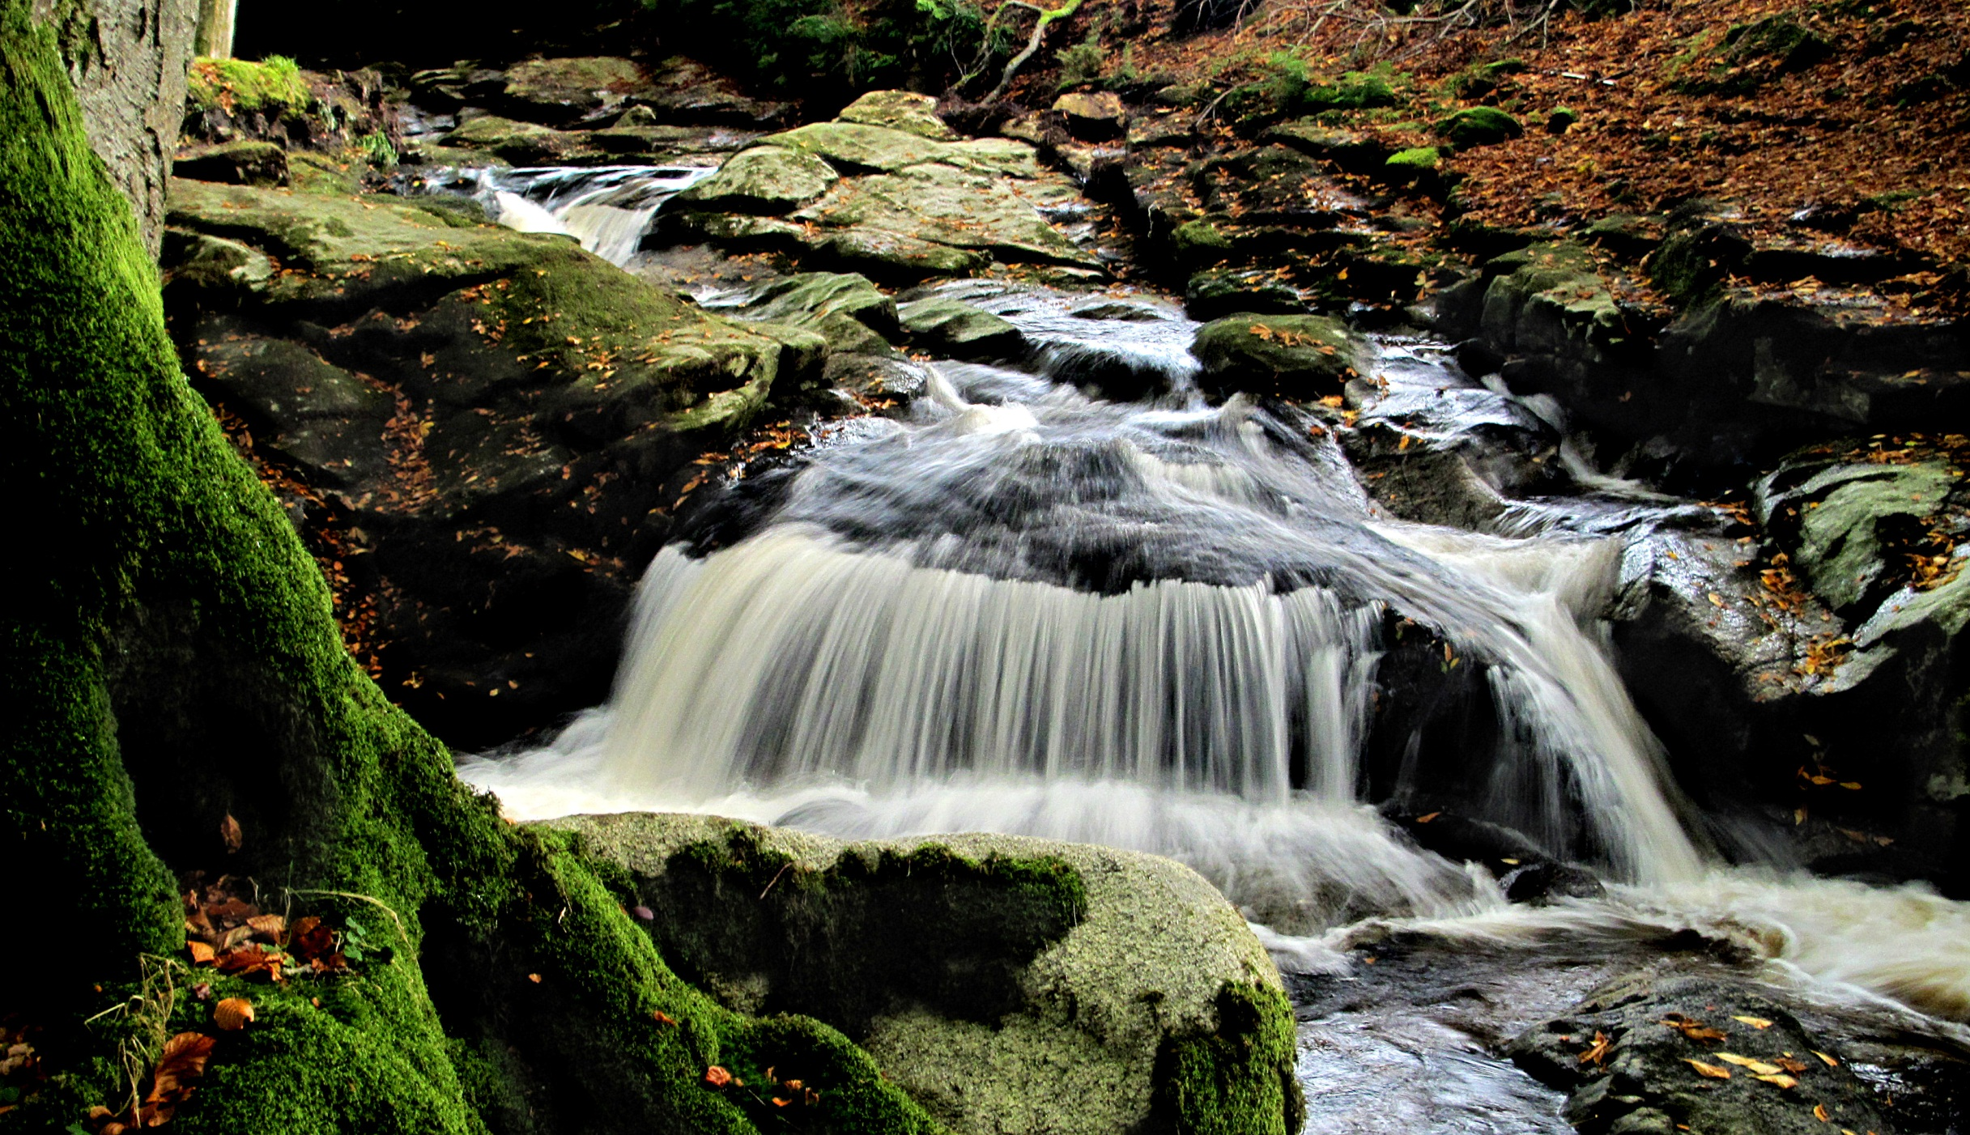
In the midst of
life’s dryness
her thirst was quenched with the blessing of water
welling up from inner springs;

Slide 3
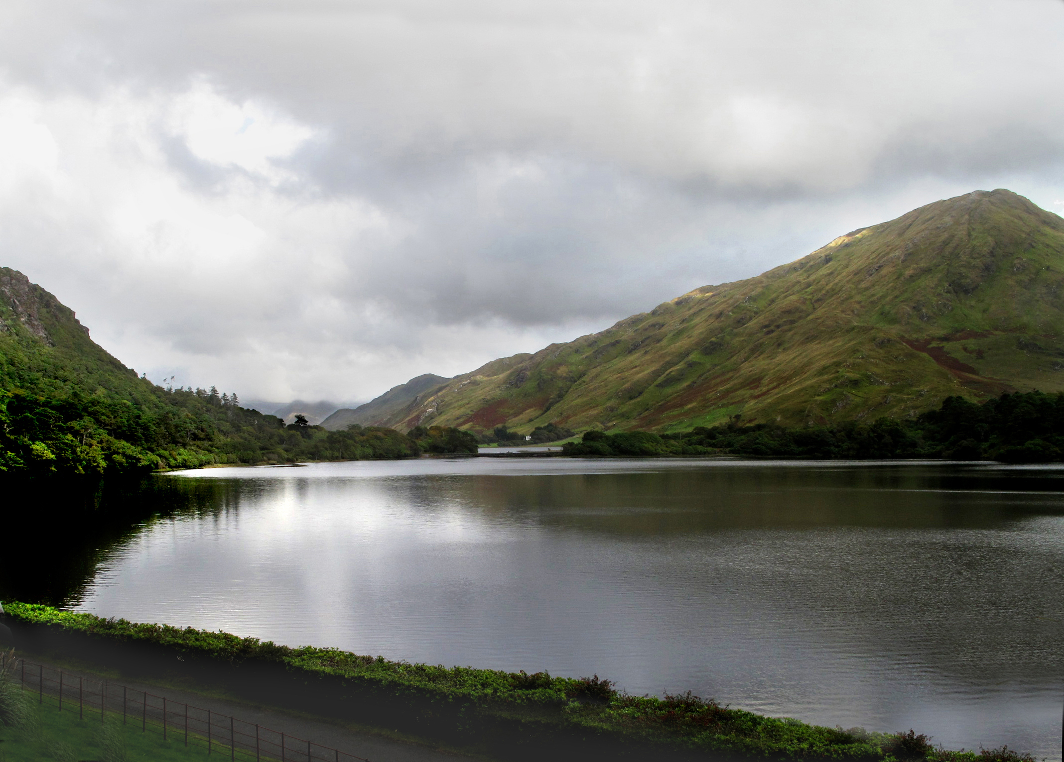
Becoming a pool,
mirroring its origin;

Slide 4
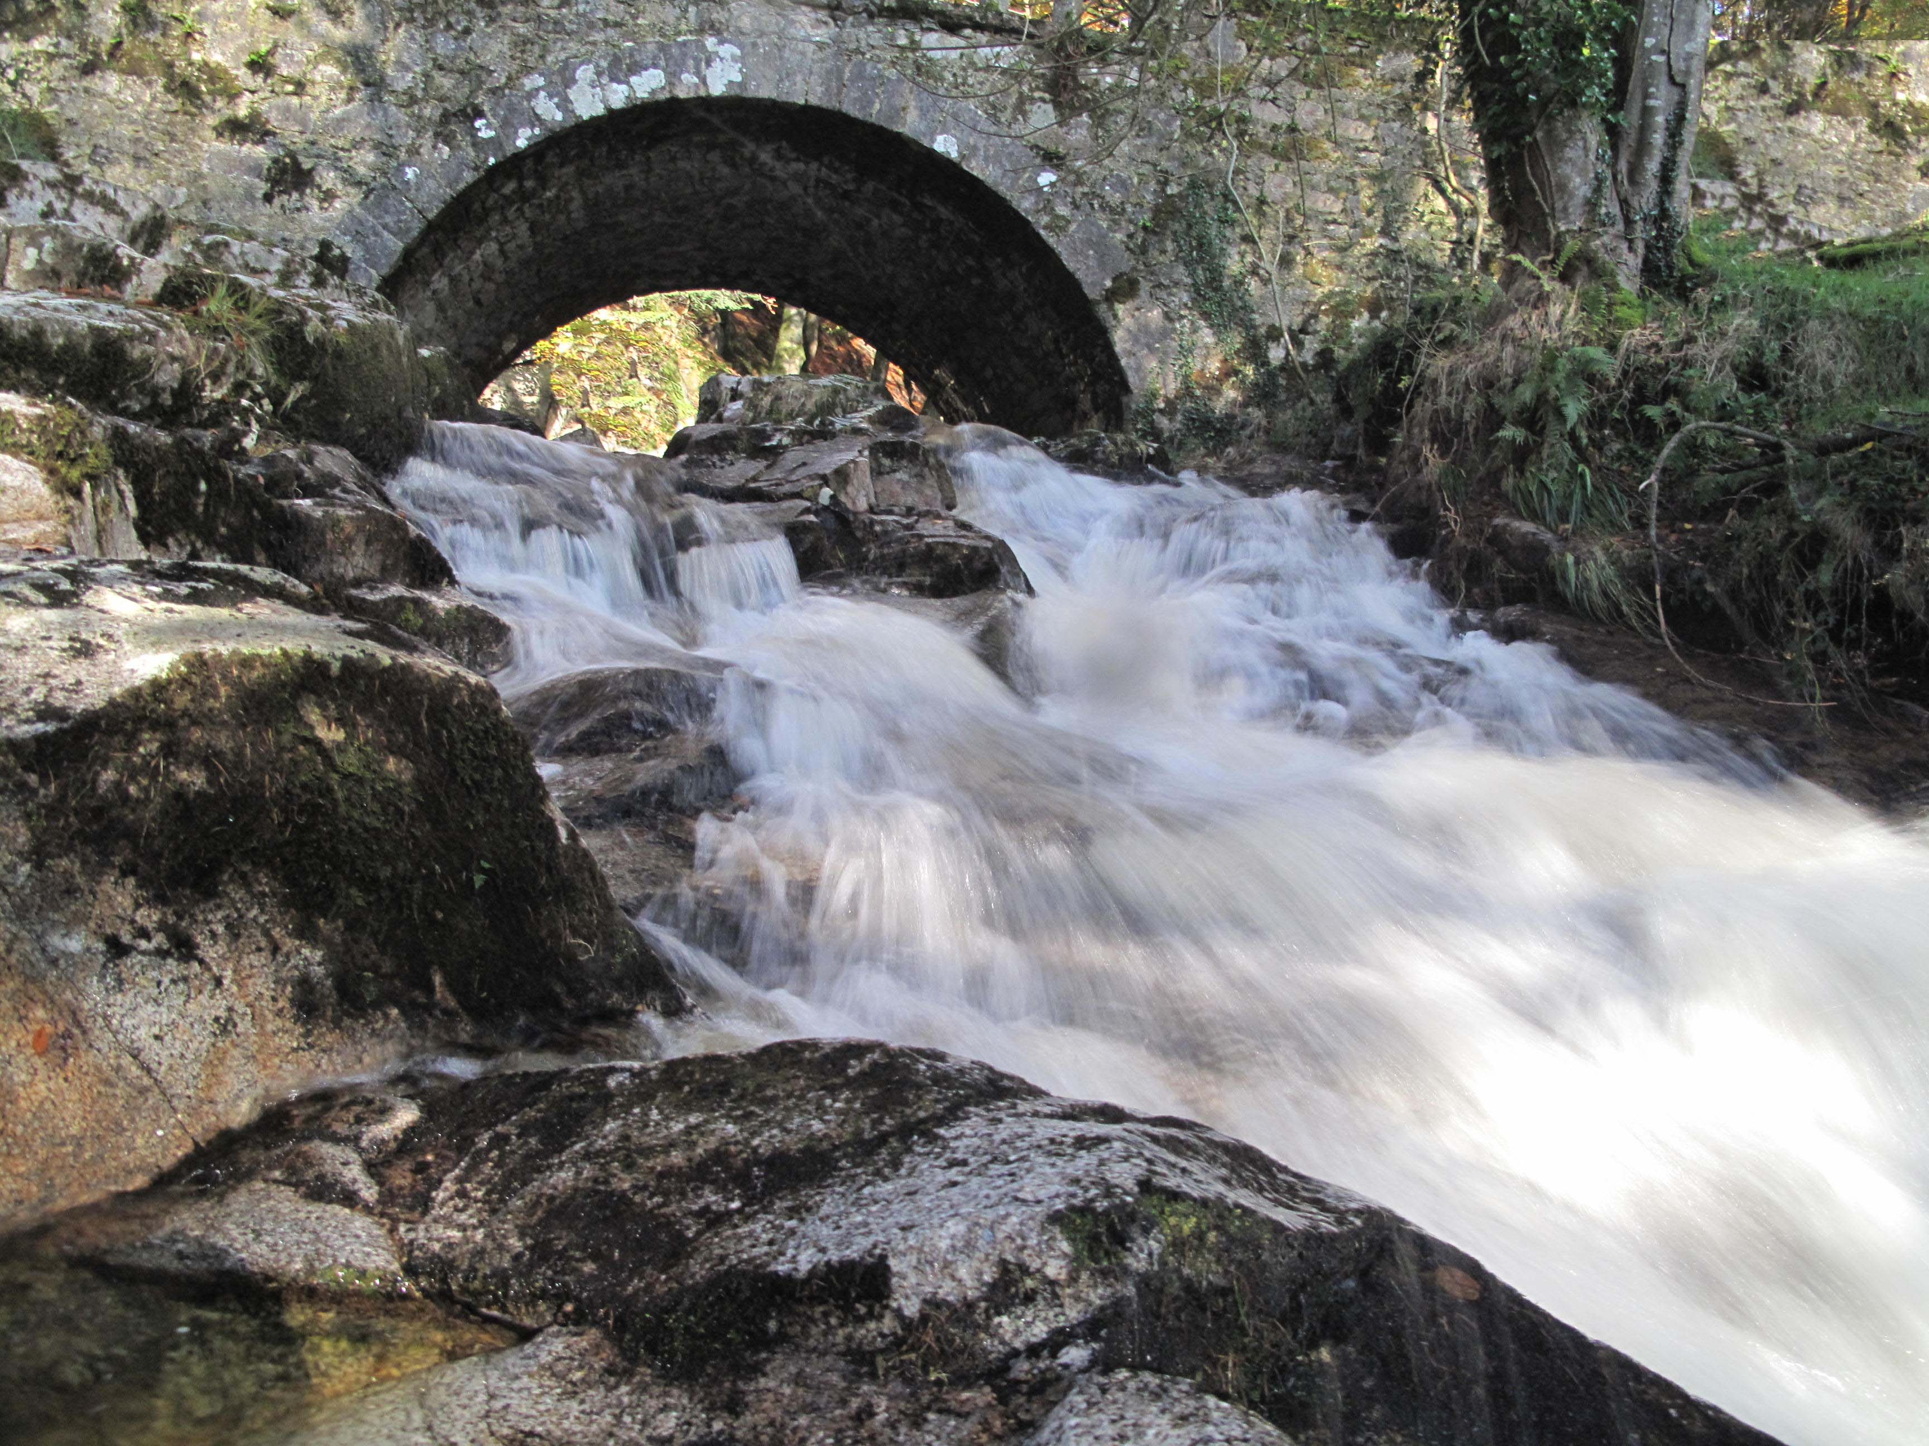
Source overflowing, until -
a
cascading
Fountain
of Mercy
broke over her to become source for other rivers.

Slide 5
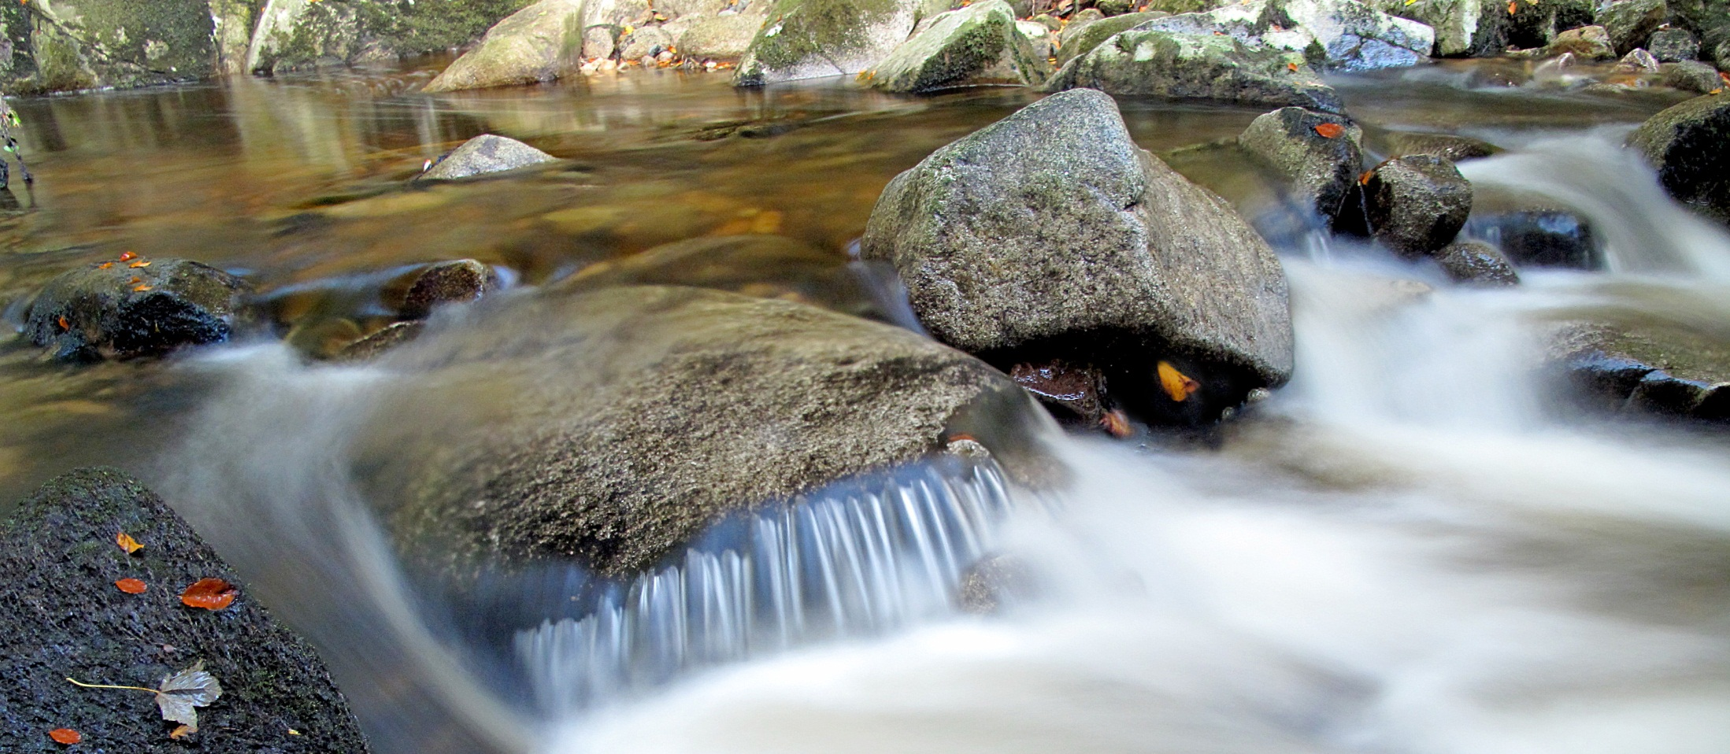
Rivers that flowed outward and onward,
pouring mercy, at times in trickles
at times in torrents,
Onto a parched land.

Slide 6
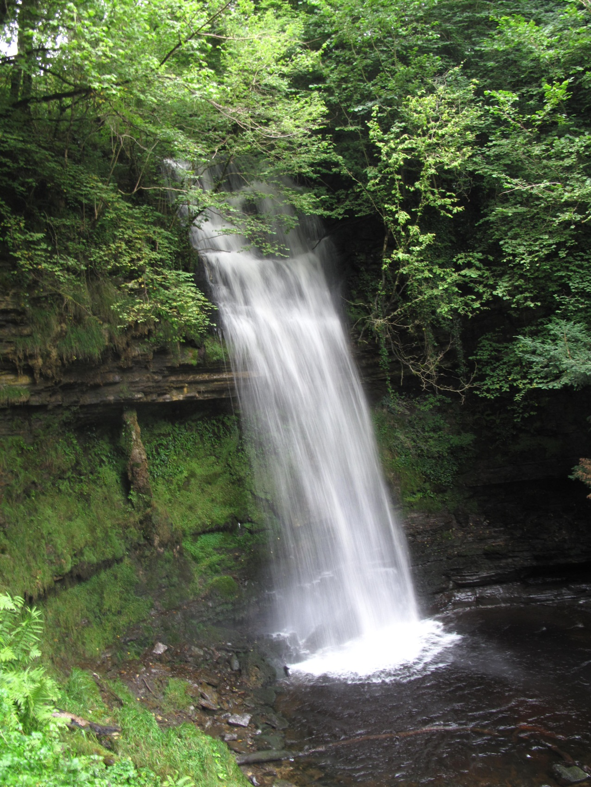
Rivers
that
channelled out
new paths
that allowed
deserts
to
blossom;
gushing waters
that
wore away
stones;

Slide 7
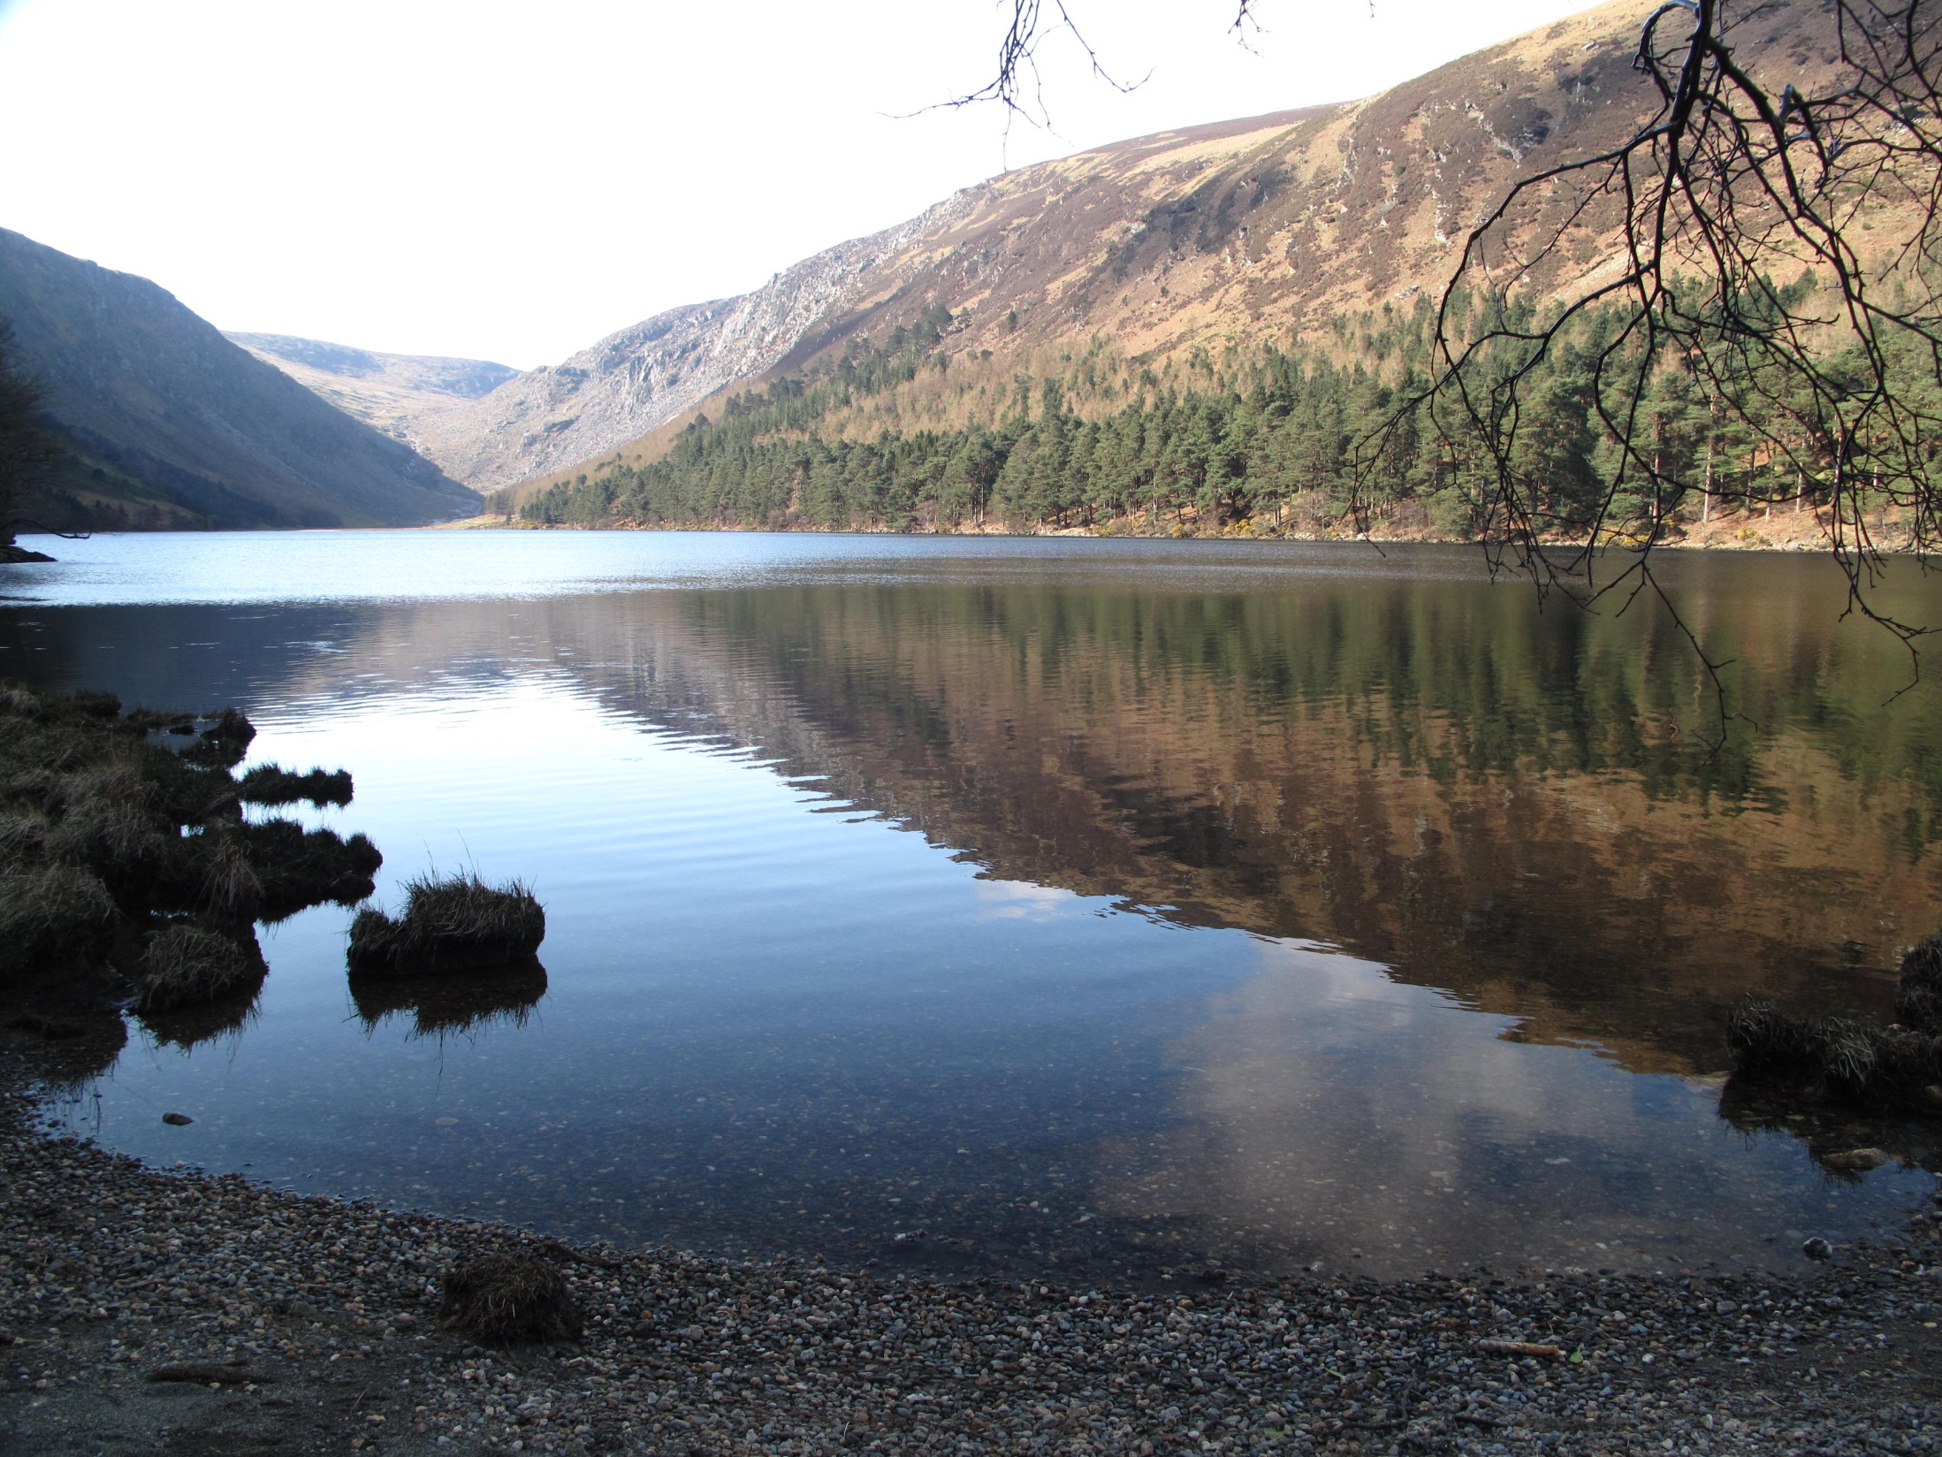
Refreshing
waters
that cleansed,
healed
and
supported
the myriads
of creatures
it
teemed with.

Slide 8
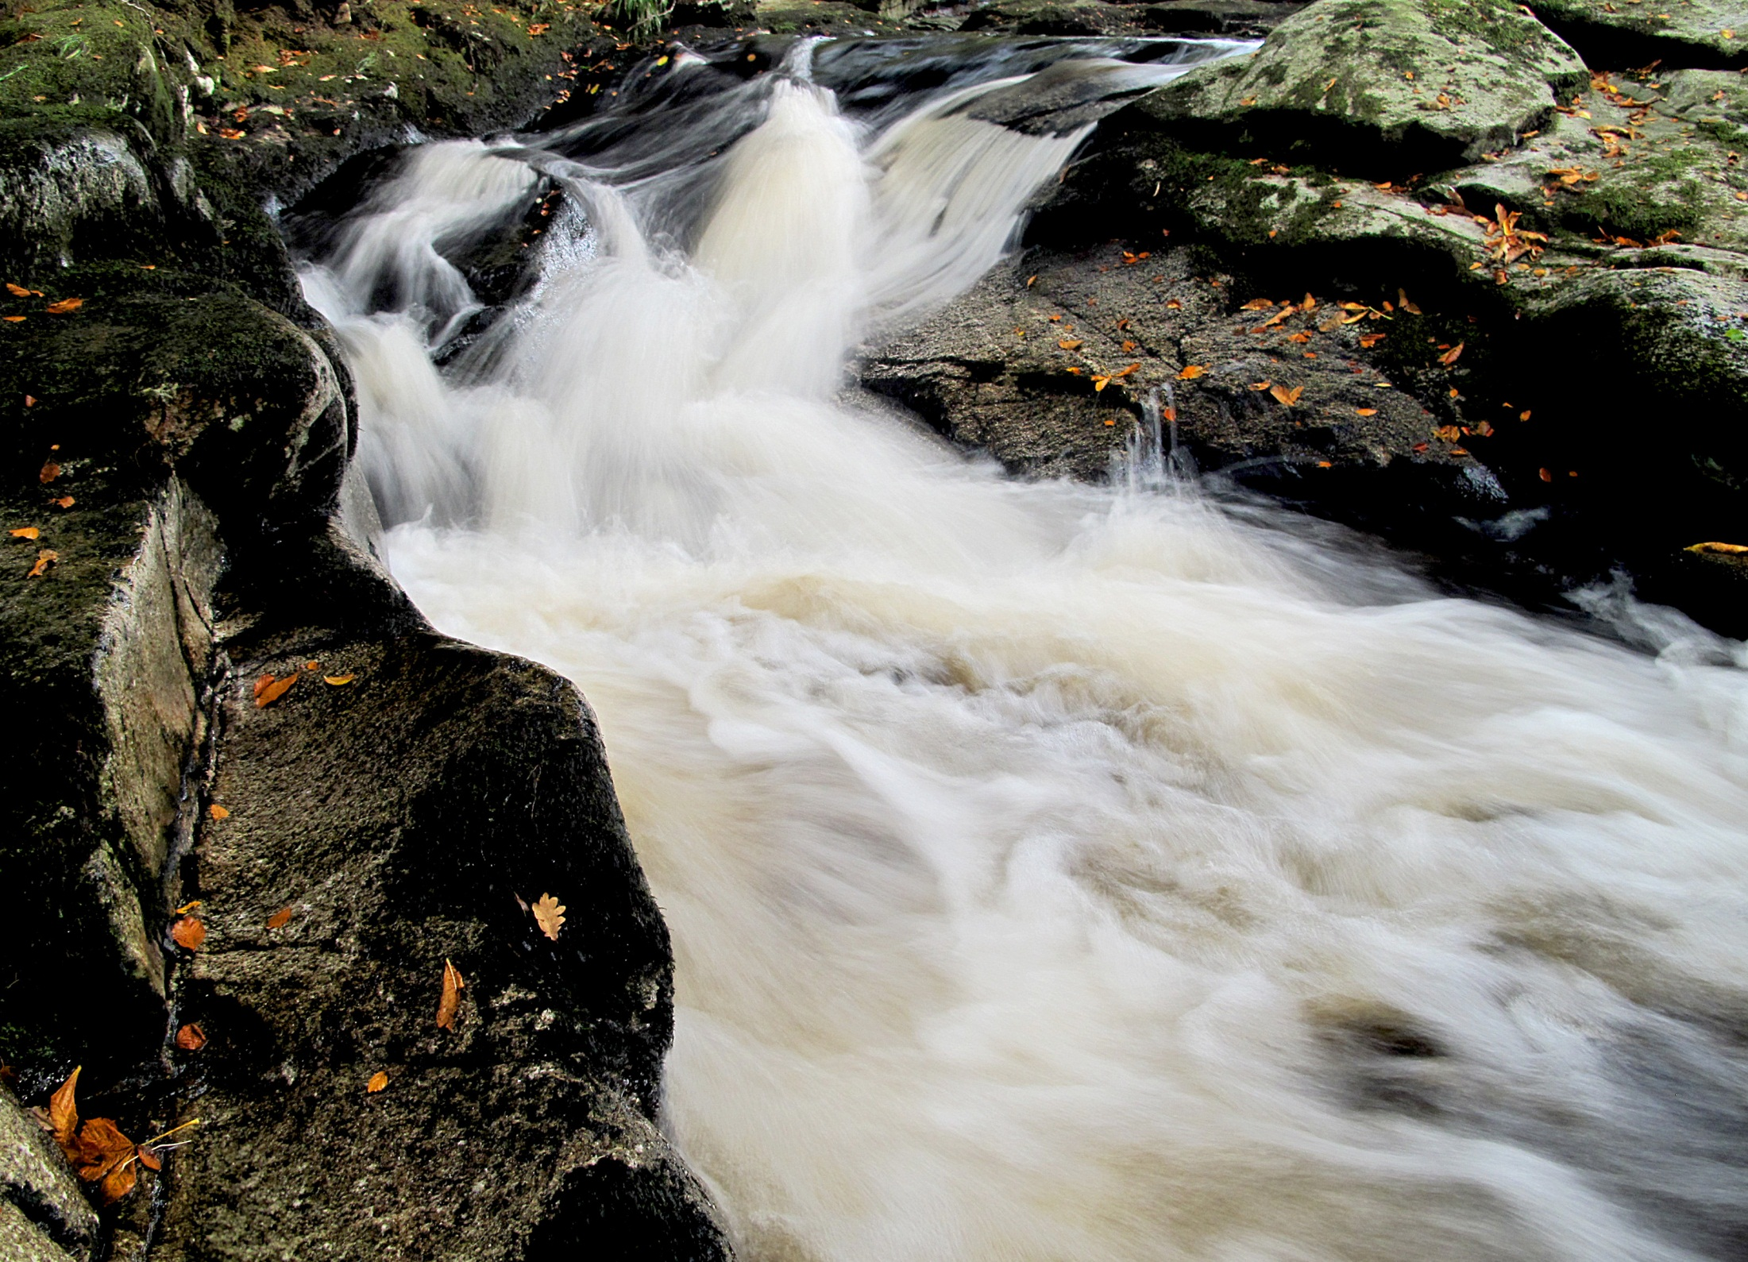
Swirl us around
again in that
fountain of life;

Slide 9
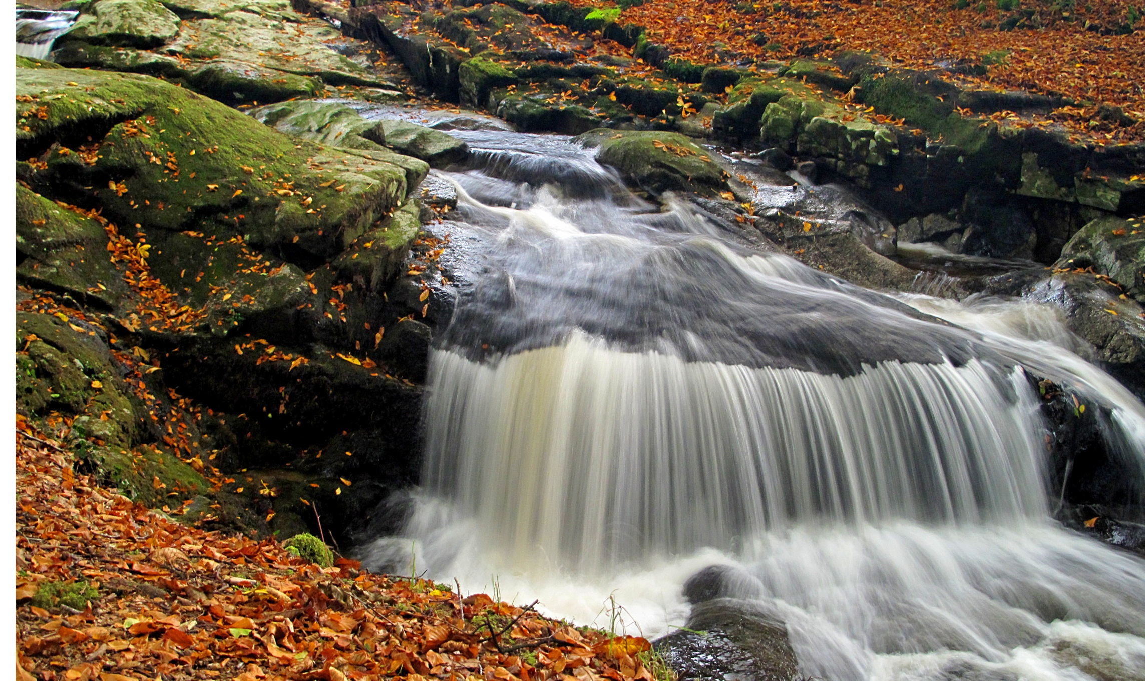
Immerse us in our One Source -
- the flow
of Mercy
surging
in our veins.

