Slide 1
The steadfast love
of the Lord
never ceases.
(Lam. 3:22-23)

Slide 2
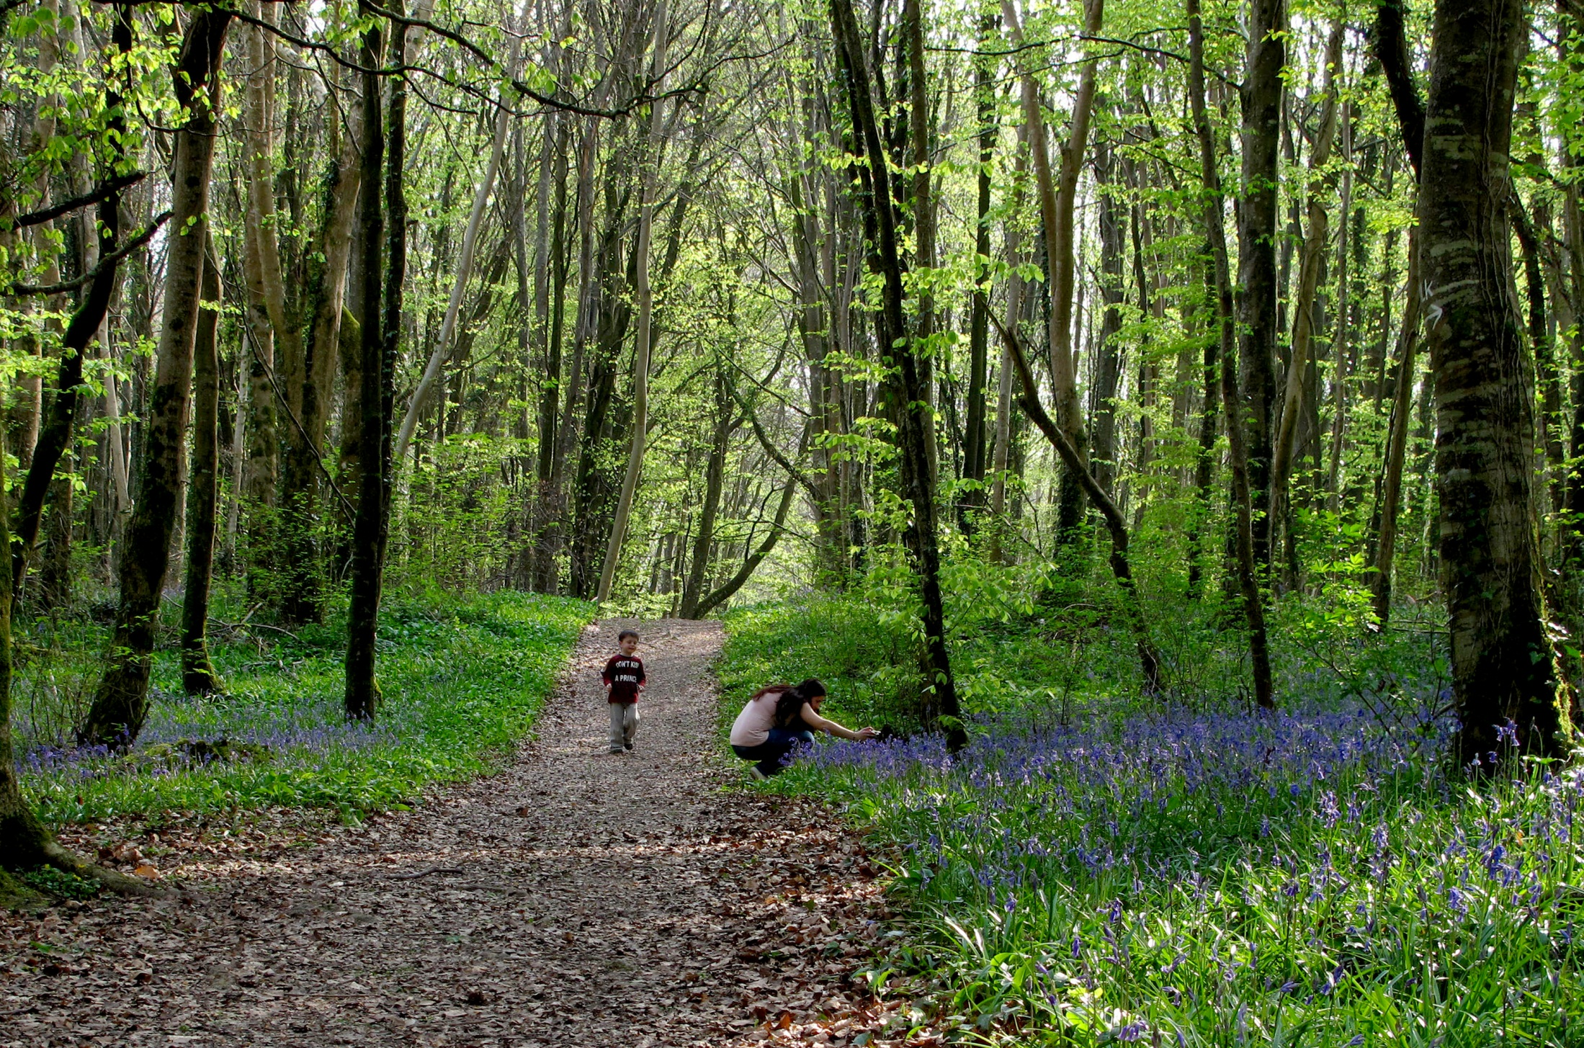
God’s mercies never come to an end;
they are new every morning. (Lam. 3:22-23)

Slide 3
Great
is
Your
faithfulness.
(Lam. 3:22-23)

Slide 4
Pause for Reflection

Slide 5
What does the Lord require of you?

Slide 6
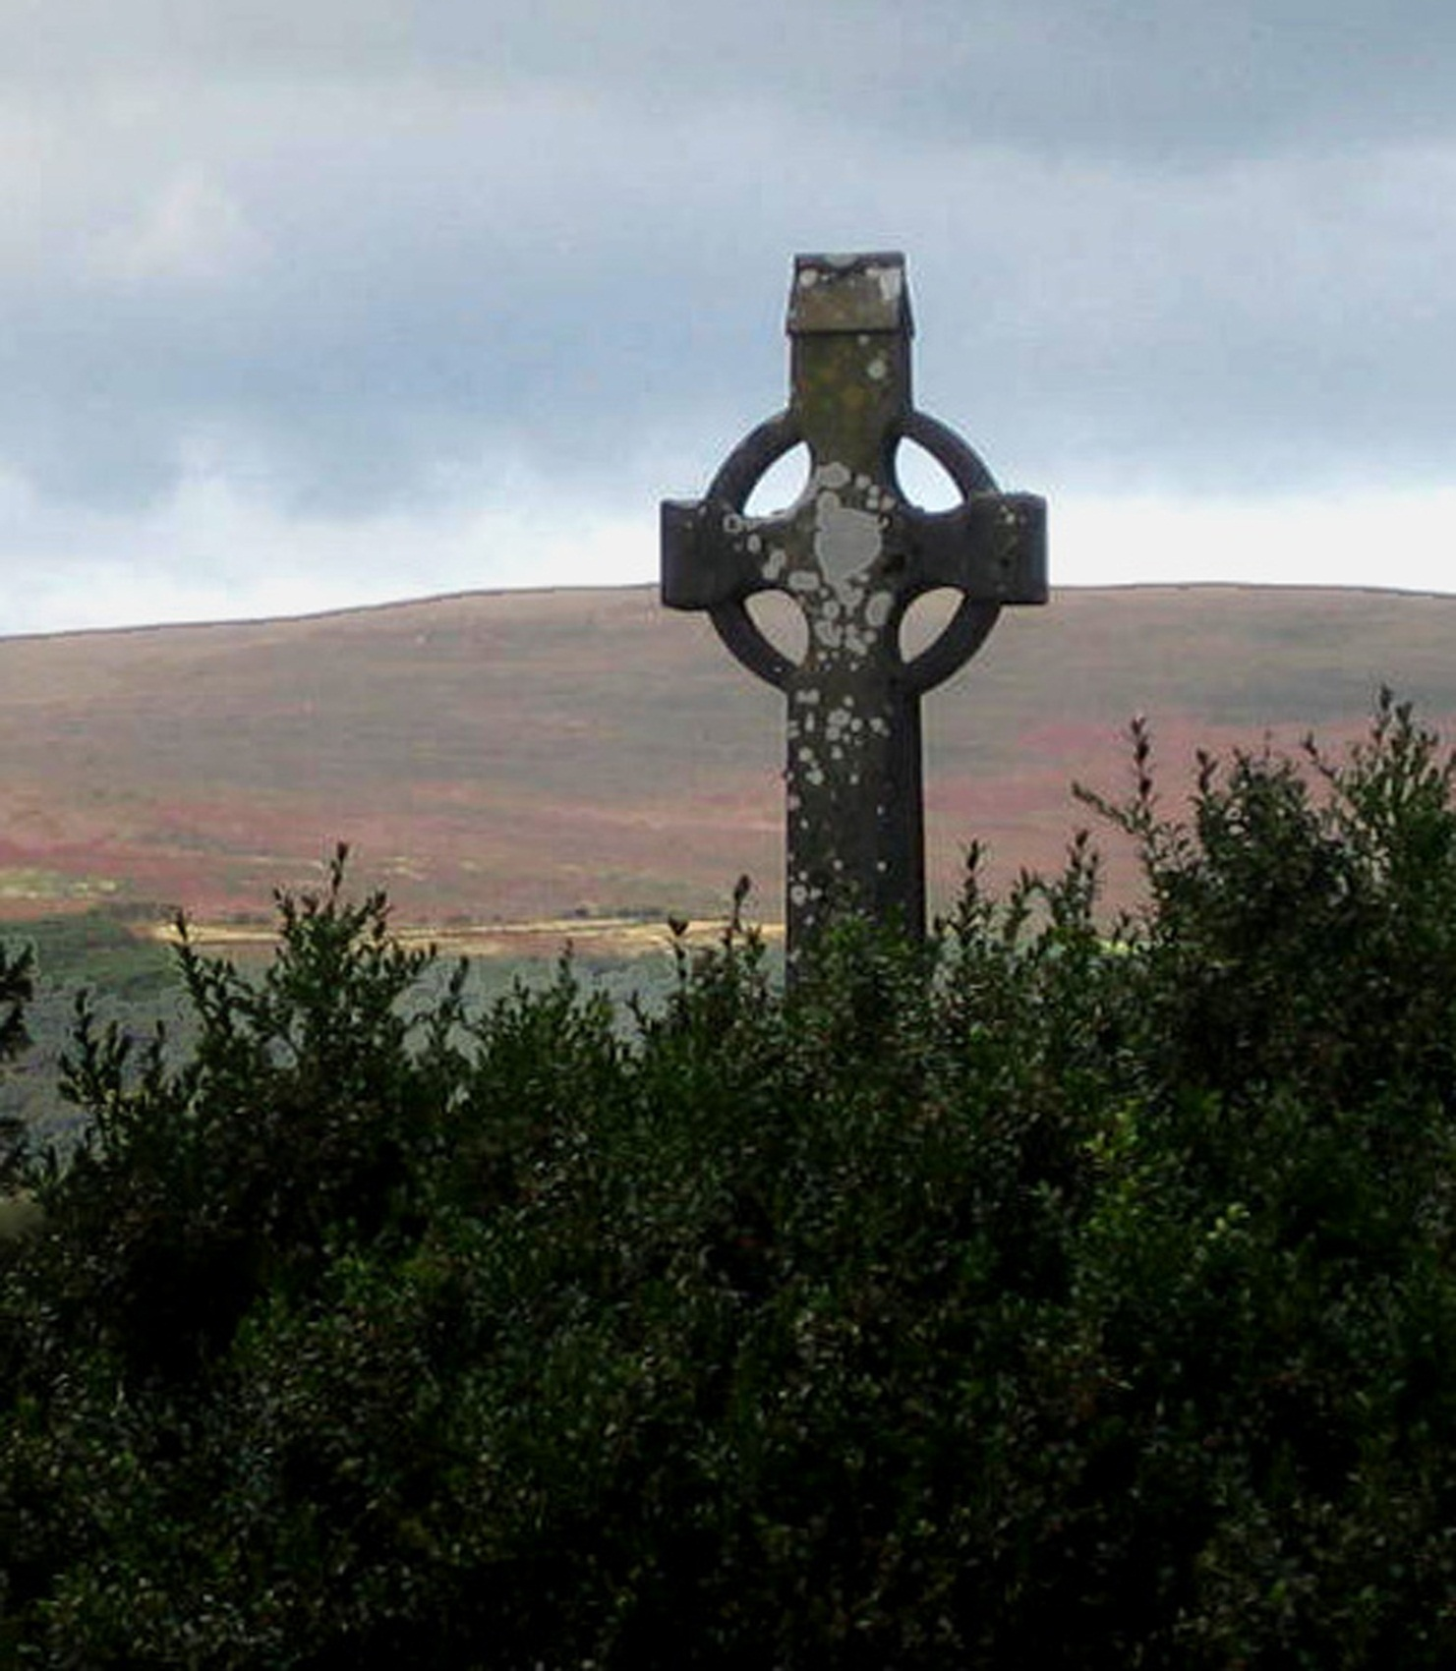
…To
act
justly…

Slide 7
…To
love
tenderly…

Slide 8
…To
walk
humbly
with
your
God.
(Micah 6:8)

Slide 9
Pause for Reflection

Slide 10
There are
three things
that
are prized
more highly
than
gold,
though
they cost
the donor
nothing… (C. McAuley)

Slide 11
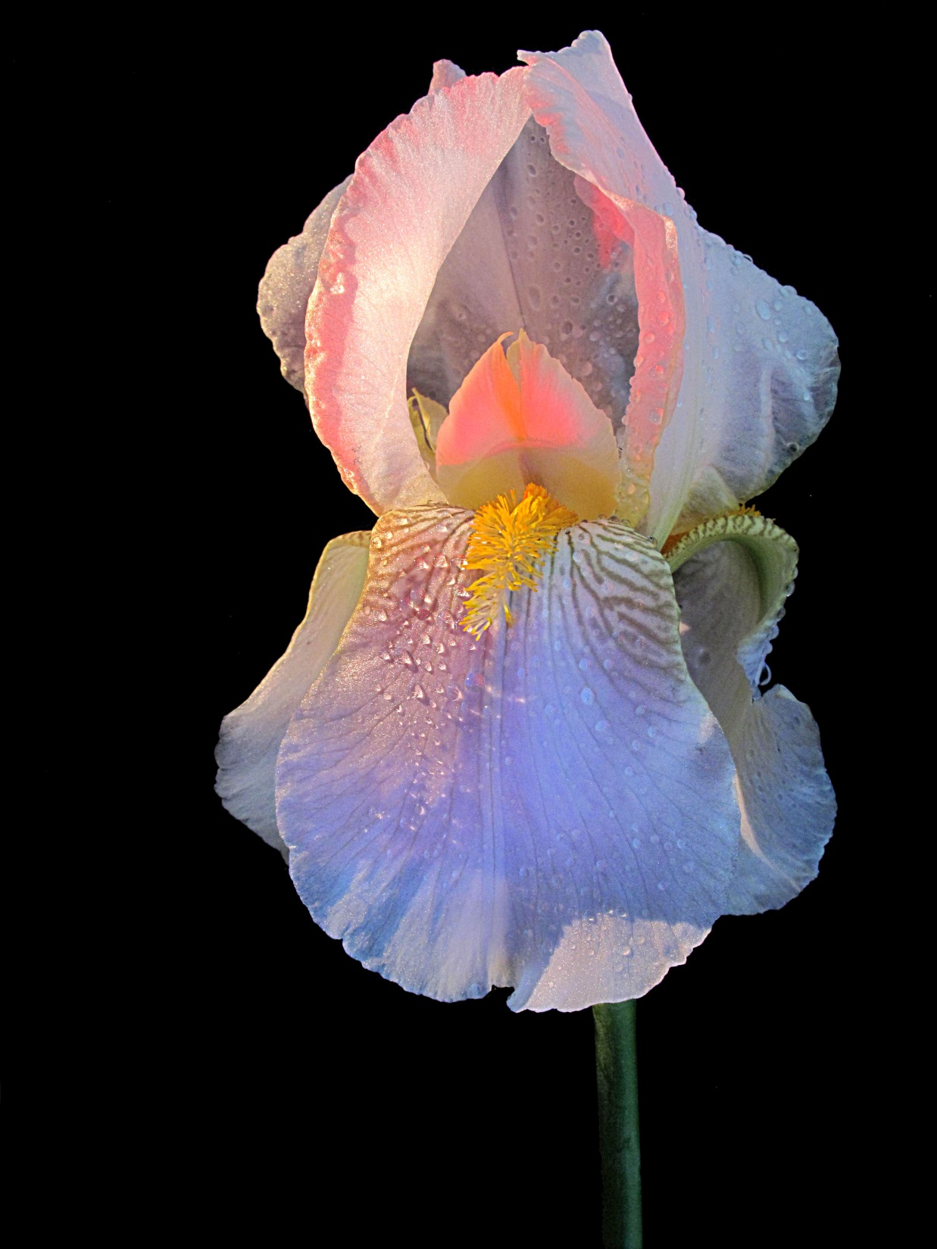
…the kind word….
(C. McAuley)

Slide 12
…the
gentle,
compassionate
look …
(C. McAuley)

Slide 13
… and the
patient hearing
of sorrows.
(C. McAuley)

Slide 14
Pause for Reflection

