Slide 1
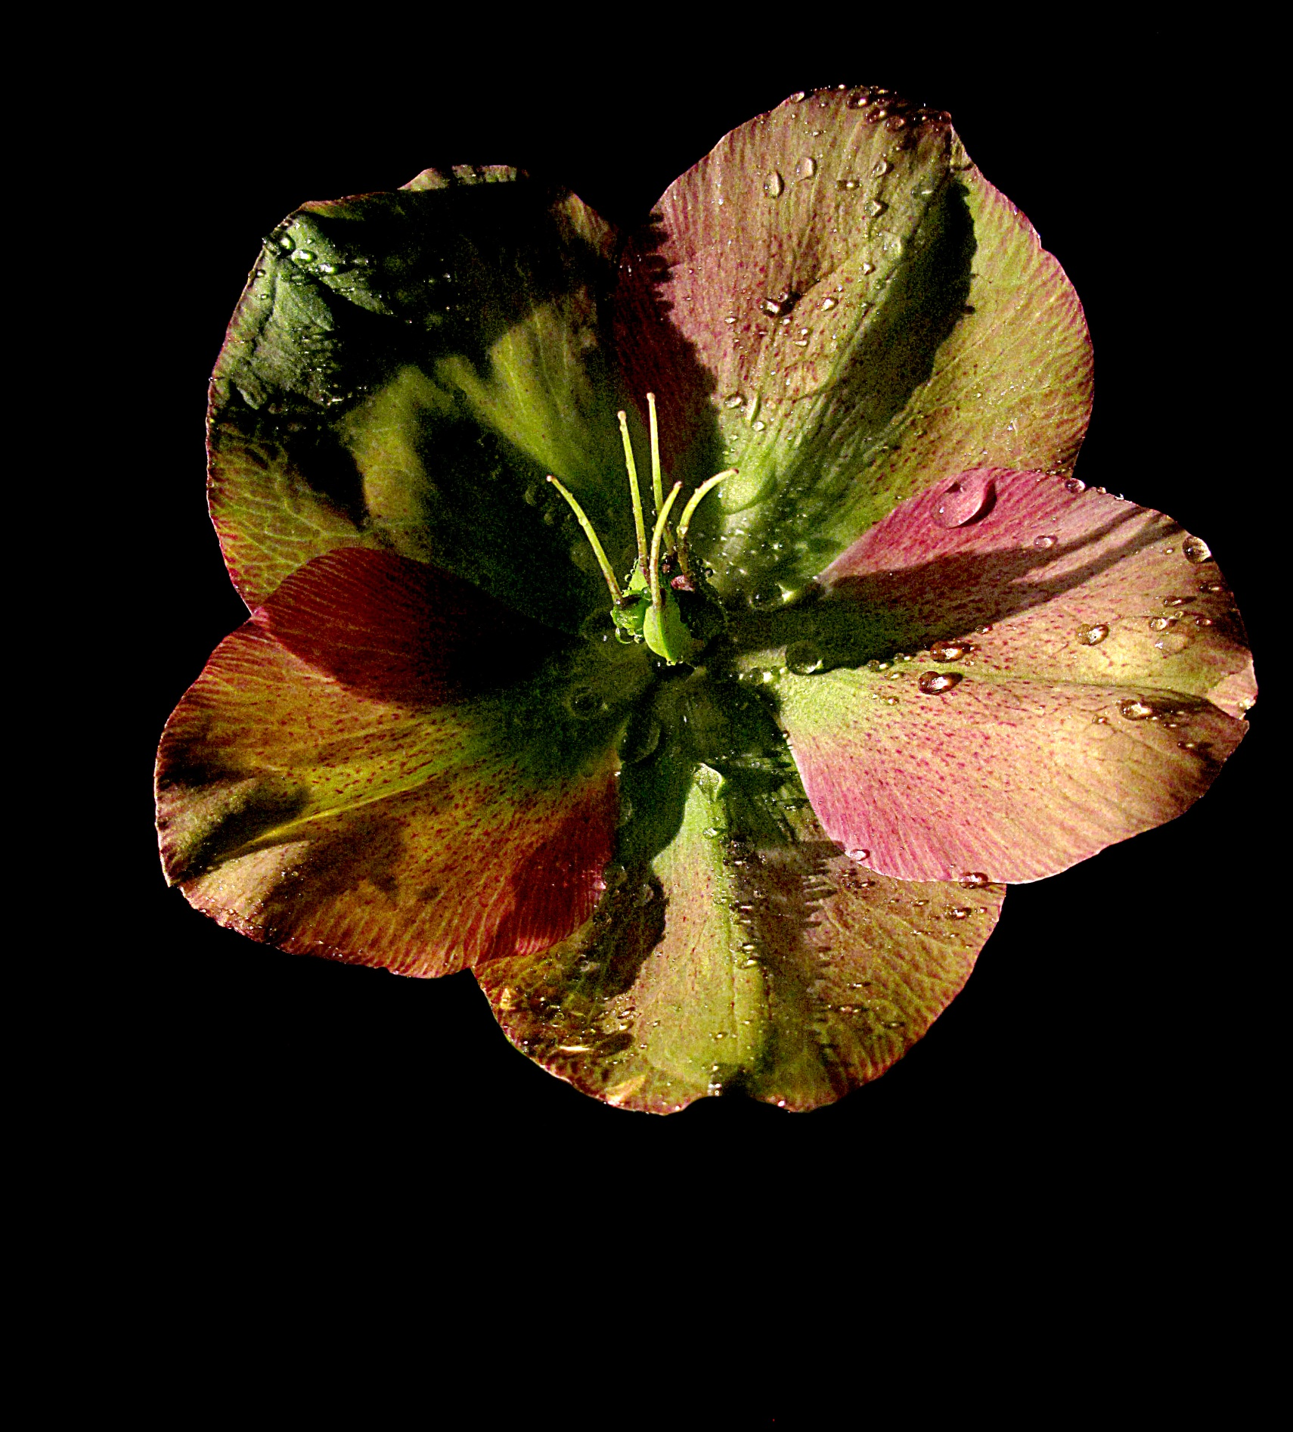
Mercy
is the name
of our
God
and
without mercy
we are
lost.
(Pope Francis)

Slide 2
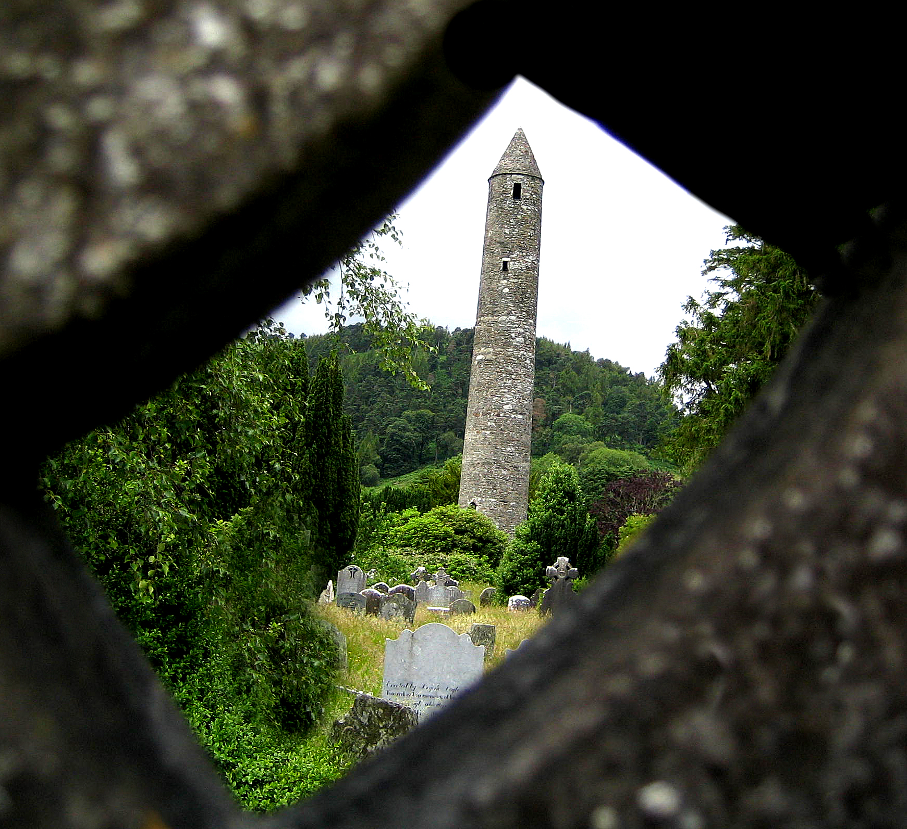
Hearing
the word
‘Mercy’
changes
everything…
...it changes the world.
(Pope Francis)

Slide 3
Mercy ….
is the Lord’s
most powerful
message.
(Pope Francis)

Slide 4
It is not easy
to entrust oneself to
God’s mercy,
because
it is an abyss
beyond
our
comprehension –
but
we must!
(Pope Francis)

Slide 5
God’s mercy
lovingly heals
the wounds
of sin.
(Pope Francis)

Slide 6
Be ministers of Mercy
- above all else.
(Pope Francis)

Slide 7
Pause for Reflection

