Slide 1
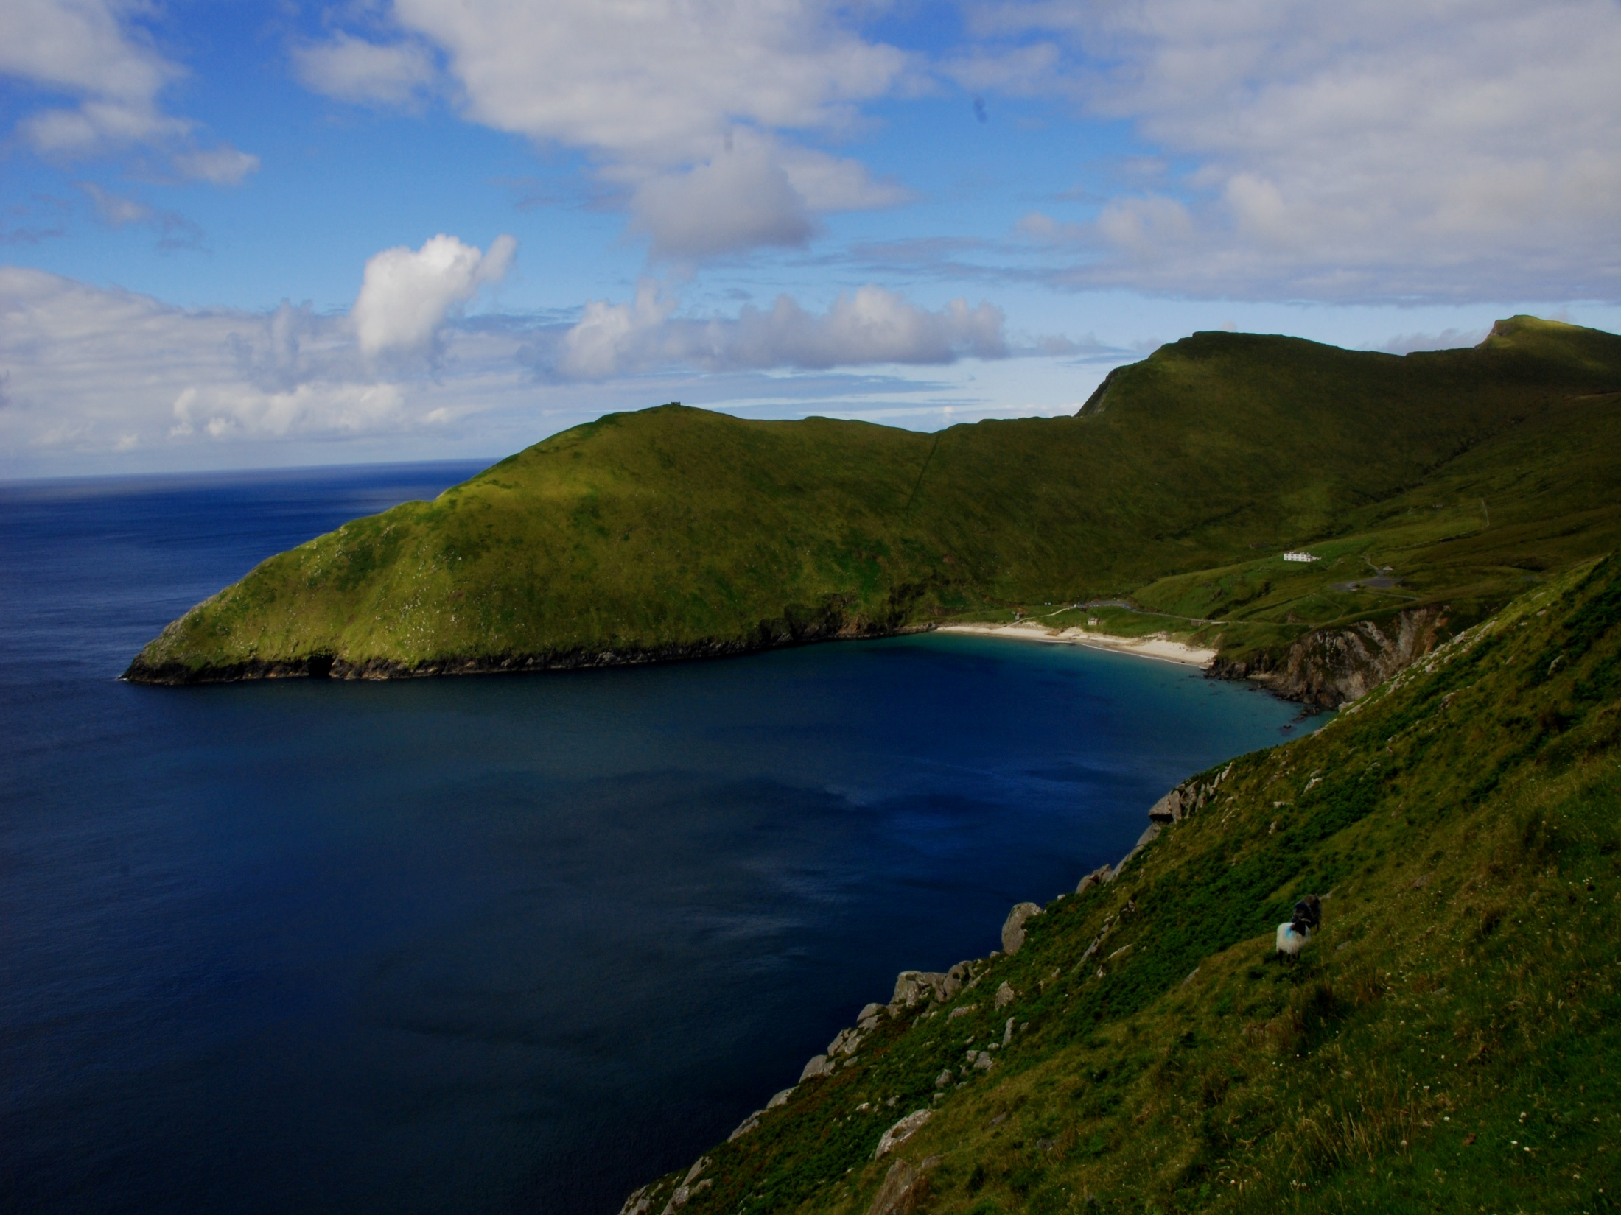
In Ireland and Great Britain...
Our hearts are centered in God

Slide 2
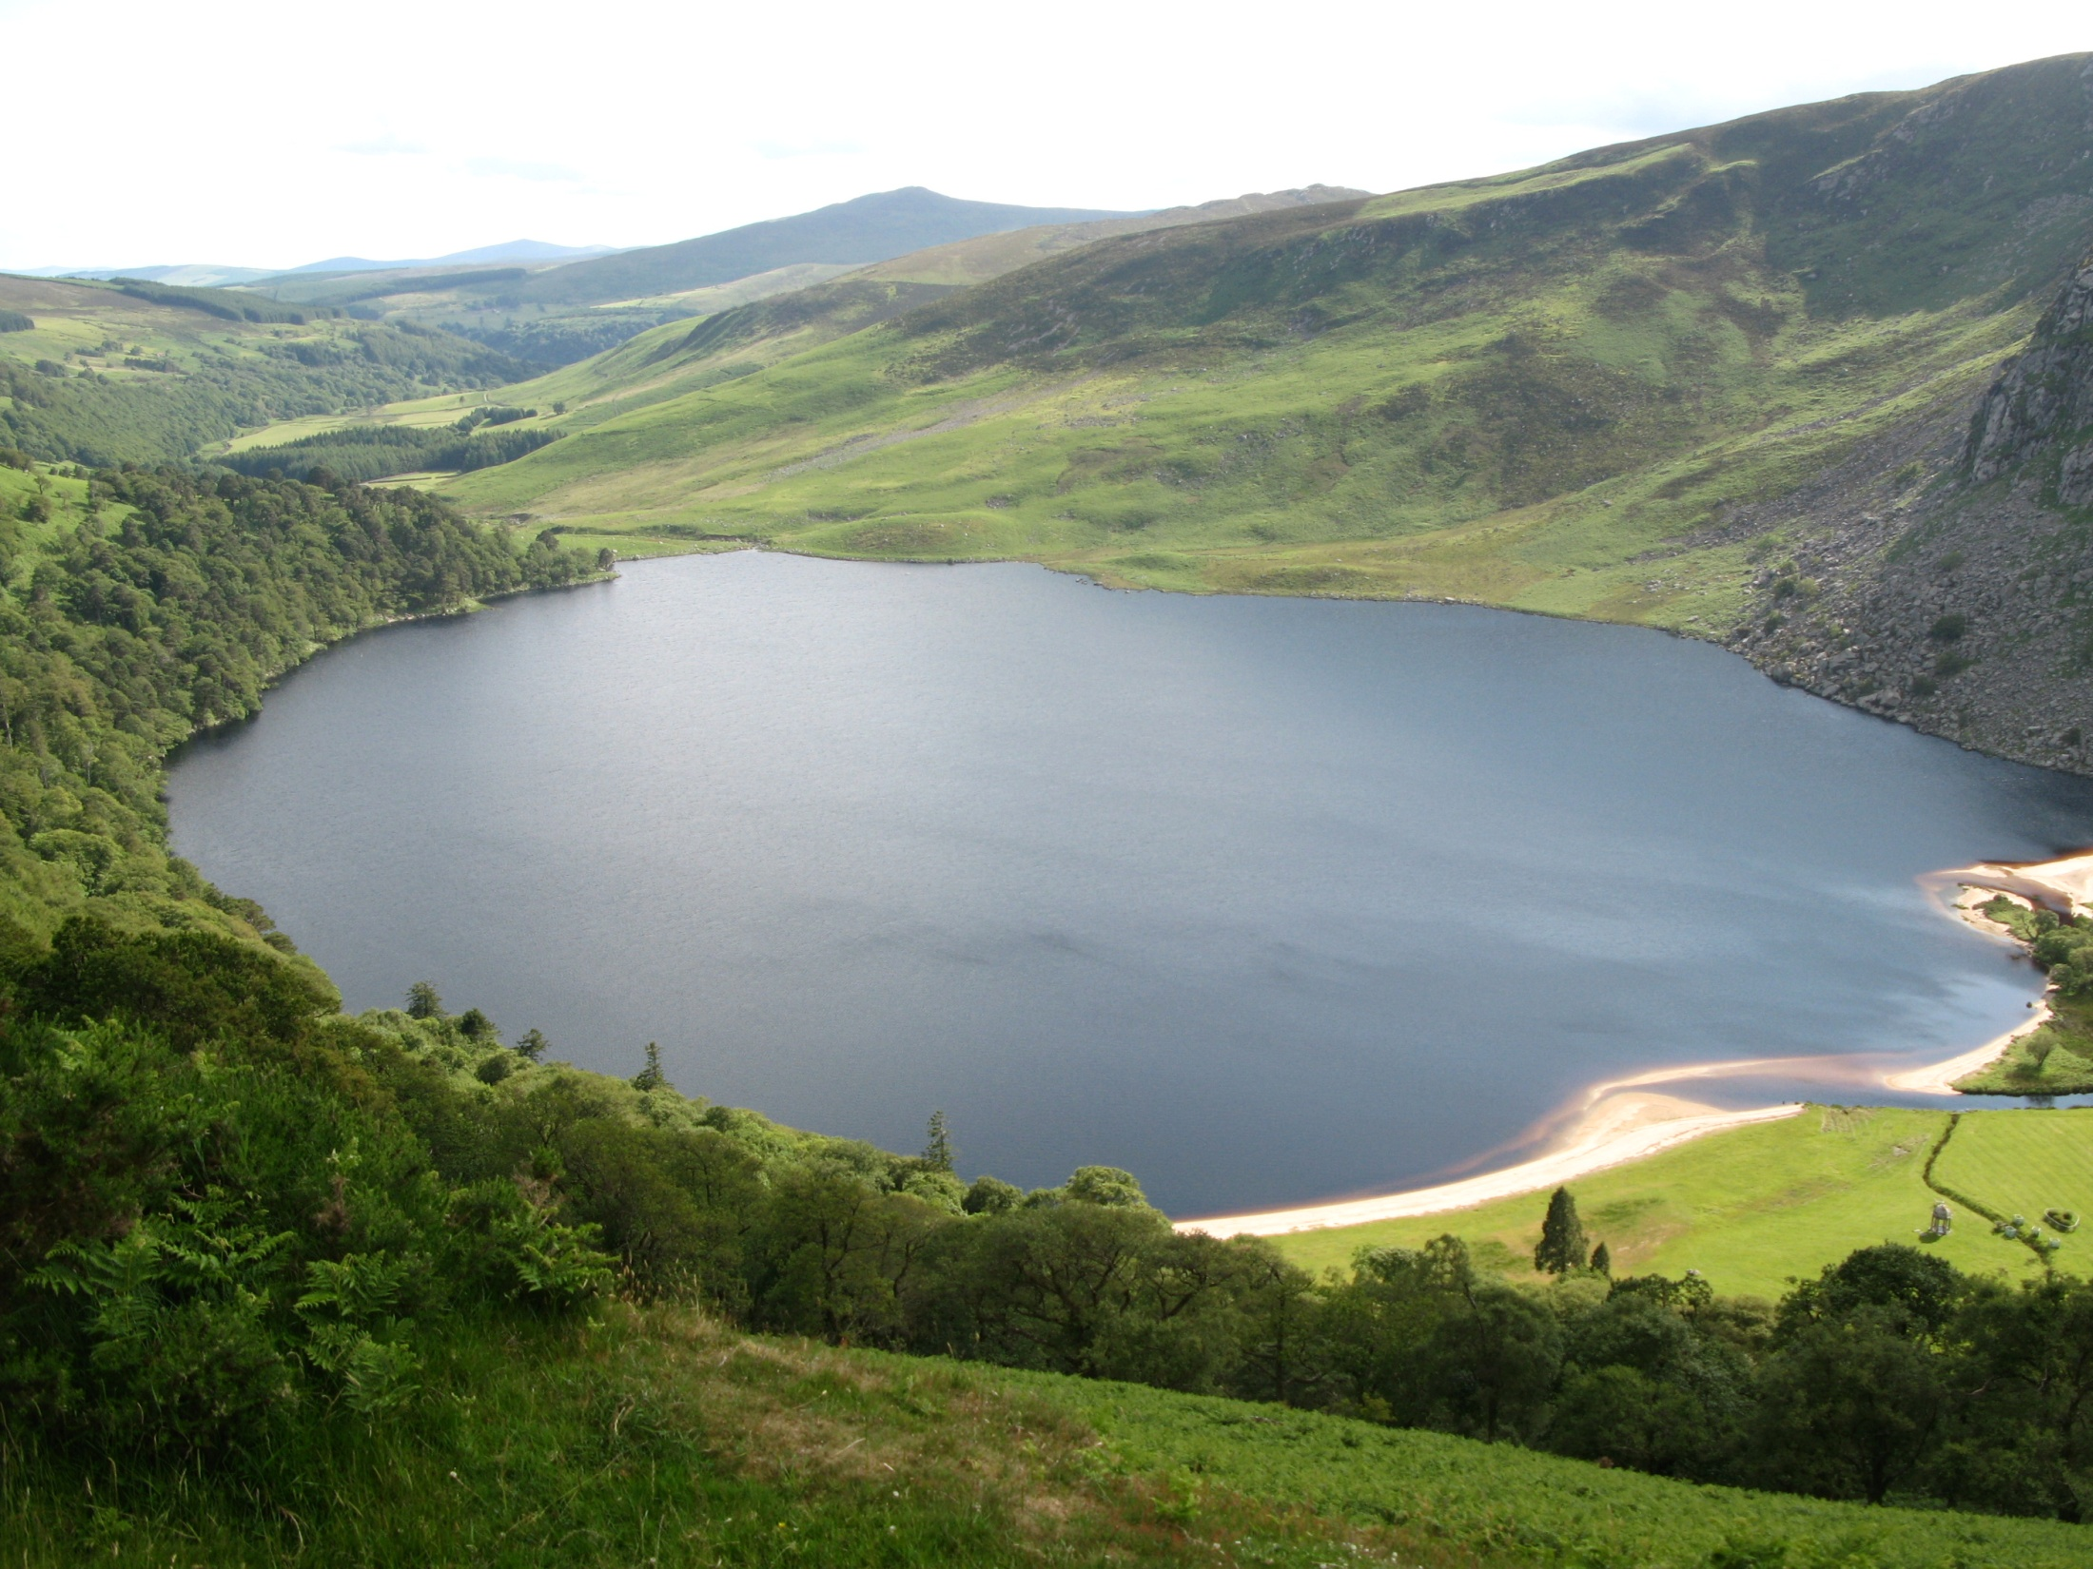
In North and South America...
Our hearts are centered in God

Slide 3
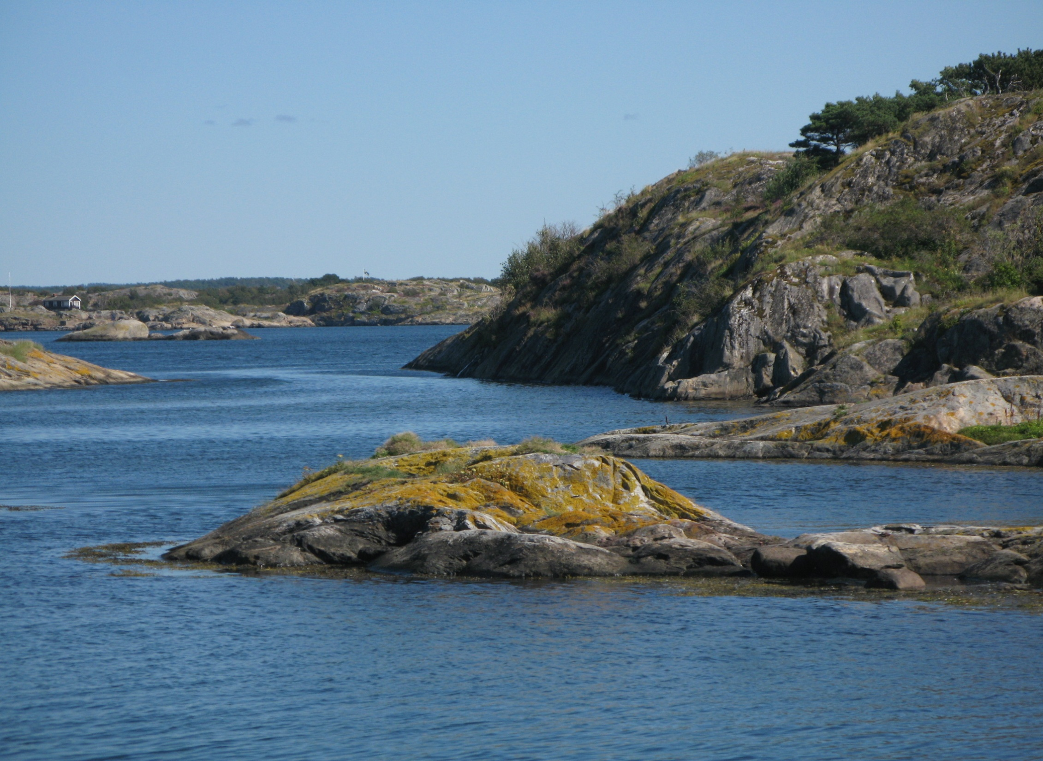
In Africa – North and South...
Our hearts are centered in God

Slide 4
In Australia, Papua New Guinea...
Our hearts are centered in God

Slide 5
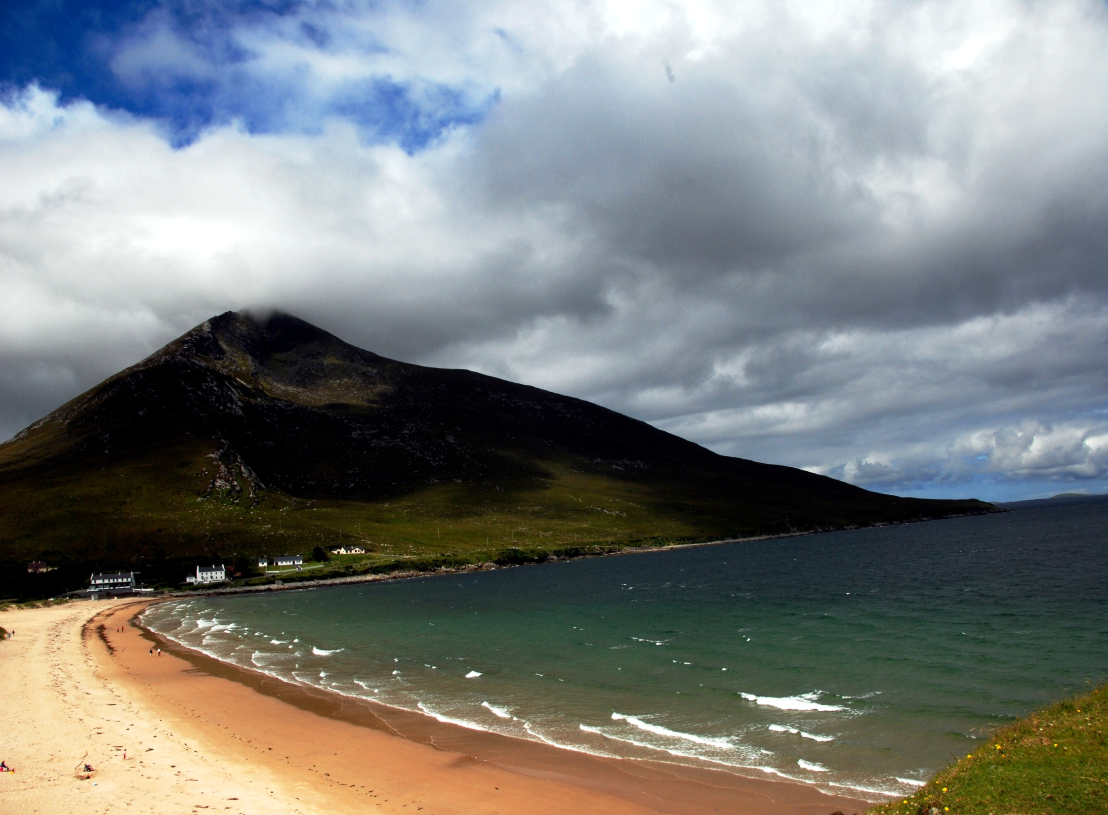
In Aotearoa New Zealand...
Our hearts are centered in God

Slide 6
In Newfoundland and the Philippines...
Our hearts are centered in God

Slide 7
Within our families, neighbourhood and with our co-workers...
Our hearts are centered in God

Slide 8
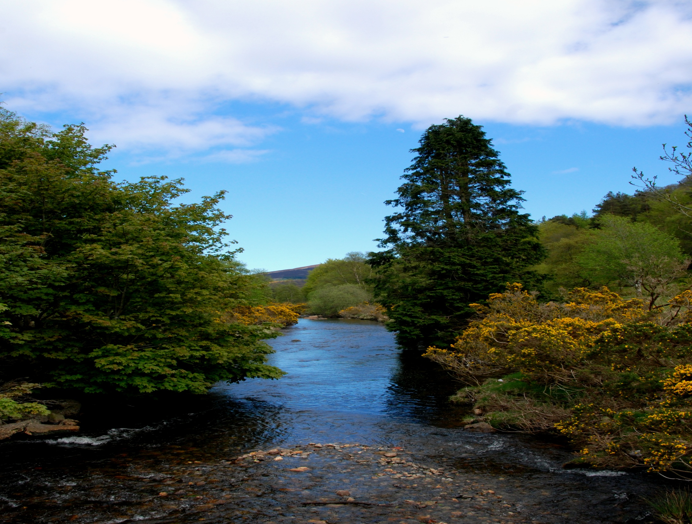
Wherever there is a Mercy presence ...
Our hearts are centered in God

Slide 9
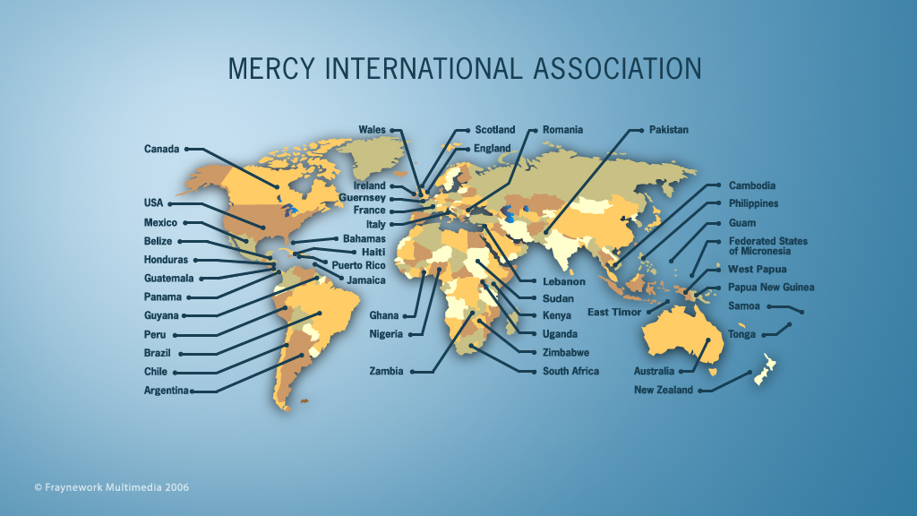
Our hearts are centered in God

