Slide 1
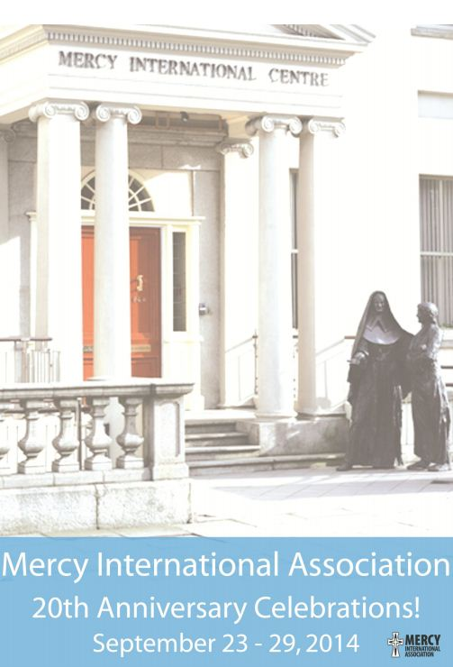

Slide 4
Our gratitude to all
who made this possible.....

Slide 5
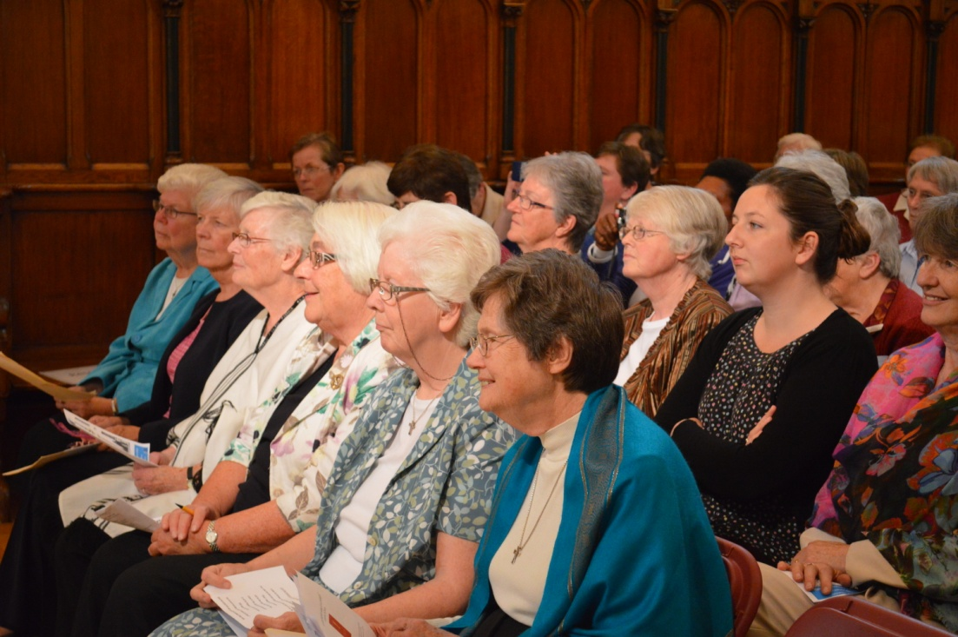
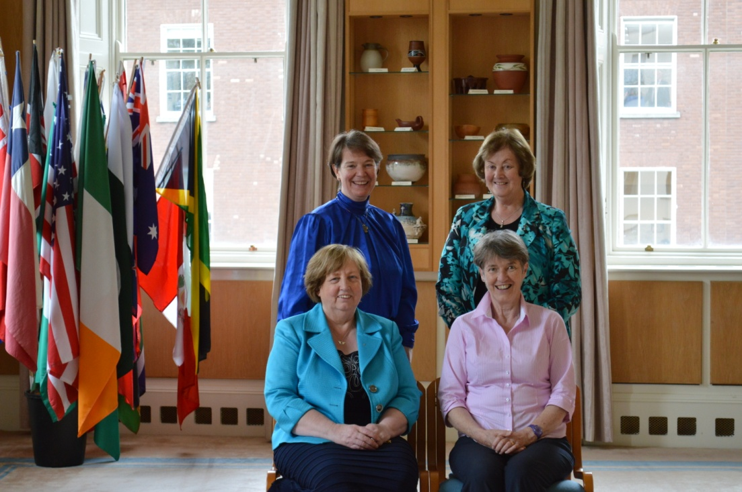

Slide 6
MIA Members:
Sheila Burke rsm, Carmella Cabactulan rsm,
Anne Campbell rsm, Margaret Casey rsm,
Loreto Conroy rsm, Colette Cronin rsm,
Elizabeth Davis rsm, Berneice Loch rsm,
Pat McDermott rsm, Dolores Magee rsm,
Cath Reuter rsm, Catherine Ryan rsm

Slide 7
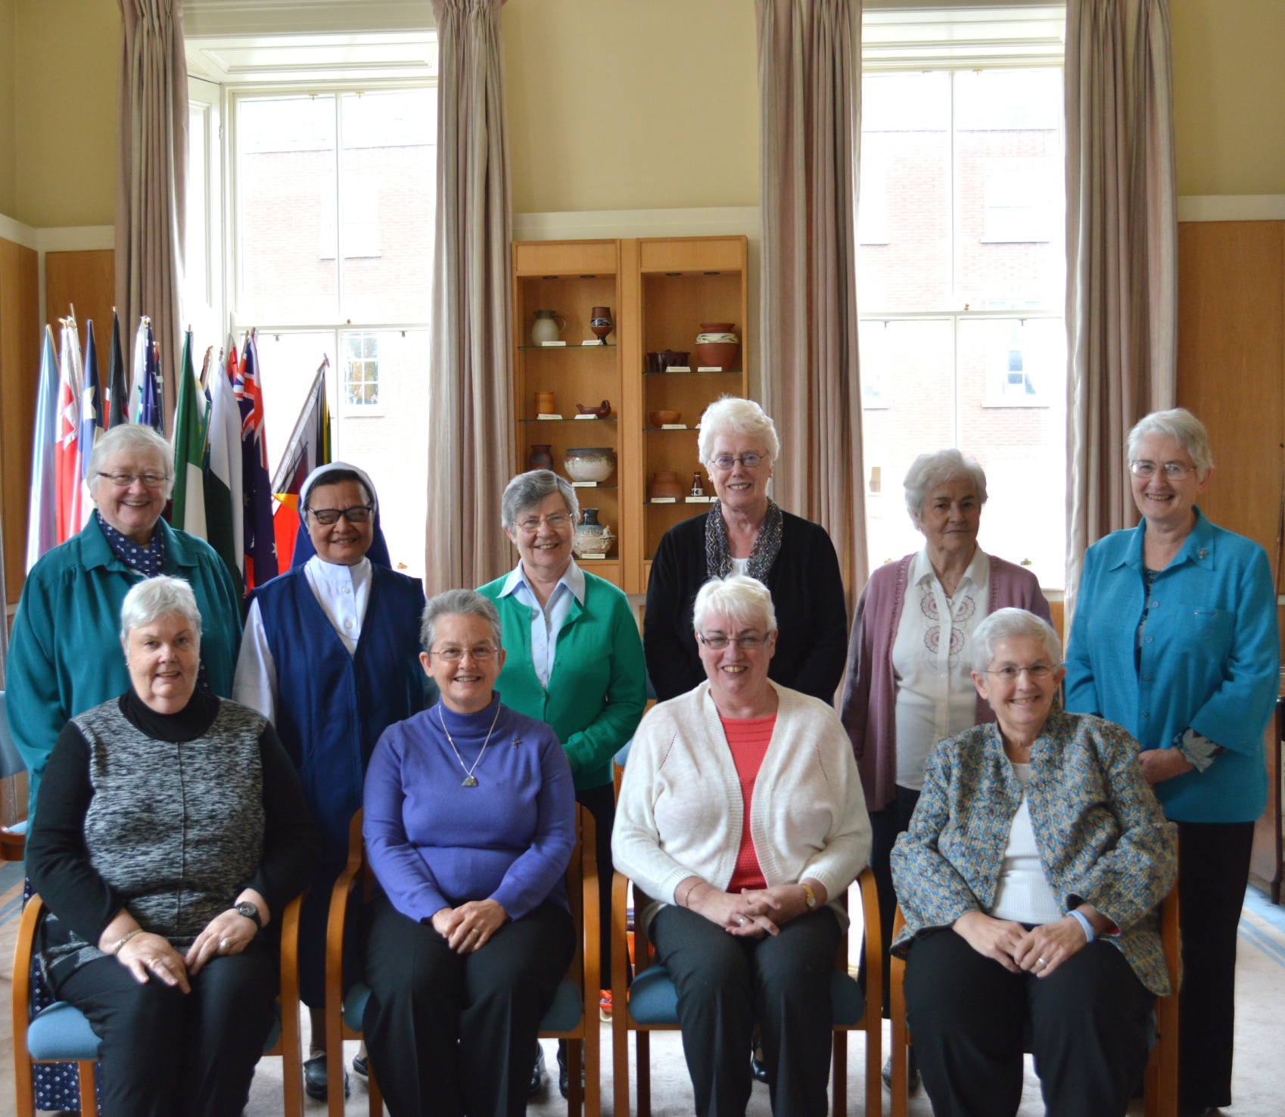

Slide 8
MIA Board of Directors:
Ron Ashworth, Peter Burnett,
Margaret Casey rsm, Colette Cronin rsm
Denise Fox rsm, Maura Hyland,
Pat McDermott rsm, James Peppiatt-Combes

Slide 9
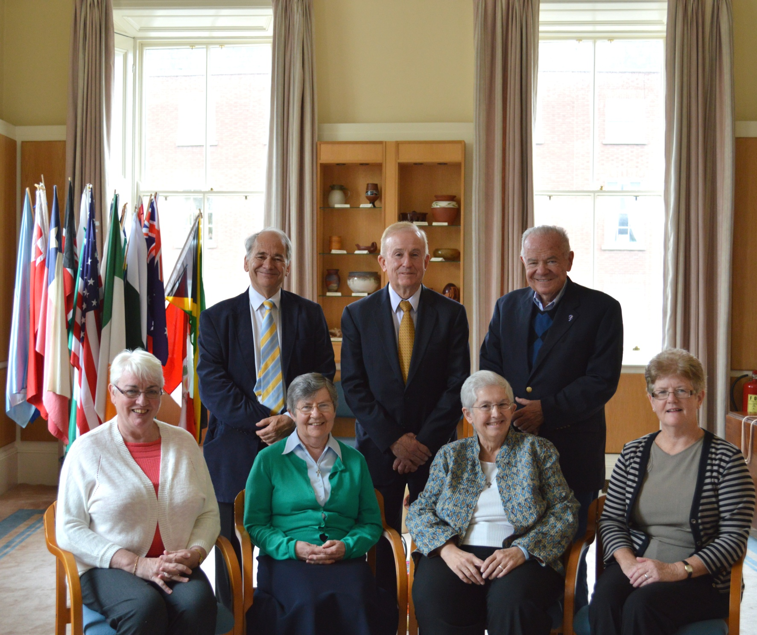

Slide 10
MIA Team:
Mary Reynolds rsm,
Denise Boyle fmdm,
Mary Kay Dobrovolny rsm,
Sylvia Williams rsm

Slide 11
MIA Support Staff:
Germano Carvalho Dias, Sara Druhan,
Kathy Higgins rsm, Betty Lacey,
Andy Lawless, Gillian McAllen,
Louise O’Driscoll, Madeleine O’Hanlon,
Liz O’Sullivan, Joseph Tomina Dabitora

Slide 13
MIA Volunteers:
Catherine Gibbons rsm,
Anne Hetherington rsm, Carita Irwin rsm,
Nuala O’Gorman rsm, Carmel Setford rsm

Slide 16
MIA Communications Team:
Anne Walsh, Adele Howard rsm,
Sara Druhan, Ailish O’Brien rsm,
Fr Bill Kemmy, Raymond Beggan,
Sandor Gera

Slide 17
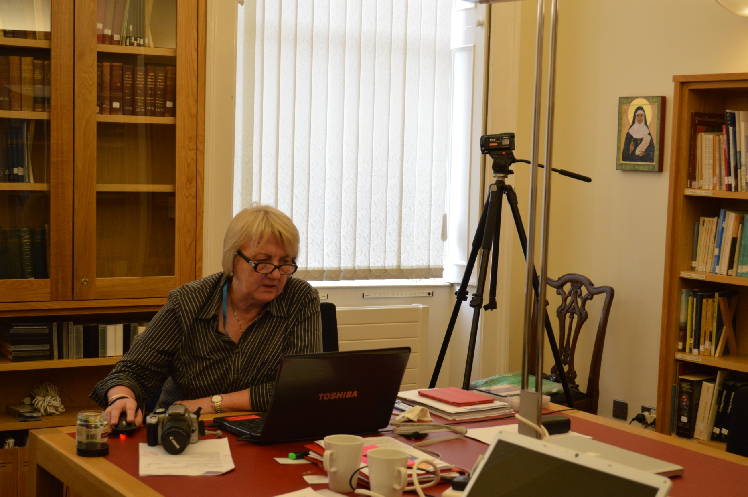

Slide 18
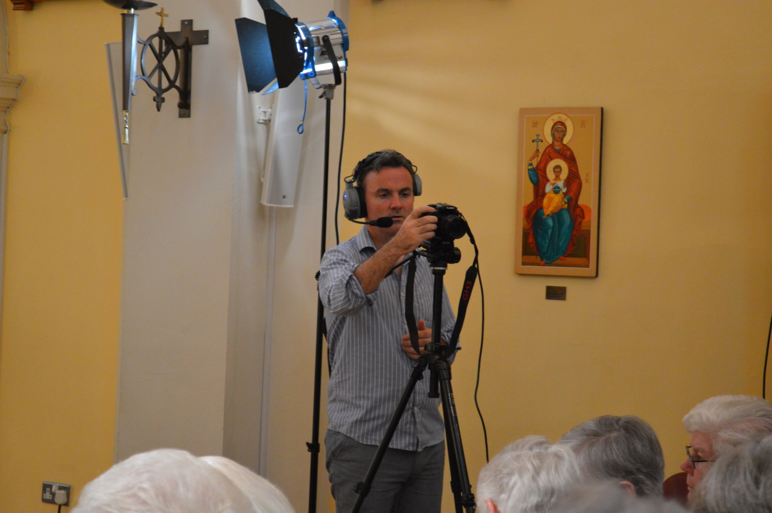

Slide 20
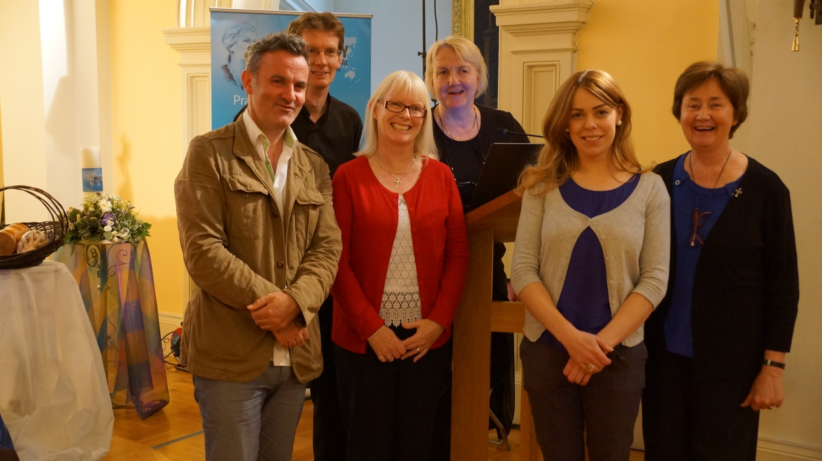

Slide 21
Photographic Exhibition Producer:
Adele Howard rsm

Slide 22
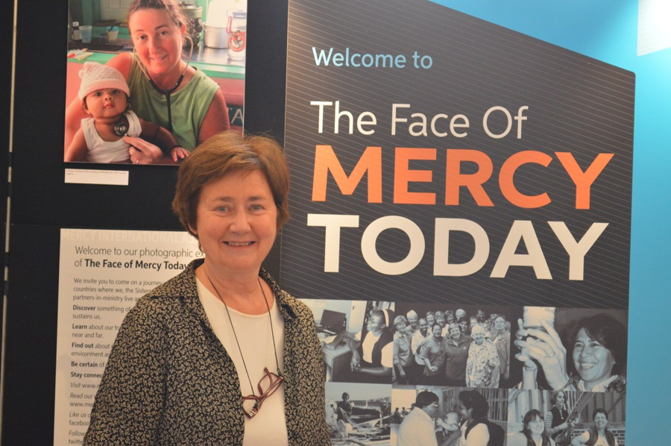

Slide 23
Point People for Rituals
& Photographic Exhibition:
Raphael Amante rsm, Kate Anderson rsm,
Barbara Bolster rsm, Philomena Bowers rsm,
Sheila Carney rsm, Breda Coman rsm, Margaret Duffy rsm,
Margaret Farrell rsm, Anne Ferguson, Adele Howard rsm,
Stephanie Kitching rsm, Mary Lawson rsm,
Josepha Matthews rsm, Anne McMillan rsm,
Sheila O’Dea rsm, Mary-Louise Petro rsm,
Anne Walsh

Slide 24
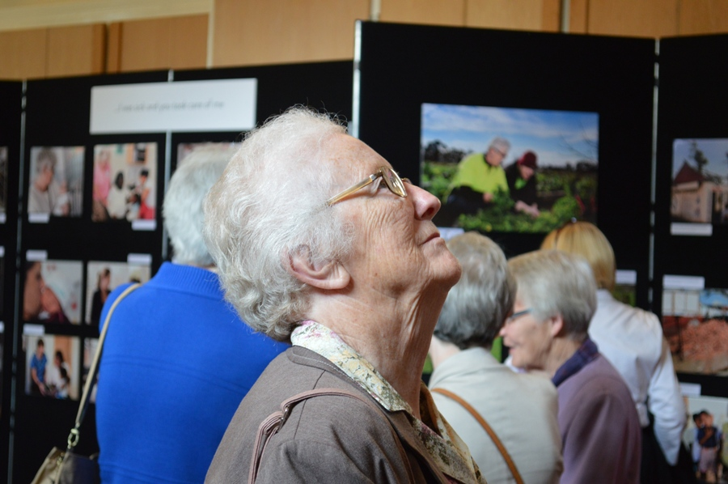
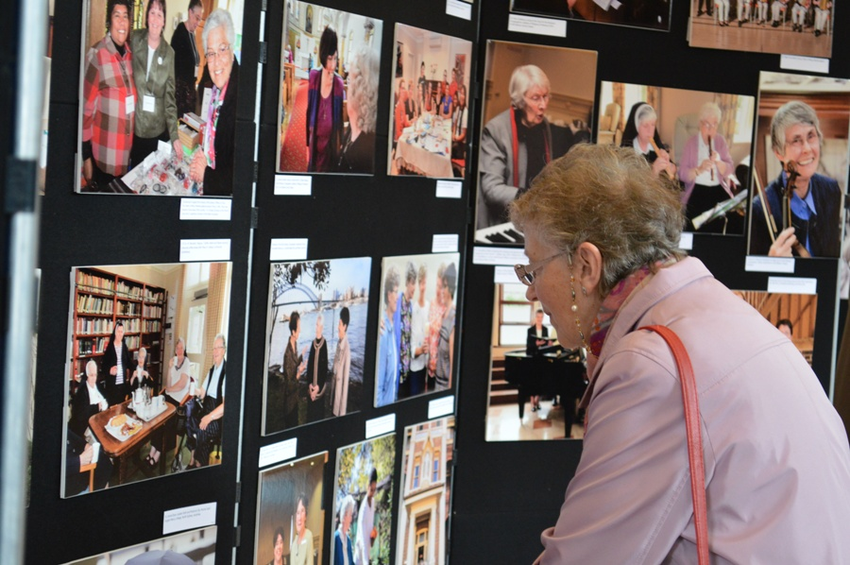
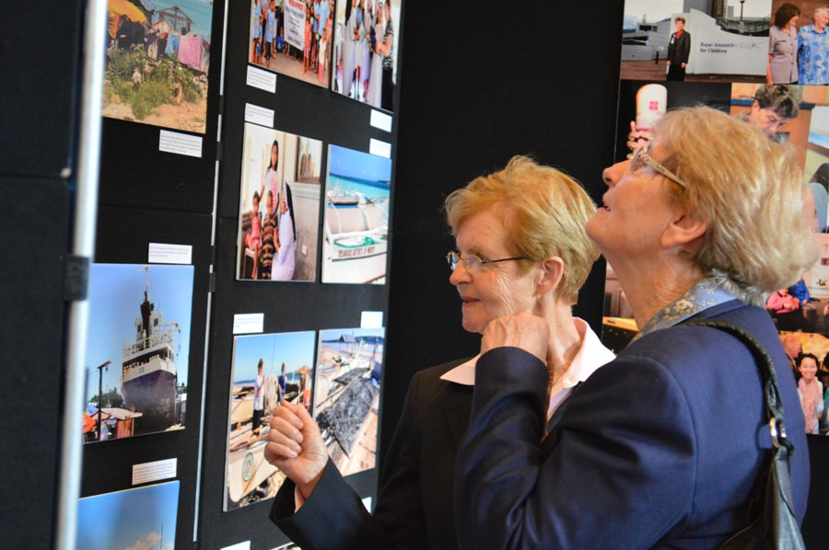
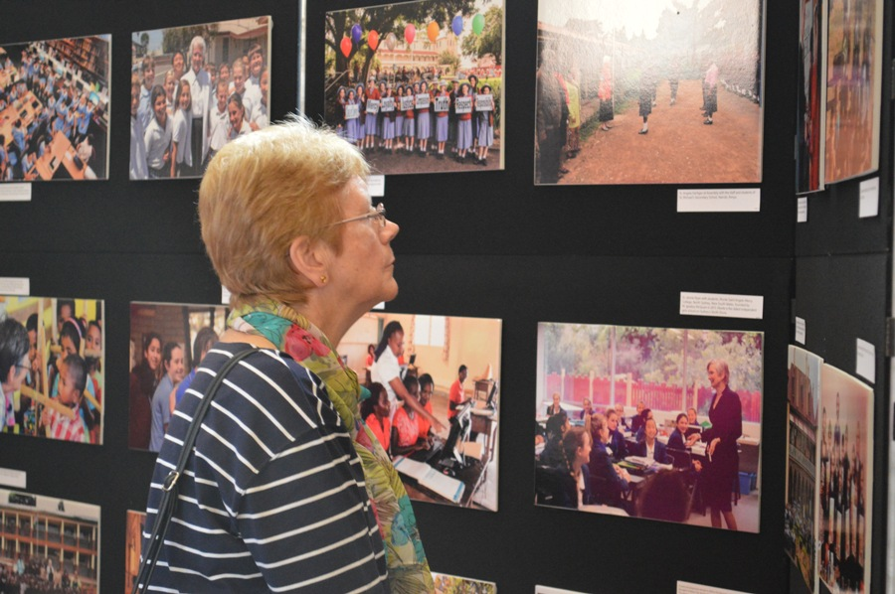

Slide 25
Irish Ritual Participants:
Carmel Bracken rsm, Bonnie Brennan rsm,
Margaret Casey rsm, Breda Coman rsm,
Caitlín Conneely rsm, Mary Conway rsm,
Veronica Ekerick rsm, Margaret Farrell rsm,
Thomasina Finn rsm, Kathleen Friel rsm,
Teresa Martin rsm, Áine McGoldrick rsm,
Nuala O’Gorman rsm, Anne Reid,
Noeleen Reilly rsm, Bernie Ryan rsm,
Scholasticah Nganda rsm

Slide 26
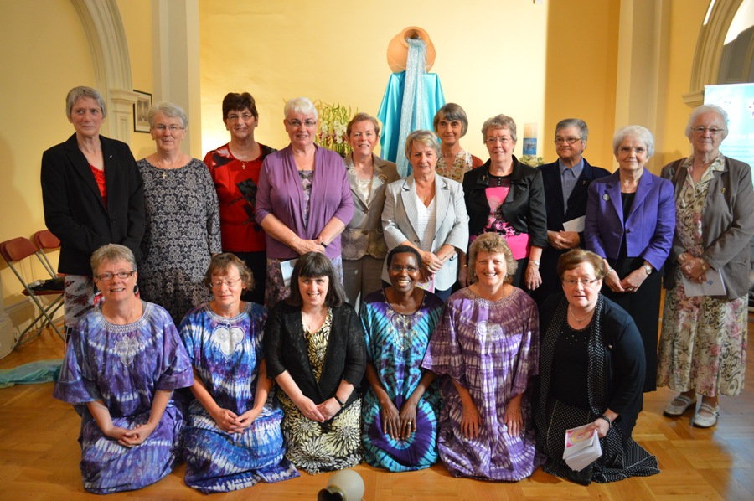

Slide 27
Great Britain Ritual Participants:
Philomena Bowers rsm, Kathleen Gooch rsm,
Barbara Jeffrey rsm, Betty Larkin rsm,
Angela Moroney rsm, Paschal O’Brien rsm,
Helen Ryan rsm, Bridie Stephens rsm,
Dominic Timmins rsm

Slide 28
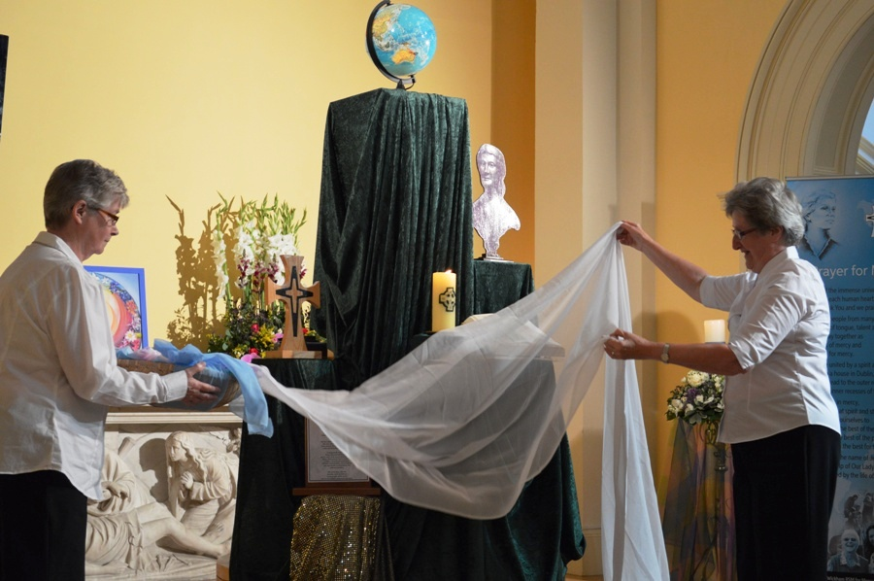

Slide 29
Australia Ritual Participants:
Barbara Bolster rsm, Rosie Carroll rsm,
Nicole Christensen, Veronica Ekerick rsm,
Ursula Gilbert rsm, Catherine Jambet rsm,
Faith Jones rsm, Margaret Jones rsm,
Anna Koeneman rsm, Jacqueline Magurren,
Nerida Tinkler rsm

Slide 30
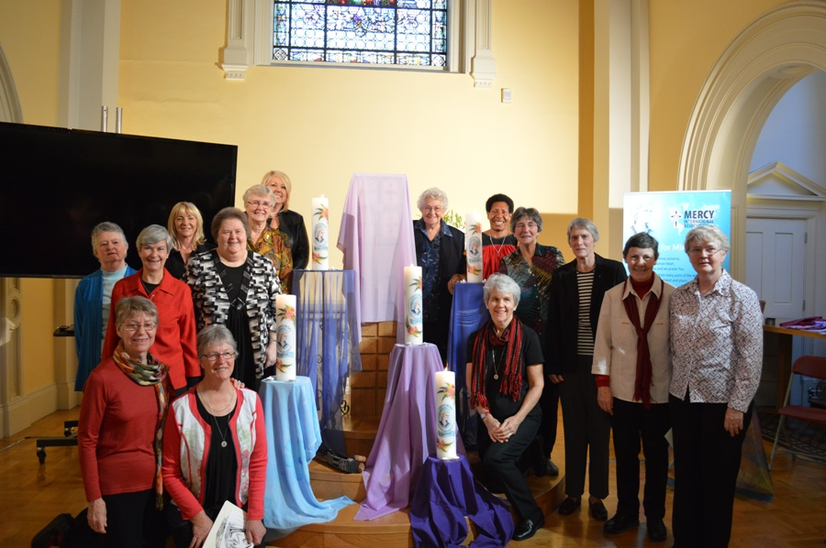

Slide 31
Philippines Ritual Participants:
Raphael Amante rsm,
Patricia Bell rsm, Philomena Bowers rsm,
Mary Geason rsm, Clare Gunning rsm,
Patricia March rsm, Jane McNamara rsm,
Nancy Whitley rsm

Slide 32
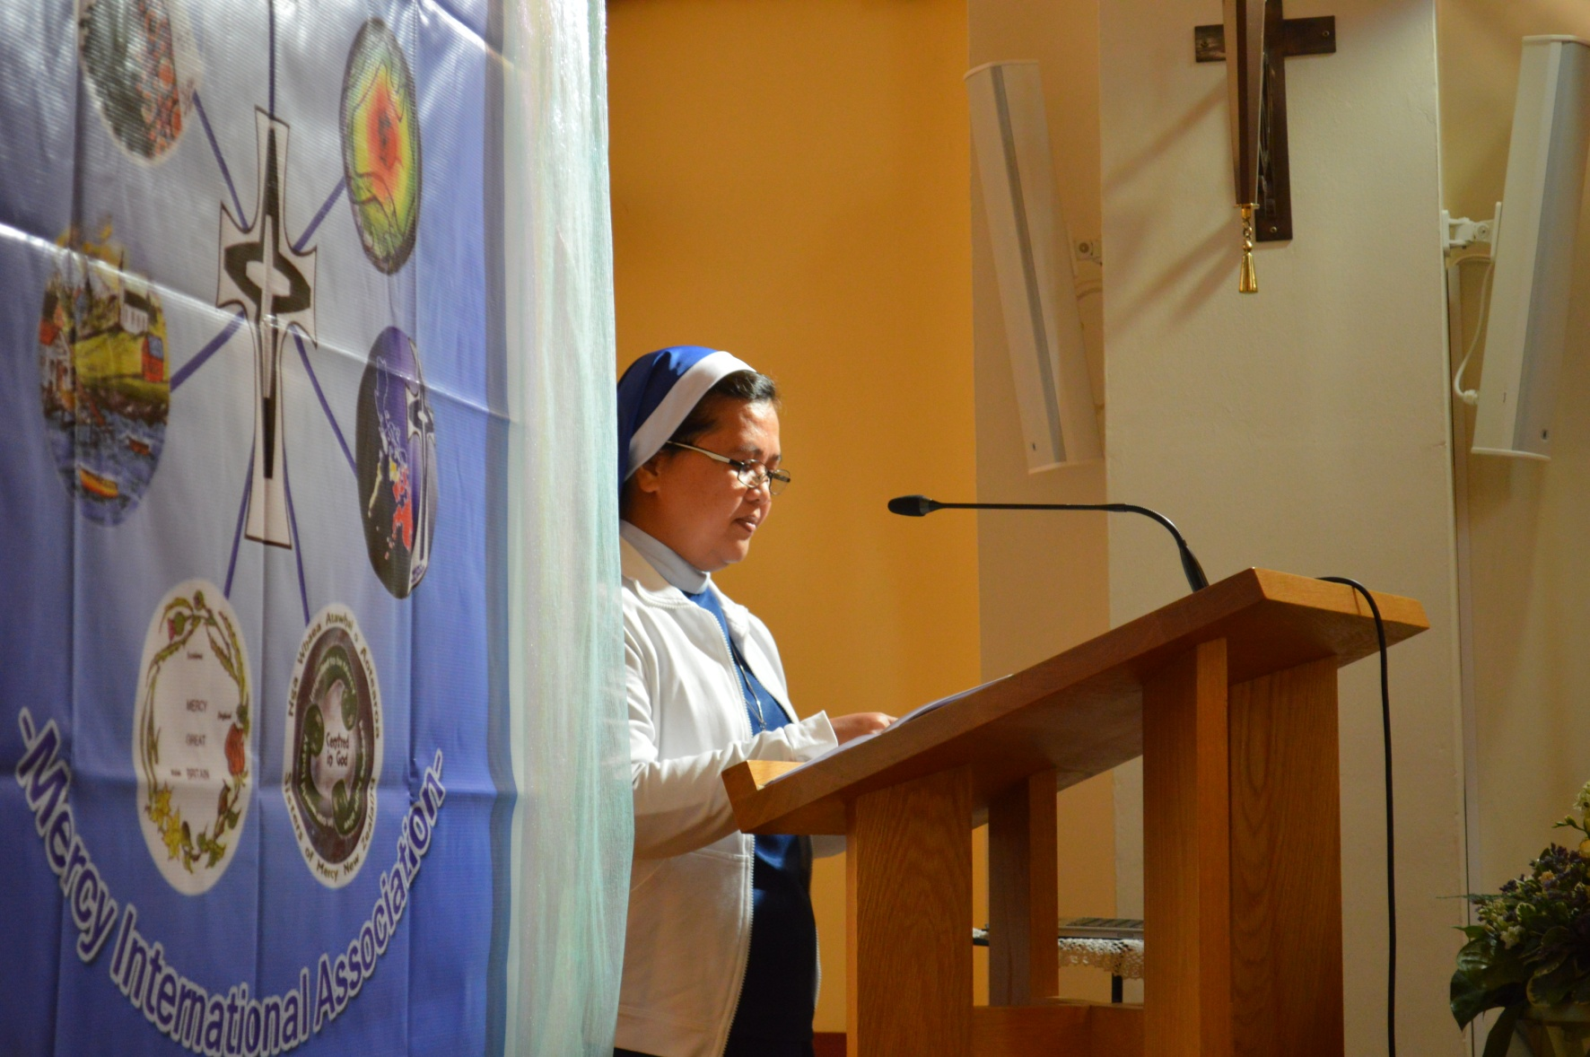

Slide 33
USA Ritual Participants:
Mary Trainer rsm, Mary Waskowiak rsm,
Nancy Whitley rsm

Slide 34
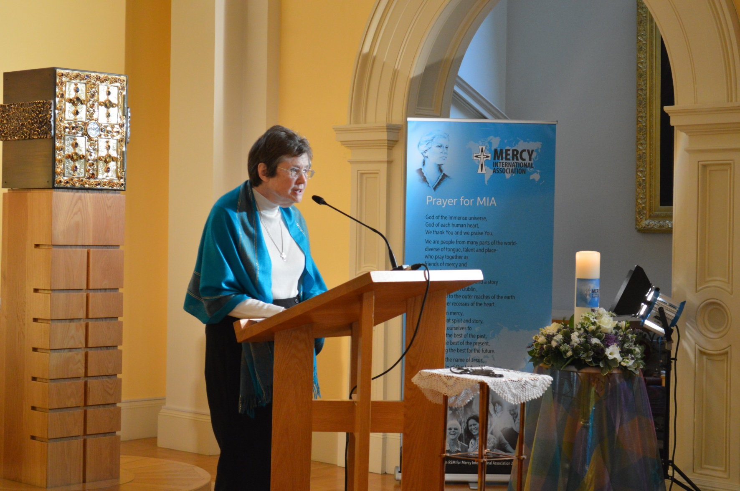

Slide 35
Newfoundland Ritual Participants:
Monica Hickey rsm, Patricia March rsm,
Peggy Cleary rsm, Faith Jones rsm,
Josepha Matthews rsm, Anne Reid,
Nancy Whitley rsm

Slide 36
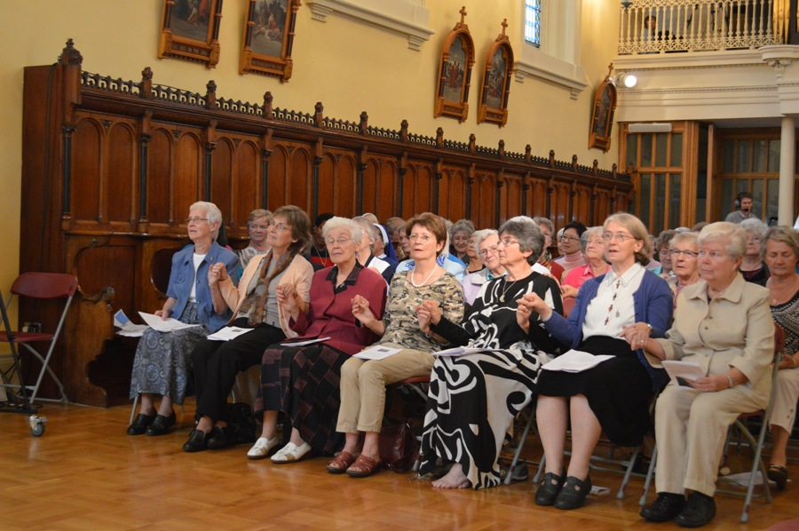
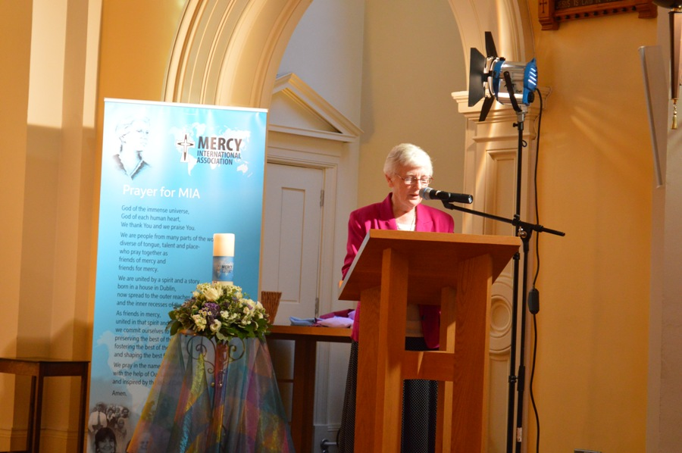

Slide 37
New Zealand Ritual Participants:
Breda Burke rsm, Nora O’Neill rsm,
Teresa O’Neill rsm, Rosello Pepper rsm
Johanna Walsh rsm

Slide 38
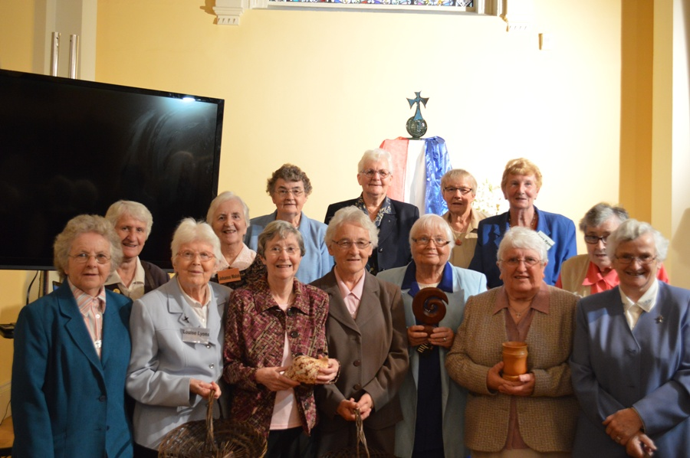

Slide 39
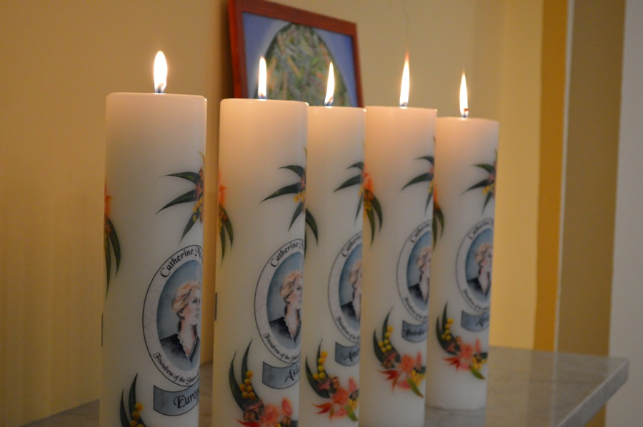

Slide 40
Musicians:
Marie Cox rsm,
Frances Kennedy rsm,
Ailish O’Brien rsm,
Patricia O’Donovan rsm

Slide 42
Honoured Guests:
President Michael D. Higgins
Australian Ambassador Ruth Adler
Representative from US Embassy,
Thomas E. Griffiths

Slide 44
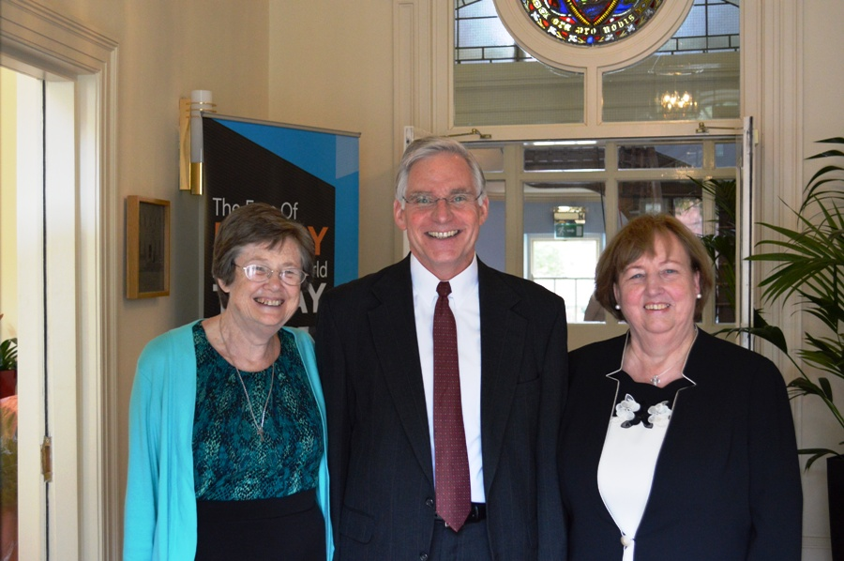
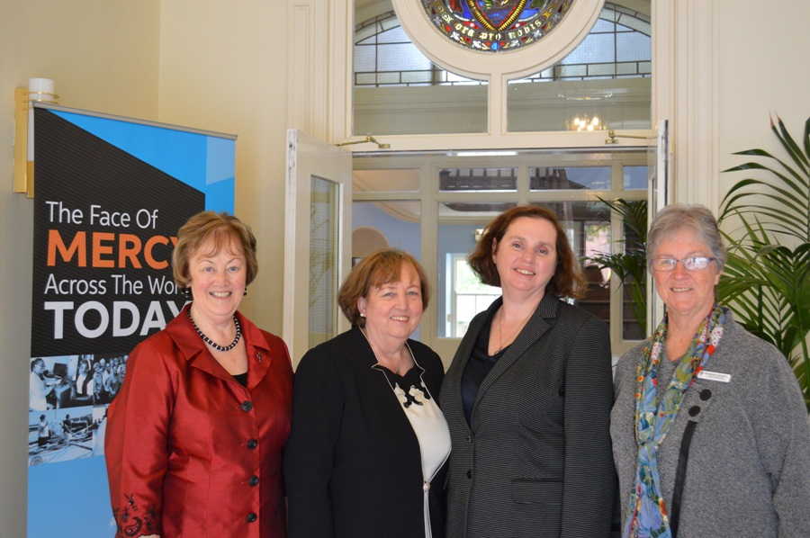
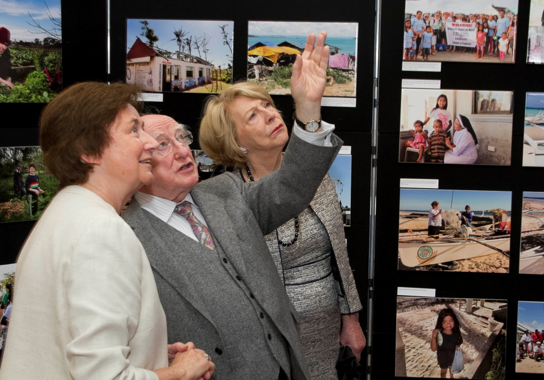

Slide 45
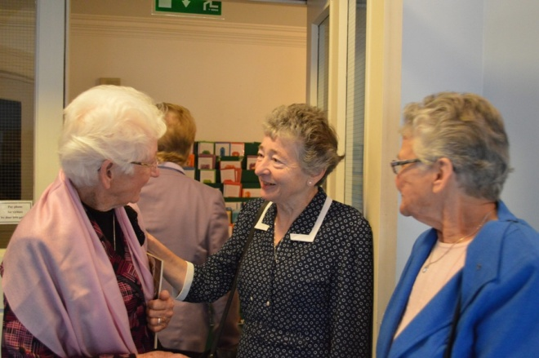
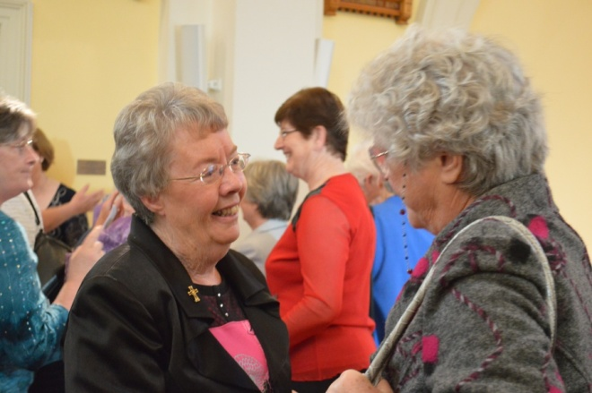
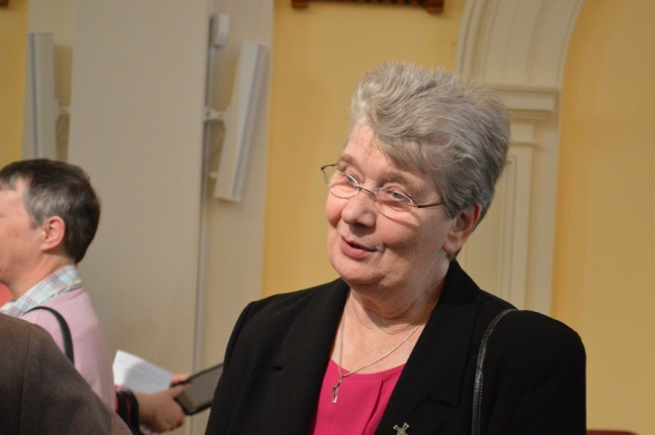
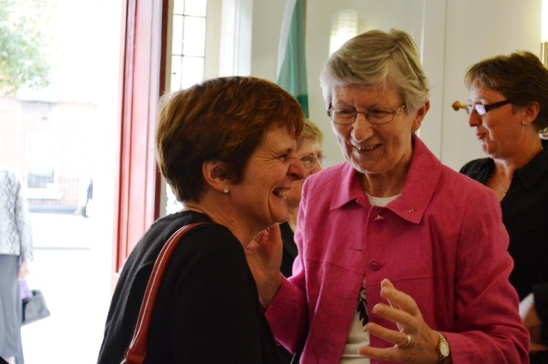
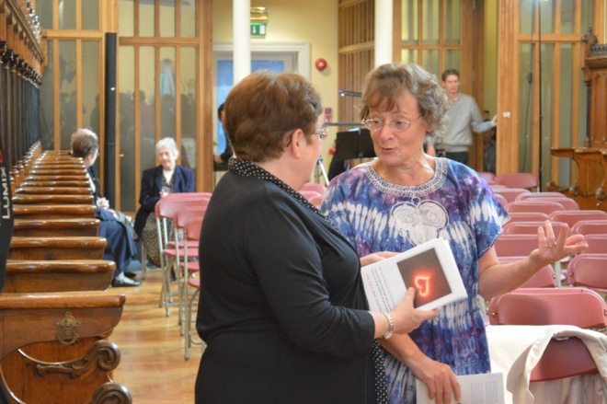
All Guests -
On site and via web

Slide 46
Presenters:
Playback Theatre,
Spanner in the Works Theatre Company (Diablo),
Carmel Bracken rsm, Fr. Sean McDonagh,
Aedín McLoughlin, Áine O’Connor rsm

Slide 47
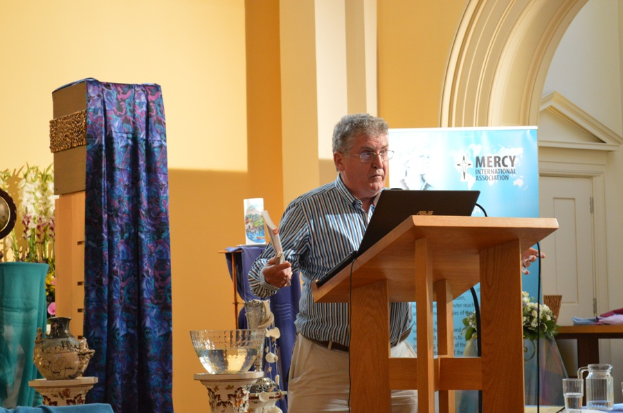
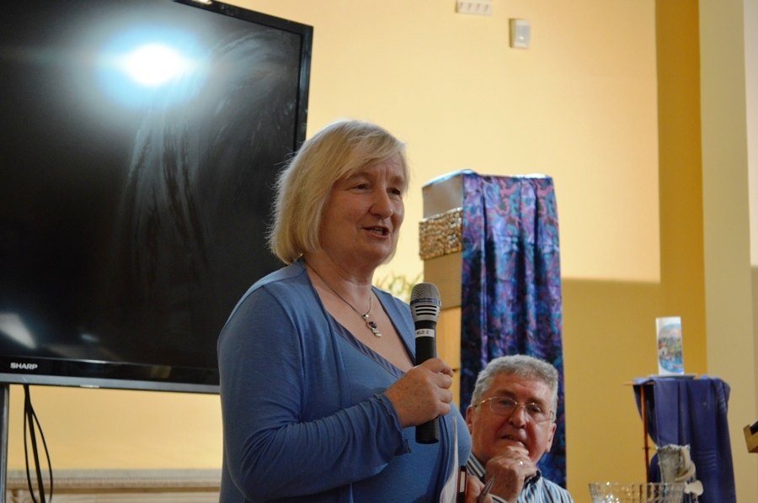

Slide 48
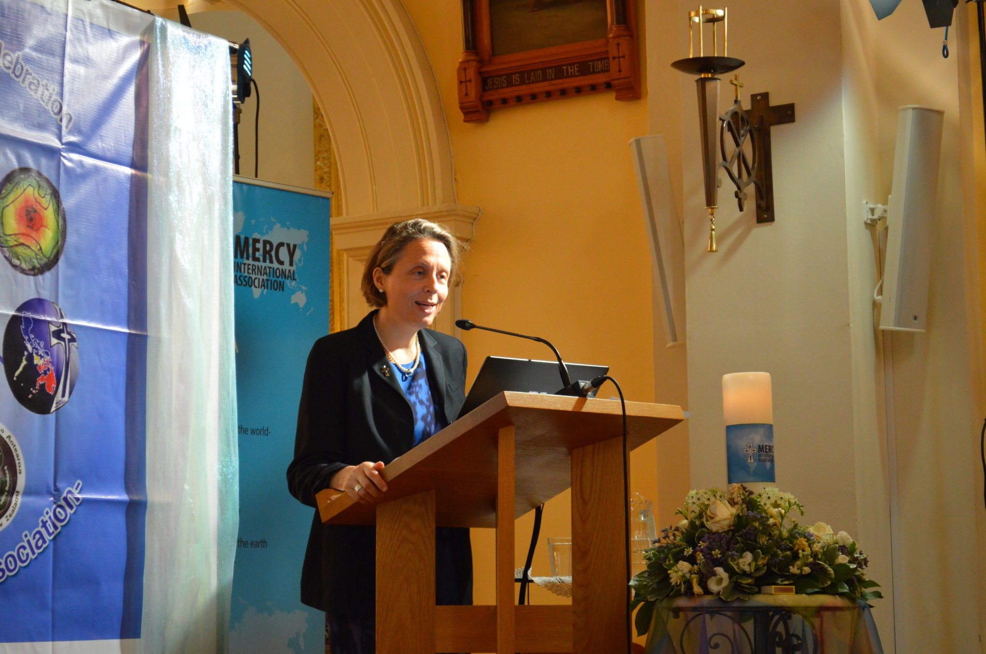

Slide 49
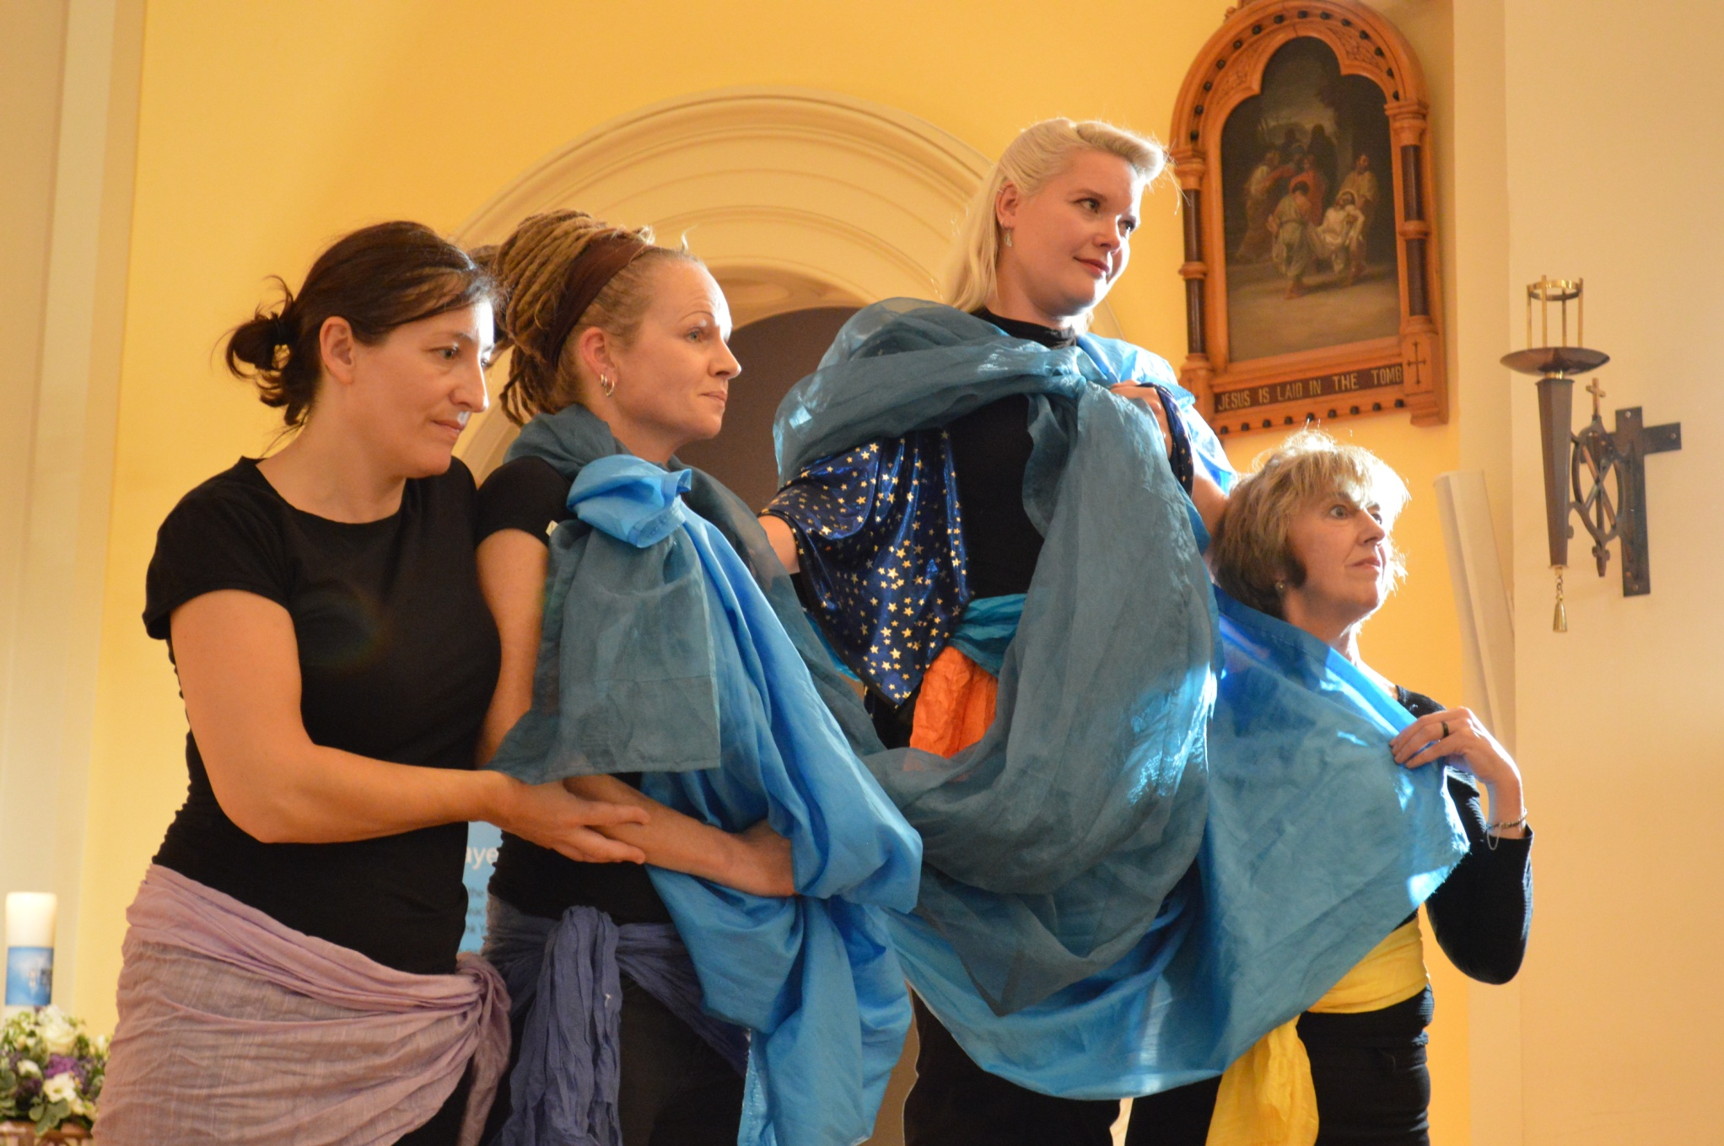

Slide 50
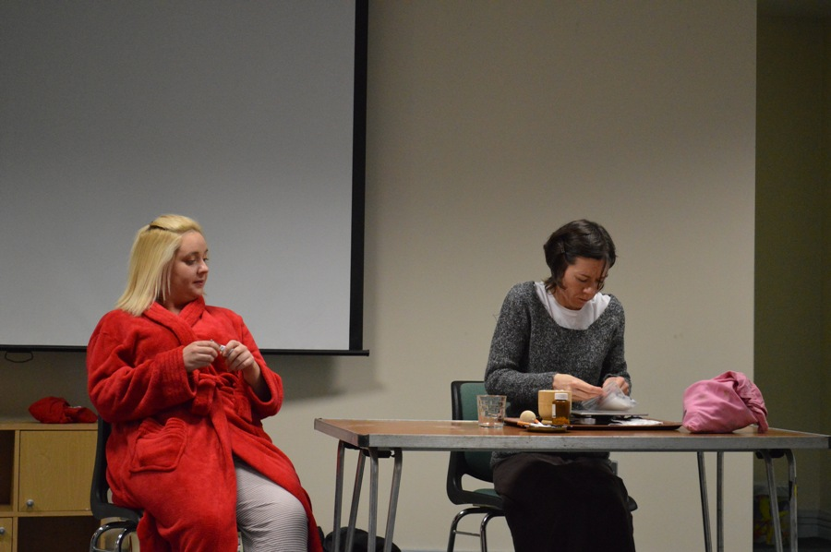

Slide 51
Playback Participants:
Canice Hanrahan rsm, Rosaleen Hogan rsm,
Patricia March rsm, Mary Trainer rsm

Slide 52
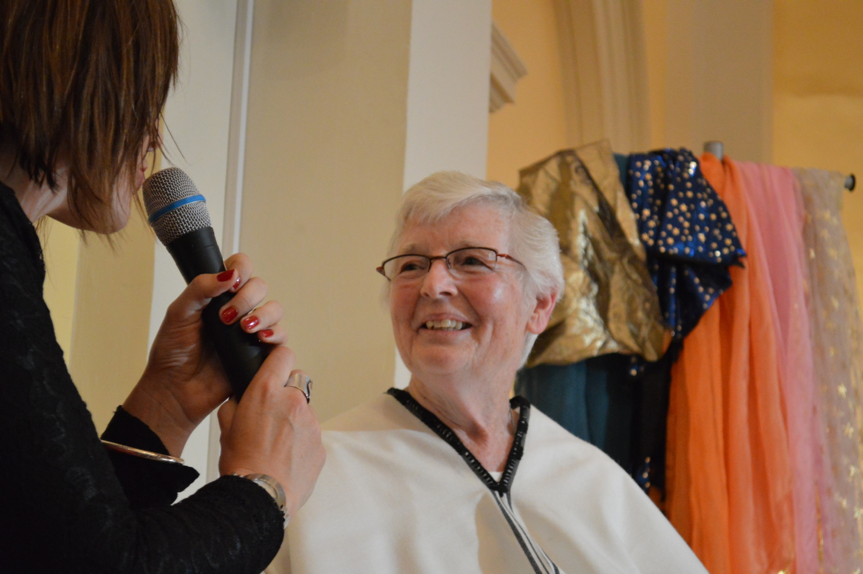

Slide 53
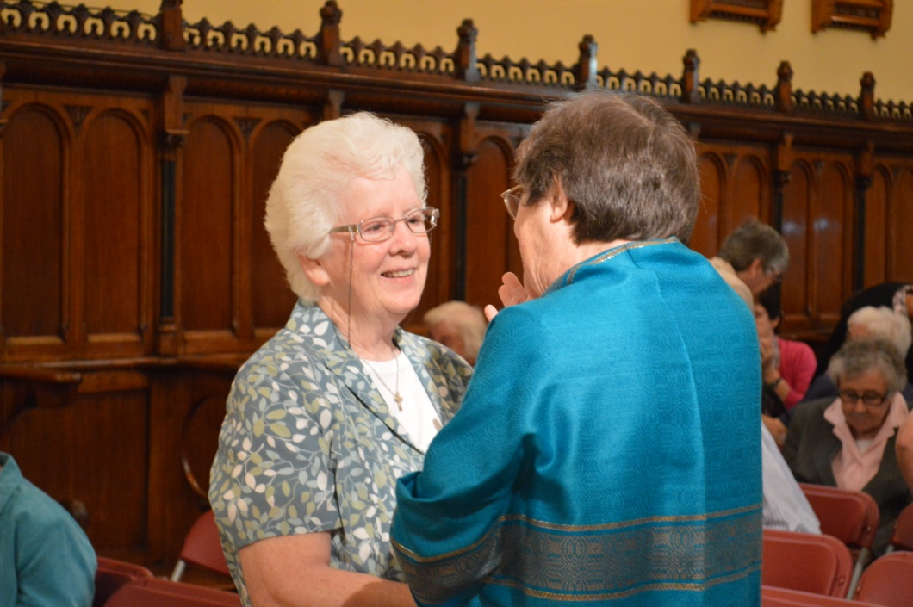

Slide 54
Facilitators:
Dee McKenna rsm,
Áine Barrins rsm, Bríd Biggane rsm,
Carmel Byrne rsm, Peggy Collins rsm,
Caitlín Conneely rsm, Mary Conway rsm,
Sheila Curran rsm, Mae Mc Manus rsm,
Kathleen Somers rsm, Kristi Wessling

Slide 55
Group Animators:
Raphael Amante rsm, Ron Ashworth, Sue Clarke,
Marianne Cosgrave, Carmel Crawford, Anne Curtis,
Rachel Davies, Mary Kay Dobrovolny rsm,
Patricia Dunne rsm, Gerry Glennon,
Danielle Hicks-Gallagher, Maura Hyland,
Catherine Jambet rsm, Ruth Kilcullen,
Brendan McLoughlin, Cristina Mira rsm,
Scholasticah Nganda rsm, Aisling O’Connor, Bryan Pini,
Anne Reid, Katie Salerno, Samantha Swanson,
Mary Trainer rsm, Úna Wallace, Mary Waskowiak rsm

Slide 56
Decor of St Mary’s Haddington Road:
Genemarie Beegan rsm
Cristina Mira rsm
Teresa Anne Nagle rsm

Slide 57
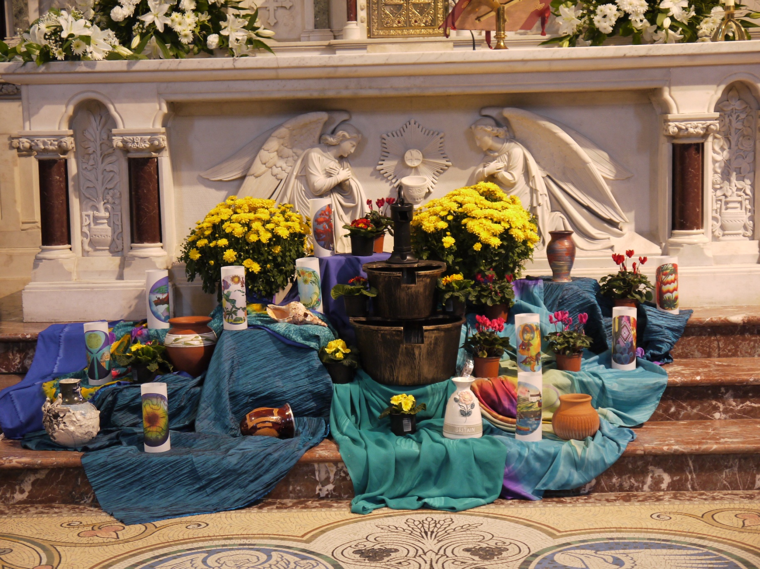

Slide 58
Mercy Day Greetings Streamed from St Mary’s Haddington Road:
Raphael Amante rsm, Barbara Bolster rsm,
Sheila Burke rsm, Margaret Casey rsm, Carmel Crawford,
Veronica Ekerick rsm,
Barbara Jeffery rsm, Margaret Jones rsm,
Ruth Kilcullen, Anna Koeneman rsm,
Dolores Magee rsm, Patricia March rsm,
Cristina Mira rsm, Rosello Pepper rsm,
Anne Reid, Mary Trainer rsm,
Mary Waskowiak rsm

Slide 59
Presider and Concelebrants of
Mercy Day Mass:
Most Rev. Diarmuid Martin, D.D.
Archbishop of Dublin
Fr Fachtna McCarthy,
Parish Priest of St Mary’s
Fr Damian McNiece,
Master of Ceremonies to the Archbishop

Slide 60
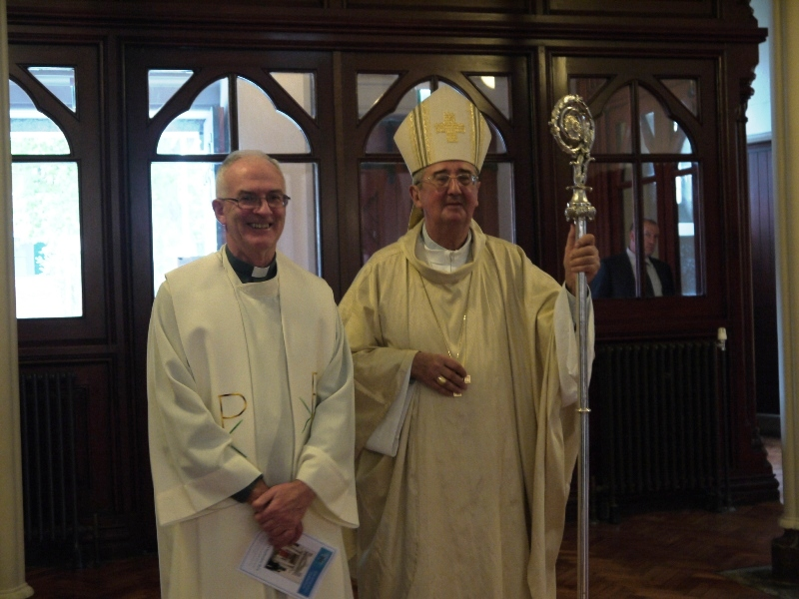

Slide 61
Greeters for Mercy Day Mass:
Breda Burke rsm, Dervilla Byrne rsm,
Cecilia Cadogan rsm, Rosie Carroll rsm,
Peggy Cleary rsm, Faith Jones rsm,
Betty Larkins rsm, Bridie Stephens rsm,
Mary Waskowiak rsm

Slide 62
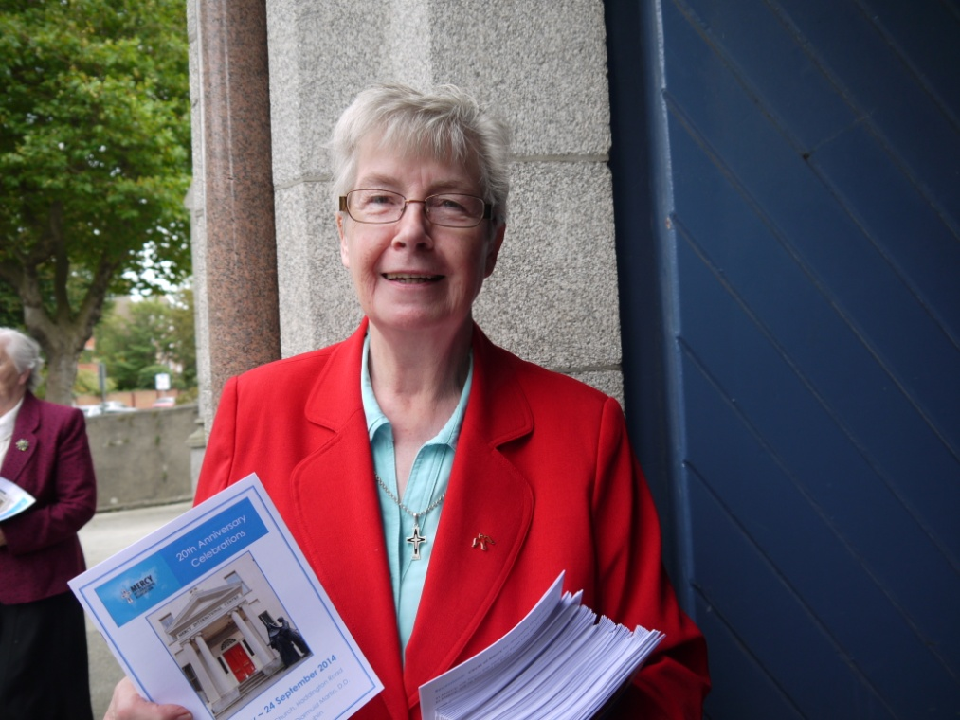

Slide 63
Water Vessel Carriers for
Mercy Day Mass:
Raphael Amante rsm, Sheila Burke rsm,
Caitlín Conneely rsm, Monica Hickey rsm,
Margaret Jones rsm, Cristina Mira rsm,
Rosello Pepper rsm

Slide 65
Altar Servers for
Mercy Day Mass:
Students from Mercy Secondary School, Inchicore:
Kendra Cardiff, Megan Power, Kathryn Tolster

Slide 66
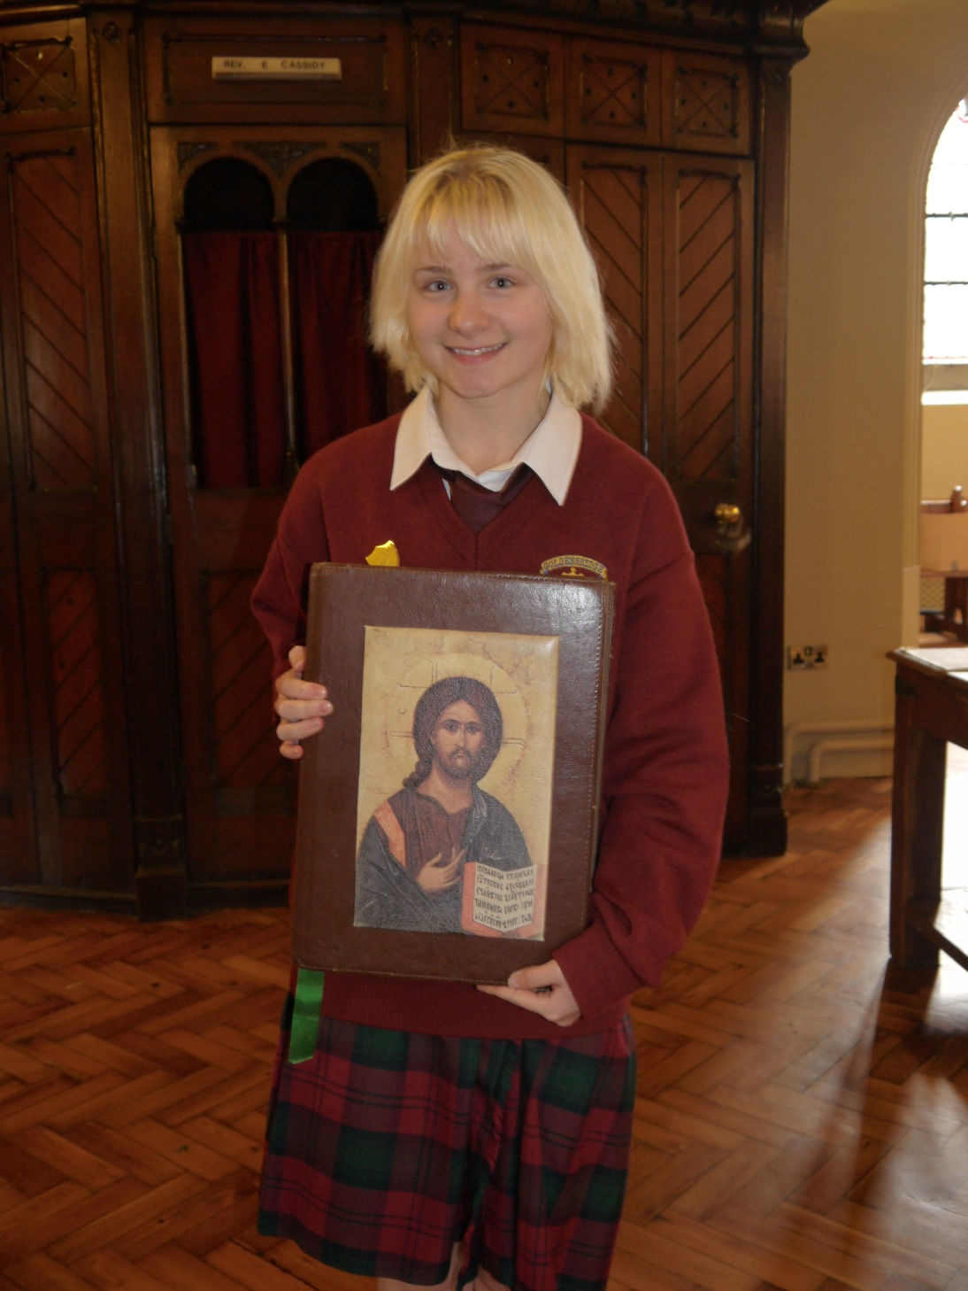

Slide 67
Lectors for Mercy Day Mass:
Patricia Bell rsm, Barbara Bolster rsm,
Scholasticah Nganda rsm

Slide 68
Offertory Procession
for Mercy Day Mass:
Sisters and Associates of Feltham UK

Slide 69
Eucharistic Ministers
for Mercy Day Mass:
Áine Barrins rsm, Joan Breen rsm,
Mary Conway rsm, Pat Fox rsm,
Canice Hanrahan rsm, Veronica Ekerick rsm,
Anna Koeneman rsm, Dolores Magee rsm,
Nerida Tinkler rsm, Marie Louise White rsm,
Nancy Whitley rsm

Slide 70
MIA Prayer Composer:
Mary Wickham rsm

Slide 71
Donors:
Sisters in Australia, PNG, Brisbane, North Sydney & Parramatta
Sisters of Mercy, Sunderland
Union of Sisters of Mercy, Great Britain
Sisters of Mercy, Bridgegate
Congregation Leadership Team, Ireland
Northern Province, Ireland
South Central Province, Ireland
Southern Province, Ireland
Western Province, Ireland
Sisters of Mercy, West Midwest Community Leadership Team
Sisters of Mercy, Newfoundland
Considerable number of individual donors

Slide 72
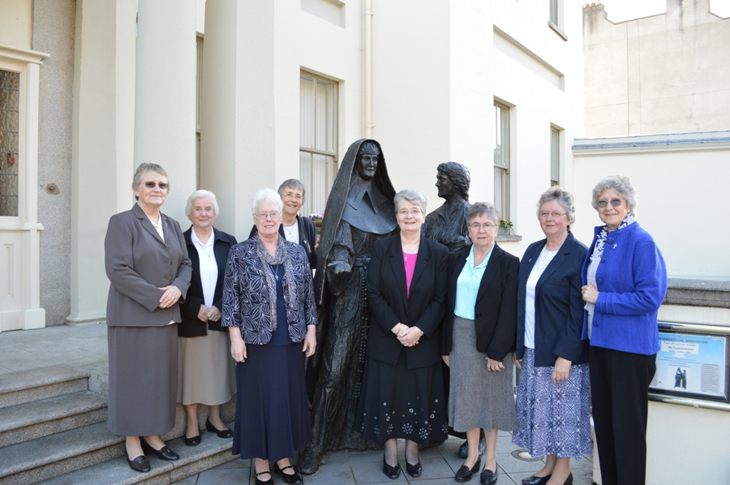

Slide 73
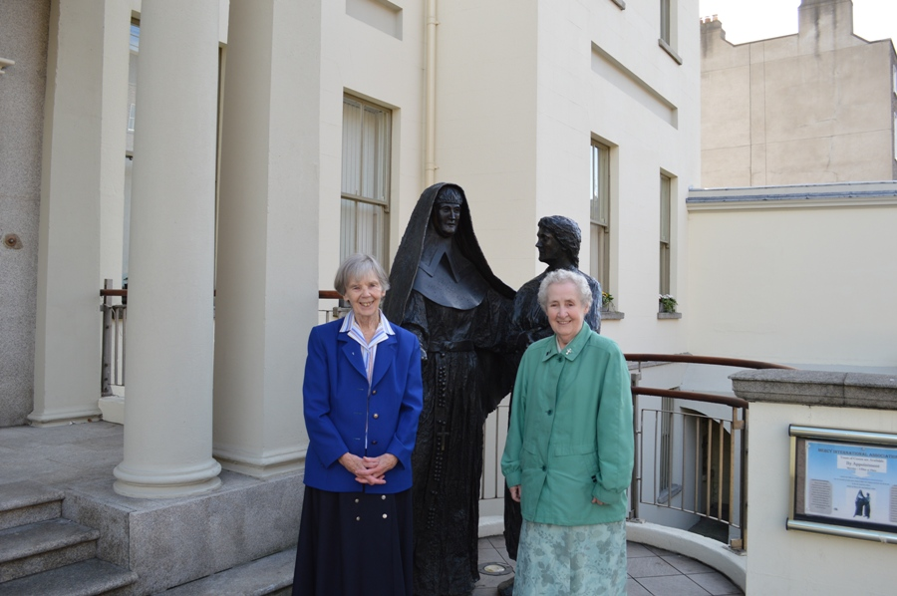

Slide 74
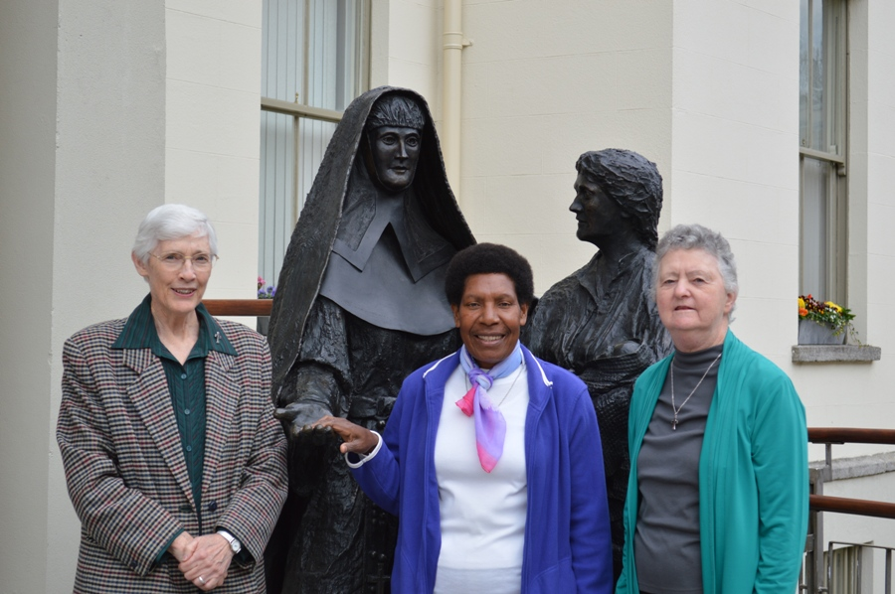

Slide 75
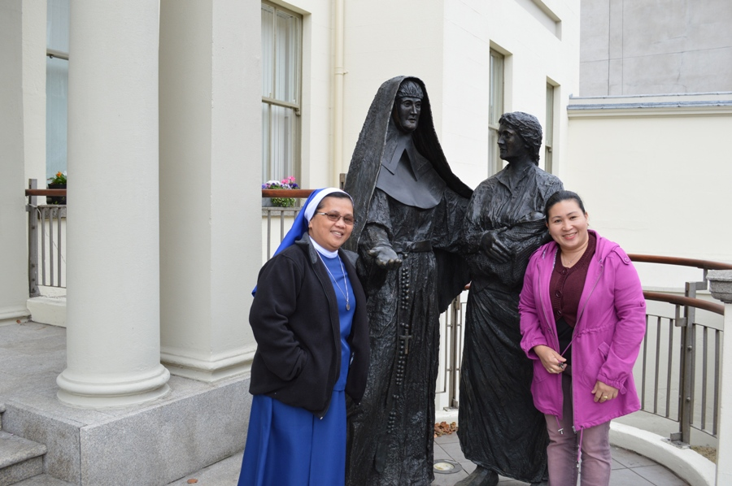

Slide 78
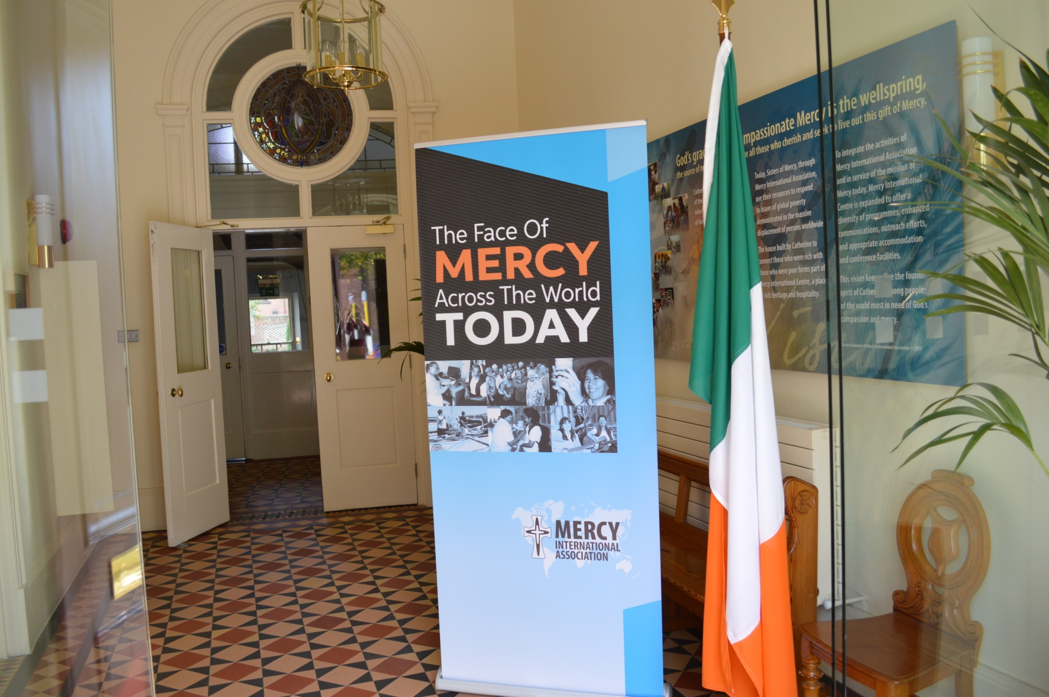
Thank You!

